Slide 1

Learning Module: Public Health Modernization 101
Notes:
Welcome to the Coalition of Local Health Official’s Public Health Modernization Learning Module. This module will answer the question “What is public health modernization?” will give a brief overview of our current public health system, and will provide examples of public health modernization in action! At the end, we will provide you with an introduction to the CLHO Public Health Modernization Roadmap to help you along your way!

Slide 2
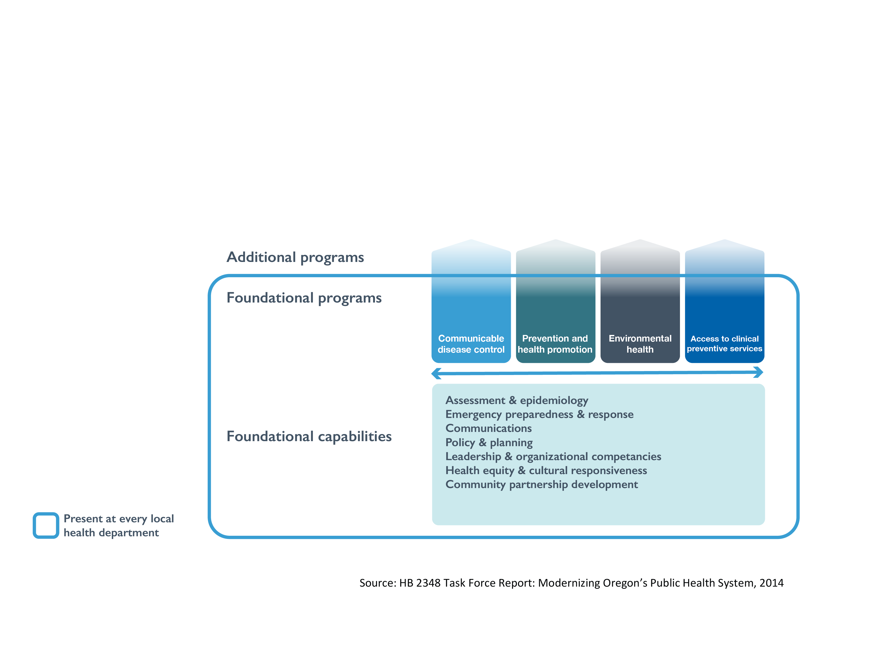
What is public health modernization?
Notes:
To begin answering the question “What is public health modernization” we need to start with the history, basic goal, and structure of public health modernization. In 2015 the Oregon state legislature passed house Bill 3100, which implemented a new model for public health in Oregon based on recommendations made by the Task Force on the Future of Public Health Services. The goal of public health modernization is to implement a common set of core public health capabilities and programs and ensure that these foundational capabilities and programs are present in all communities in the state.

Slide 3
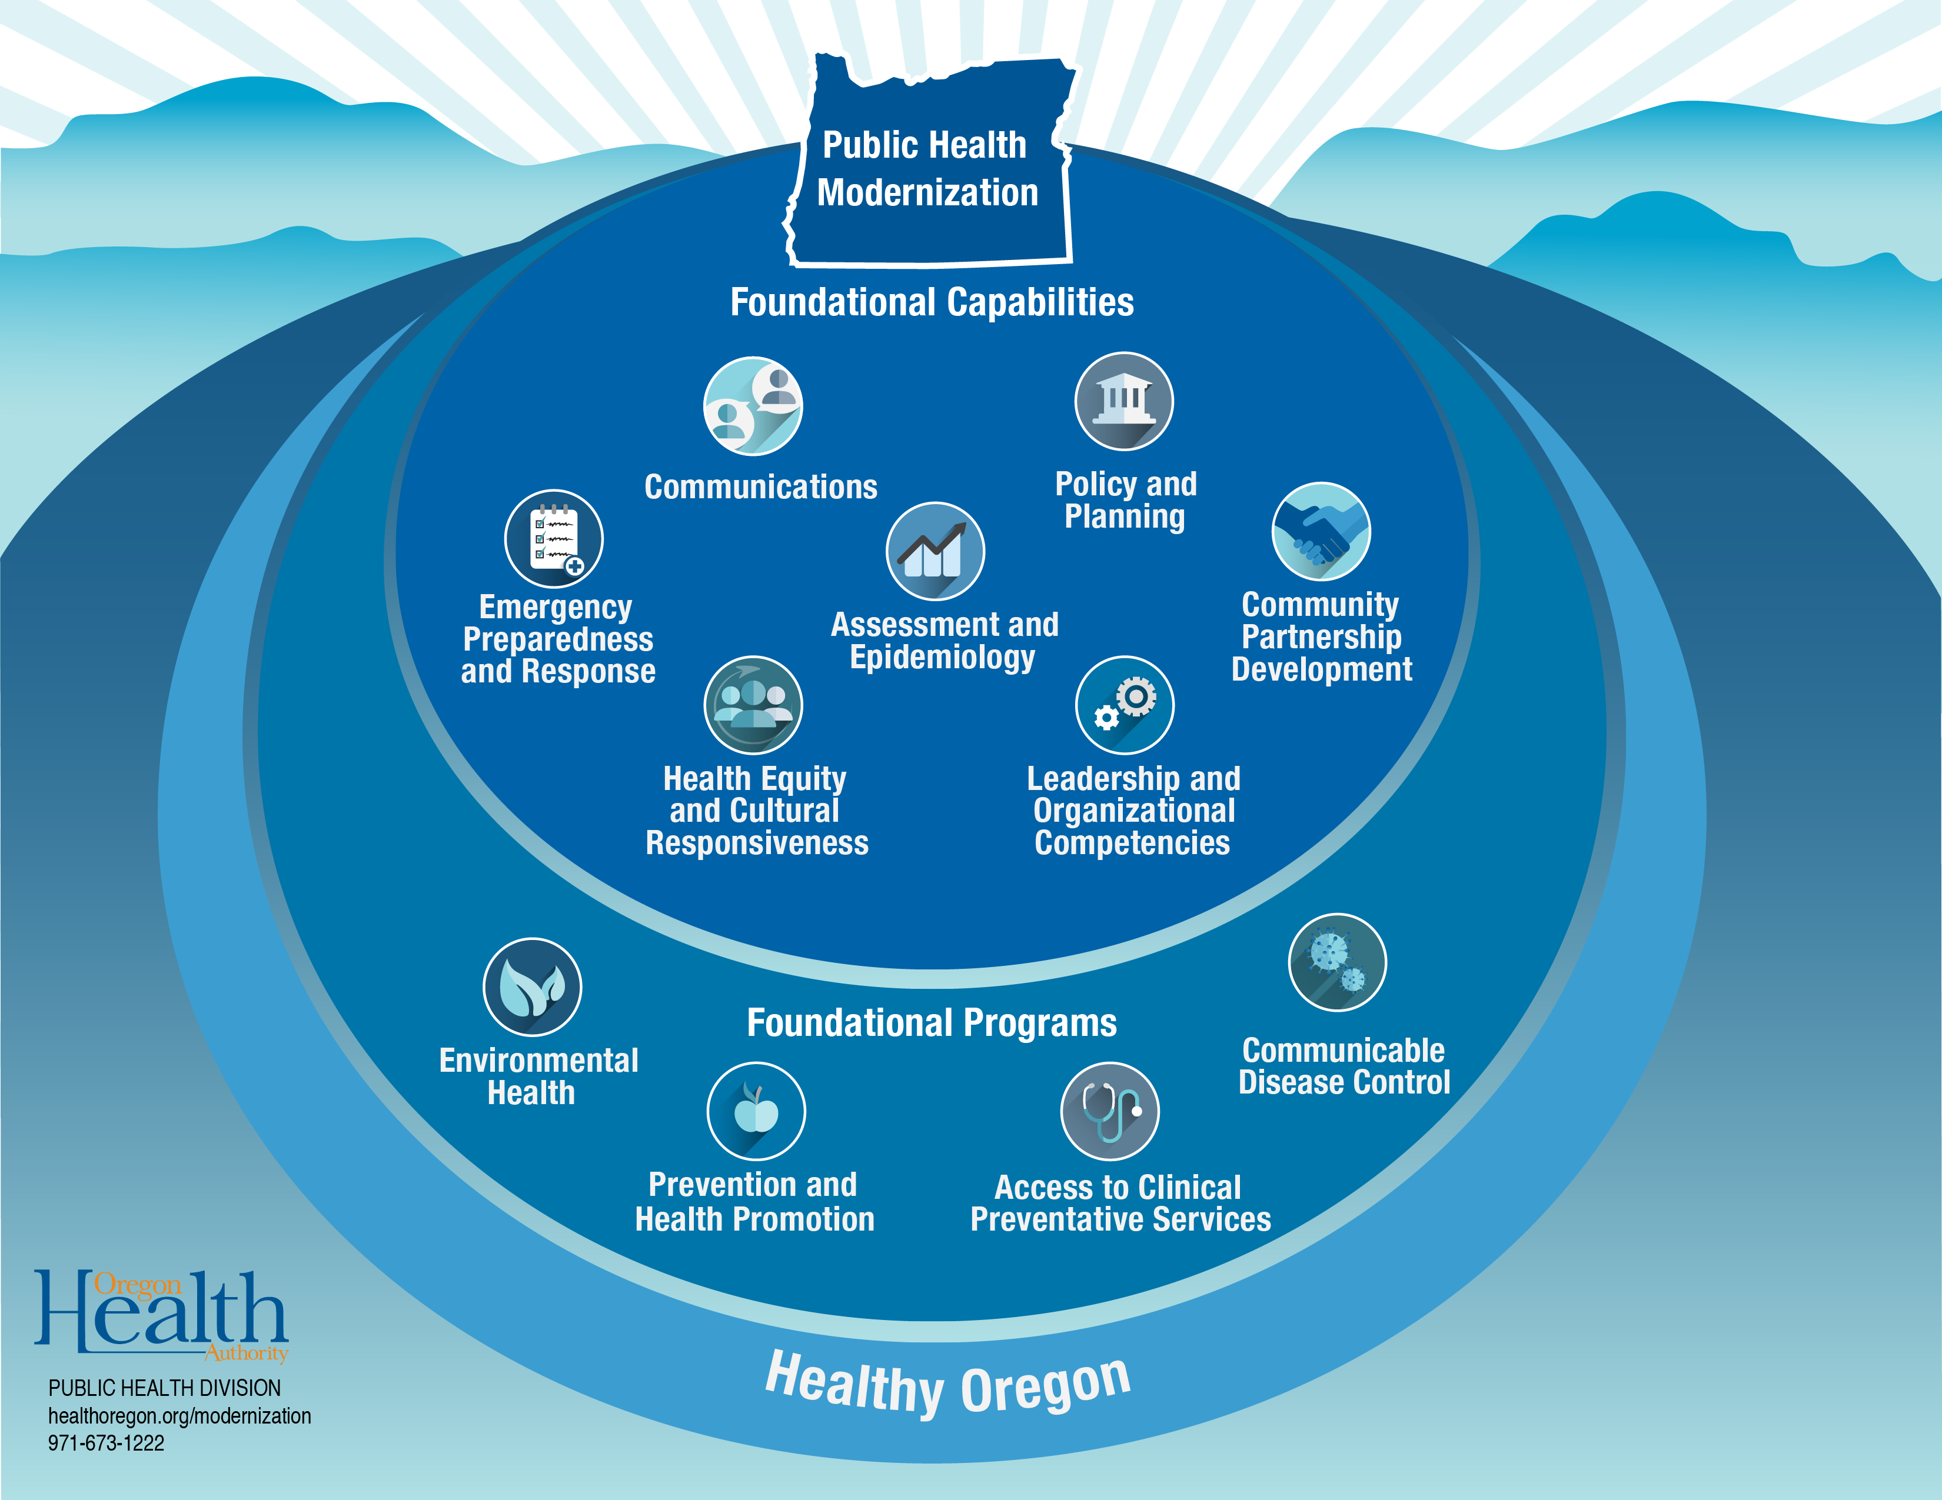
Notes:
In public health modernization, there are 7 foundational capabilities and 4 foundational programs:
Foundational capabilities are the knowledge, skills, and abilities needed to successfully implement foundational programs. The 7 foundational capabilities are: leadership and organizational competencies, health equity and responsiveness, community partnership development, assessment and epidemiology, policy and planning, communications, and emergency preparedness and response.
Foundational programs include topic- and disease-specific work to achieve improved health outcomes, such as a decrease in the prevalence of a particular disease or health risk behavior. The 4 foundational programs are: communicable disease control, prevention and health promotion, environmental health, and access to clinical preventative services.

Slide 4

Who’s involved in modernization?
Public Health Advisory Board
All Local Health Departments
Coalition of Local Health Officials (CLHO)
The Oregon Health Authority (OHA)
Notes:
The entire Oregon public health system is involved in public health modernization. Every local health department will be working towards implementing the foundational capabilities and programs in their communities, but they won’t be doing it alone! Some local health departments have already begun to implement or have implemented foundational capabilities and programs. State and local health departments will be working together towards the deliverables outlined in public health modernization as funding becomes available.
The Coalition of Local Health Officials and the Oregon Health Authority are supporting local public health departments throughout the implementation process. CLHO has been working to engage local health department staff in developing an implementation plan as well as providing tools and technical assistance to local health departments as they begin implementing public health modernization. The Oregon Health Authority is responsible for statewide public health modernization assessments and plans, provides public health data to local health departments and distributes public health modernization funding to local health departments. The Public Health Advisory Board also provides guidance and oversight to track progress toward statewide public health goals.

Slide 5

What does our public health system currently do?
Notes:
When discussing what public health modernization is, it is important to discuss what the current public health system in Oregon looks like. Though we are updating this system in order to cover all people in Oregon with the foundational programs and capabilities, it is important to acknowledge and celebrate the work and achievements of our current public health system! Some of those achievements include, healthcare accessibility, disease outbreak control, like Zika, addressing bacterial meningitis, Ebola, child mortality, food and water safety, tobacco prevention and policy, and preparing for and responding to natural disasters. Public health also works with vulnerable populations that may not otherwise have access to programs and services to protect their health. In other words, our public health system works hard to keep us healthy, prevent illness, and protect us from public health threats.

Slide 6
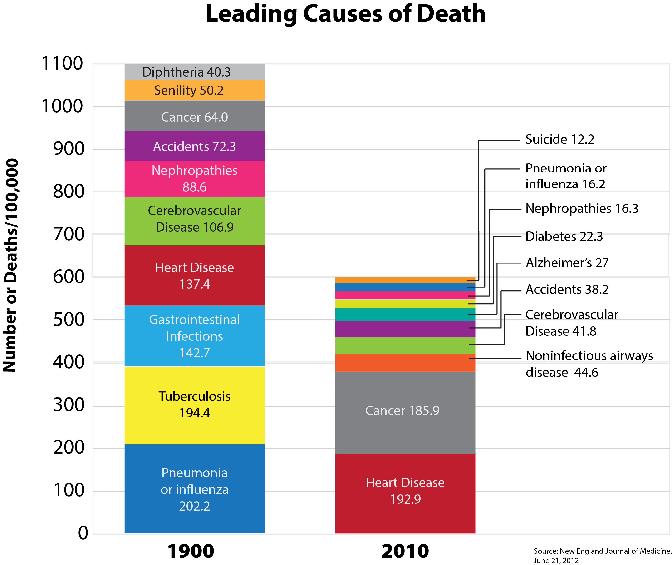
Notes:
The leading causes of death globally have changed significantly from 1900 to 2010. We can see that we have made tremendous progress in reducing premature death.

Slide 7
Notes:
While our public health system is essential for community health, we can’t ignore the fact that our system was designed for a previous age, which makes it difficult for us to address new and emerging public health challenges. Some of our current challenges are increases in chronic conditions such as diabetes and heart disease, an increase in cancers, and emerging new infectious diseases as well as outbreaks of older diseases. The most current leading causes of death (e.g. cancer, heart disease, diabetes) are diseases that are driven by tobacco use, physical inactivity, and poor nutrition.

Slide 8
Current challenges
We are seeing increases in:
diabetes
heart disease
cancer
new infectious diseases & outbreaks of older diseases
opioid addiction
suicide
Notes:
We are also seeing a rise in certain behavioral health issues like opioid addiction and suicide. Across these issues, vulnerable groups continue to experience a disproportionate burden of disease and injury.

Slide 9
Notes:
Public health modernization aims to provide access to public health services to every person in Oregon and to address the current challenges of public health by, addressing preventable chronic illnesses, through the implementation of the 11 foundational capabilities and programs.

Slide 10
What concepts are involved in public health modernization?
Focus on fairness
Be driven by data
Improve the population health of people in Oregon in ways that are measurable and sustainable
Notes:
There are several key concepts that help to inform public health modernization implementation. These include:
Focusing on fairness
Being driven by data
Improving the population health of people in Oregon in ways that are measurable and sustainable.
The next few slides will overview these concepts in greater detail.

Slide 11

1. Focus on fairness
Notes:
Public health modernization will address fairness by supporting the implementation of a set of foundational capabilities and programs across Oregon to ensure that a core set of public health services is available in every area of the state. At the same time, local public health authorities will have flexibility to determine the best method to implement the foundational capabilities and programs to meet each community’s unique needs, health gaps and health disparities.
In supporting a focus on fairness, one of the foundational capabilities is “health equity and cultural responsiveness”. The vision for this capability is to ensure equal opportunity to achieve the highest attainable level of health for all populations through policies, programs and strategies across the state that respond to the cultural factors that affect health. Also, the vision of this capability is to correct historic injustices borne by certain populations and prioritize the development of strong cultural responsiveness by public health organizations. Some functions for facilitating health equity and cultural responsiveness in public health modernization include:
Monitoring health status and tracking the conditions that influence health issues
Engaging with communities to identify and eliminate health disparities
Developing public health policies and plans to achieve health equity, protect people from health hazards and prevent health problems.

Slide 12

2. Be driven by data
Notes:
Public health modernization is driven by data. Public health assessments are utilized to describe the health of the population, identify areas for improvement, contributing factors that impact health outcomes, and assets and resources that can be mobilized to improve population health. Public health assessments are part of the public health system’s current practice of collecting, analyzing and reporting on population health data as a way to drive decision-making. In Oregon, it is solely public health’s responsibility to monitor disease rates and behaviors for the entire population. At a state-wide level, you can find population health data on the Oregon Health Authority’s website and in the Oregon Public Health State Health Improvement Plan also on the OHA website.

Slide 13
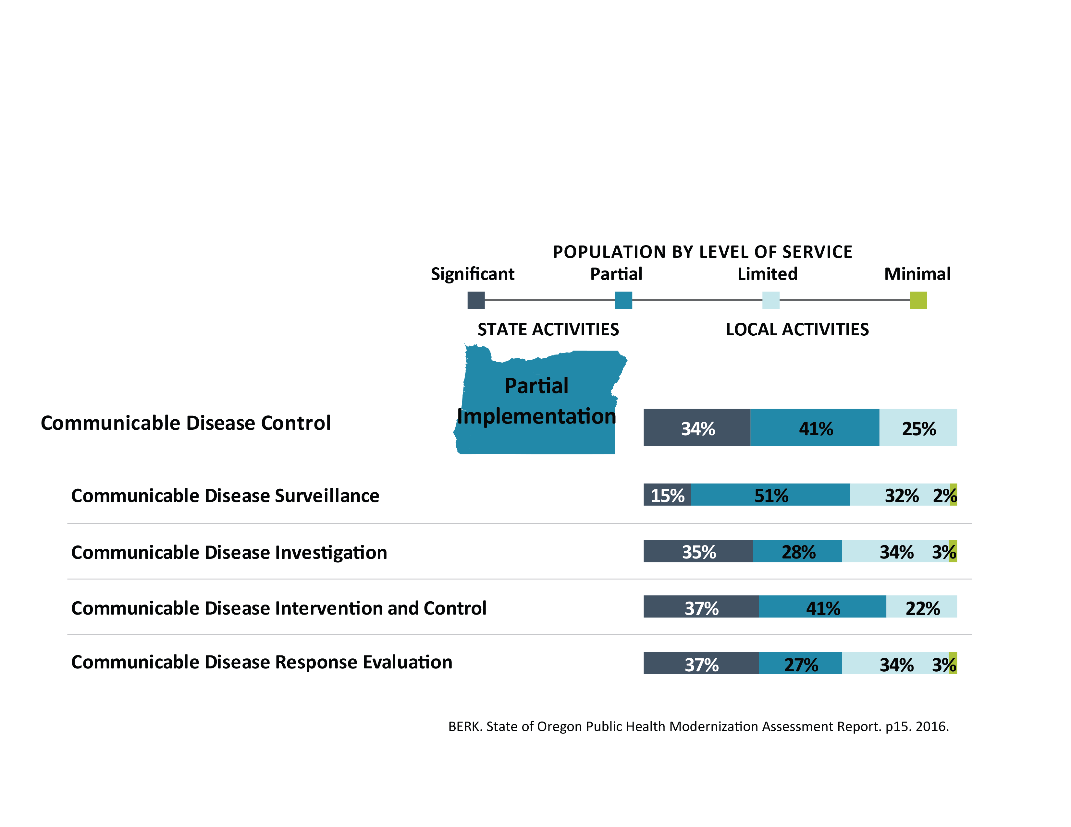
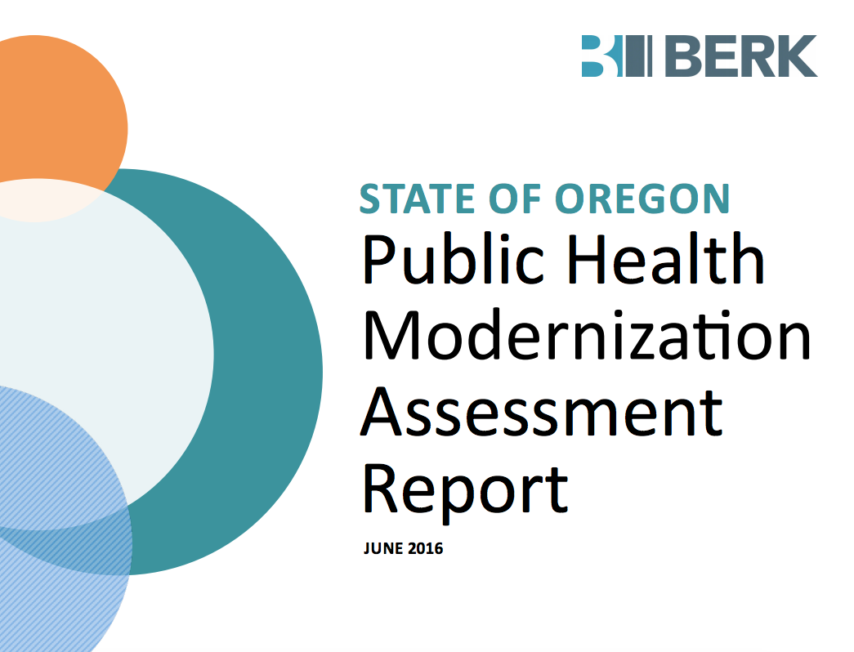
Notes:
In addition to public health assessments, as part of Oregon’s path to modernize the public health system by using data, Oregon’s governmental public health authorities were asked to assess their current implementation of the public health modernization framework, and the full cost of implementation for each of the 11 programs and capabilities. The results of this assessment can be read in the 2016 Oregon State Public Health Modernization Assessment Report prepared by Berk. Also, the bar graph image here from the report shows the data for the current state of implementation for the communicable disease program.

Slide 14
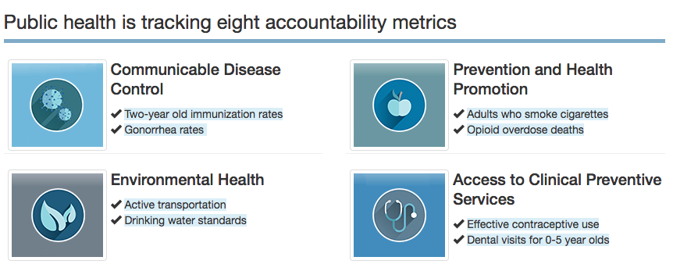
Public Health Accountability Metrics
Notes:
Finally, as another example of a focus on data, in June 2017, Oregon’s Public Health Advisory Board (PHAB) established a set of accountability metrics to track progress towards the modernization of Oregon’s public health system. These metrics emphasize Oregon’s population health priorities and help identify when goals aren’t being met.

Slide 15
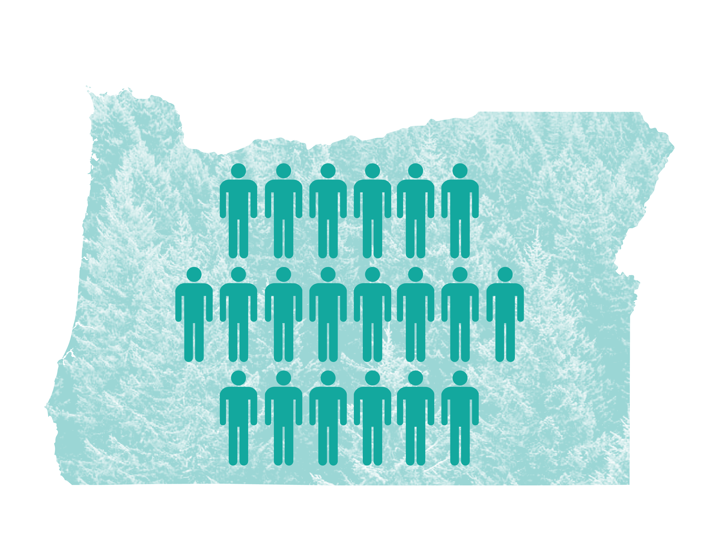
3. Improve the population health of people in Oregon in ways that are measurable and sustainable
Notes:
As part of modernization, there will also be a focus on prevention at a population health level. A population health approach fosters the conditions that make healthy communities so that more individuals can benefit from good health outcomes. Regular community health assessments, at least every 5 years, will be used to identify population level priorities and interventions to improve community health and offer baseline measures to improve the health of people in Oregon over time in a manner that is sustainable.

Slide 16
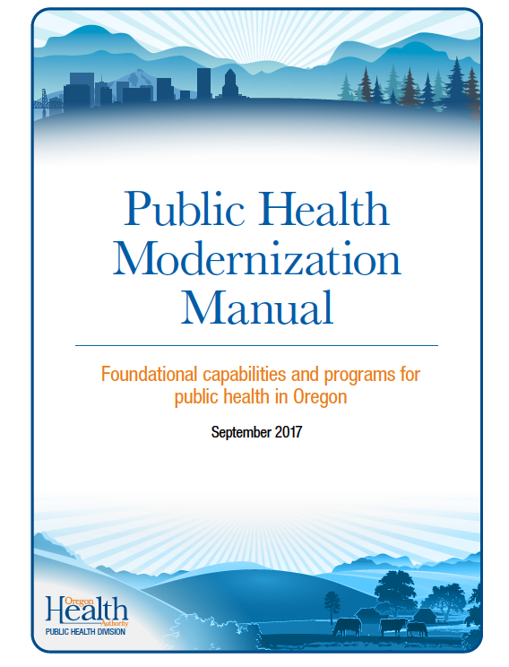
What does public health modernization look like in action?
Specifically, to guide implementation, the manual outlines, the core system functions, roles, deliverables and critical resources of each of the 7 foundational capabilities and each of the 4 foundational programs.
Notes:
The Public Health Modernization Manual developed by public health stakeholders in collaboration with the Oregon Health Authority Public Health Division in 2015, after the passing of Bill 3100, outlines what public health modernization looks like in practice. The manual describes each foundational capability and program in detail, outlining successful implementation for each foundational element. To guide implementation, the manual outlines, the core system functions, roles, deliverables and critical resources of each of the 7 foundational capabilities and each of the 4 foundational programs.

Slide 17

Example:
Suicide Prevention
In one Oregon county, through a community health assessment facilitated in partnership with regional government, suicide prevention emerged as a focus. With this focus in mind, a community health improvement plan was developed that included suicide prevention as a focus.
Notes:
To see what public health modernization means in practice, let’s take a look at an example of the full implementation of a public health project through the lens of the Prevention and Health Promotion foundational program. The first example will be a Suicide Prevention program that emerged recently in one county in Oregon. This Suicide Prevention project was developed after a Community Health Assessment identified suicide as priority health area. With this focus in mind, a community health improvement plan was developed that included suicide prevention as a focus.

Slide 18
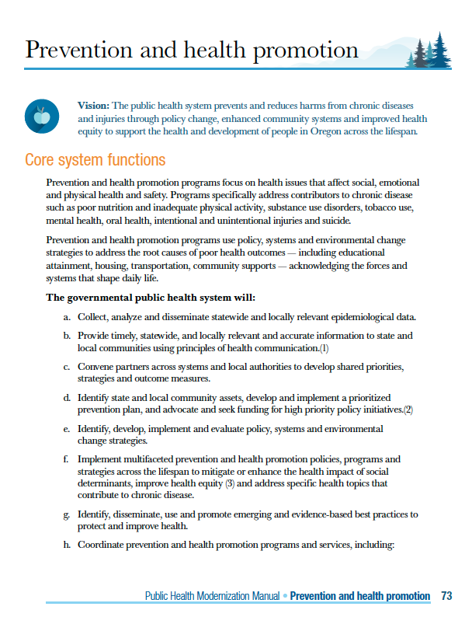
Notes:
In the Public Health Modernization Manual each of the foundational programs and capabilities begins with a list of core system functions that will be presented in a fully implemented program or capability.

Slide 19
Foundational Program:
Prevention and Health Promotion
Core System Functions
Focus on issues that affect social, emotional, and physical health and safety
Programs specifically address contributors to chronic disease such as poor nutrition and inadequate physical activity, substance use disorders, tobacco use, mental health, oral health, injuries and suicide
Use policies and systems to address root causes of poor health
Notes:
For the purposes of our example(s) we have listed the core system elements for prevention and health promotion, those functions are:
Focus on issues that affect social, emotional, and physical health and safety
Programs that specifically address contributors to chronic disease such as poor nutrition and inadequate physical activity, substance use disorders, tobacco use, mental health, oral health, injuries and suicide, and
Use policies and systems to address root causes, or social and environmental determinants, of poor health.

Slide 20
Roles of Foundational Capabilities and Program
Foundational Program: Prevention and health promotion
Program Example: Suicide Prevention
Notes:
Each capability and program has specific roles as outlined in the Public Health Modernization manual. We will go through each role for the prevention and health promotion foundational program and explain how our program example of Suicide Prevention filled that role.

Slide 21

Role 1
Collect, standardize, analyze, coordinate, use and disseminate data
Notes:
The first role for prevention and health promotion is:
Collect, standardize, analyze, coordinate, use and disseminate data
For example: In order to better understand populations most at risk of suicide, a Suicide Fatality Review Committee was established to evaluate the circumstances leading up to suicide to inform prevention efforts.

Slide 22

Role 2
Provide timely, relevant, and accurate information about social, emotional, and physical health and safety
Notes:
The second role for prevention and health promotion is:
Provide timely, relevant and accurate information about social, emotional and physical health and safety.
For example: In order to build the capacity of partners working in suicide prevention, the initiative has focused on training including the development of a training website and delivery of Applied Suicide Intervention Skills Training and Mental Health First Aid.

Slide 23

Role 3
Convene stakeholders, engage statewide organizations and partners, and cultivate leadership and vision for prevention and health promotion policies, programs and strategies
Notes:
The third role for prevention and health promotion is:
Convene stakeholders, engage statewide organizations and partners, and cultivate leadership and vision for prevention and health promotion policies, programs and strategies.
For example: A Suicide Prevention Council (SPC) was formed with first responders, faith community, law enforcement officers, government organizations, educators, survivors, mental health care providers and others. The SPC is guided by a collective impact approach to ensure a common agenda, ongoing communication, and mutually reinforcing strategies. The success of the collective impact approach is being measured on an on-going basis.

Slide 24

Role 4
Develop a prioritized plan to address health needs using policy, systems and environmental change strategies, and implement policies, programs, and strategies.
Notes:
The fourth role for prevention and health promotion is:
Develop a prioritized plan to address health needs using policy, systems, and environmental change strategies, and implement policies, programs, and strategies.
For example: In order to promote suicide prevention as a core component of health care services, the Suicide Prevention Council has been working with local health organizations to promote a Zero Suicide Initiative which has involved hosting trainings on how to assess and manage suicide risk (e.g. in post-discharge planning).

Slide 25

Role 5
Implement policies, programs and strategies
Notes:
The fifth role for prevention and health promotion is:
Implement Policies, Programs and Strategies
For example: In the Suicide Prevention case study, the county is implementing its suicide prevention work under a Community Health Improvement Plan. The objectives of the suicide prevention program align with the county’s goals under the plan such as integrating suicide prevention activities across multiple sectors, promoting responsible media reporting, and reducing access to lethal means.

Slide 26

Deliverables
Statewide and local summaries
Documented strategies shared with stakeholders
Example: Details of the Suicide Prevention initiative are communicated through regular progress reports available online
Notes:
In addition to outlining core system functions and roles, the Public Health Modernization Manual also delineates a set of deliverables for each program and capability. For prevention and health promotion those deliverables are:
Statewide and local summaries
Documented strategies shared with stakeholders
For example: In the Suicide Prevention example, the county communicates details of its initiative through regular progress reports available online.

Slide 27

Critical Tools and Resources
Routine surveillance
State health improvement plan
Example: Both data on recent suicides and its community health assessment to inform suicide prevention efforts
Notes:
Finally, the Public Health Modernization Manual identifies Critical Tools and Resources for each foundational program. For prevention and health promotion, these include routine surveillance and the state health improvement plan.
For example: In the suicide prevention case study, the initiative has been collecting data on recent suicides and its community health assessment to inform suicide prevention efforts.

Slide 28
Additional examples of work happening to modernize our public health system
Notes:
It was mentioned earlier that there are already some examples of public health modernization in progress in Oregon. We will touch on a few now.

Slide 29
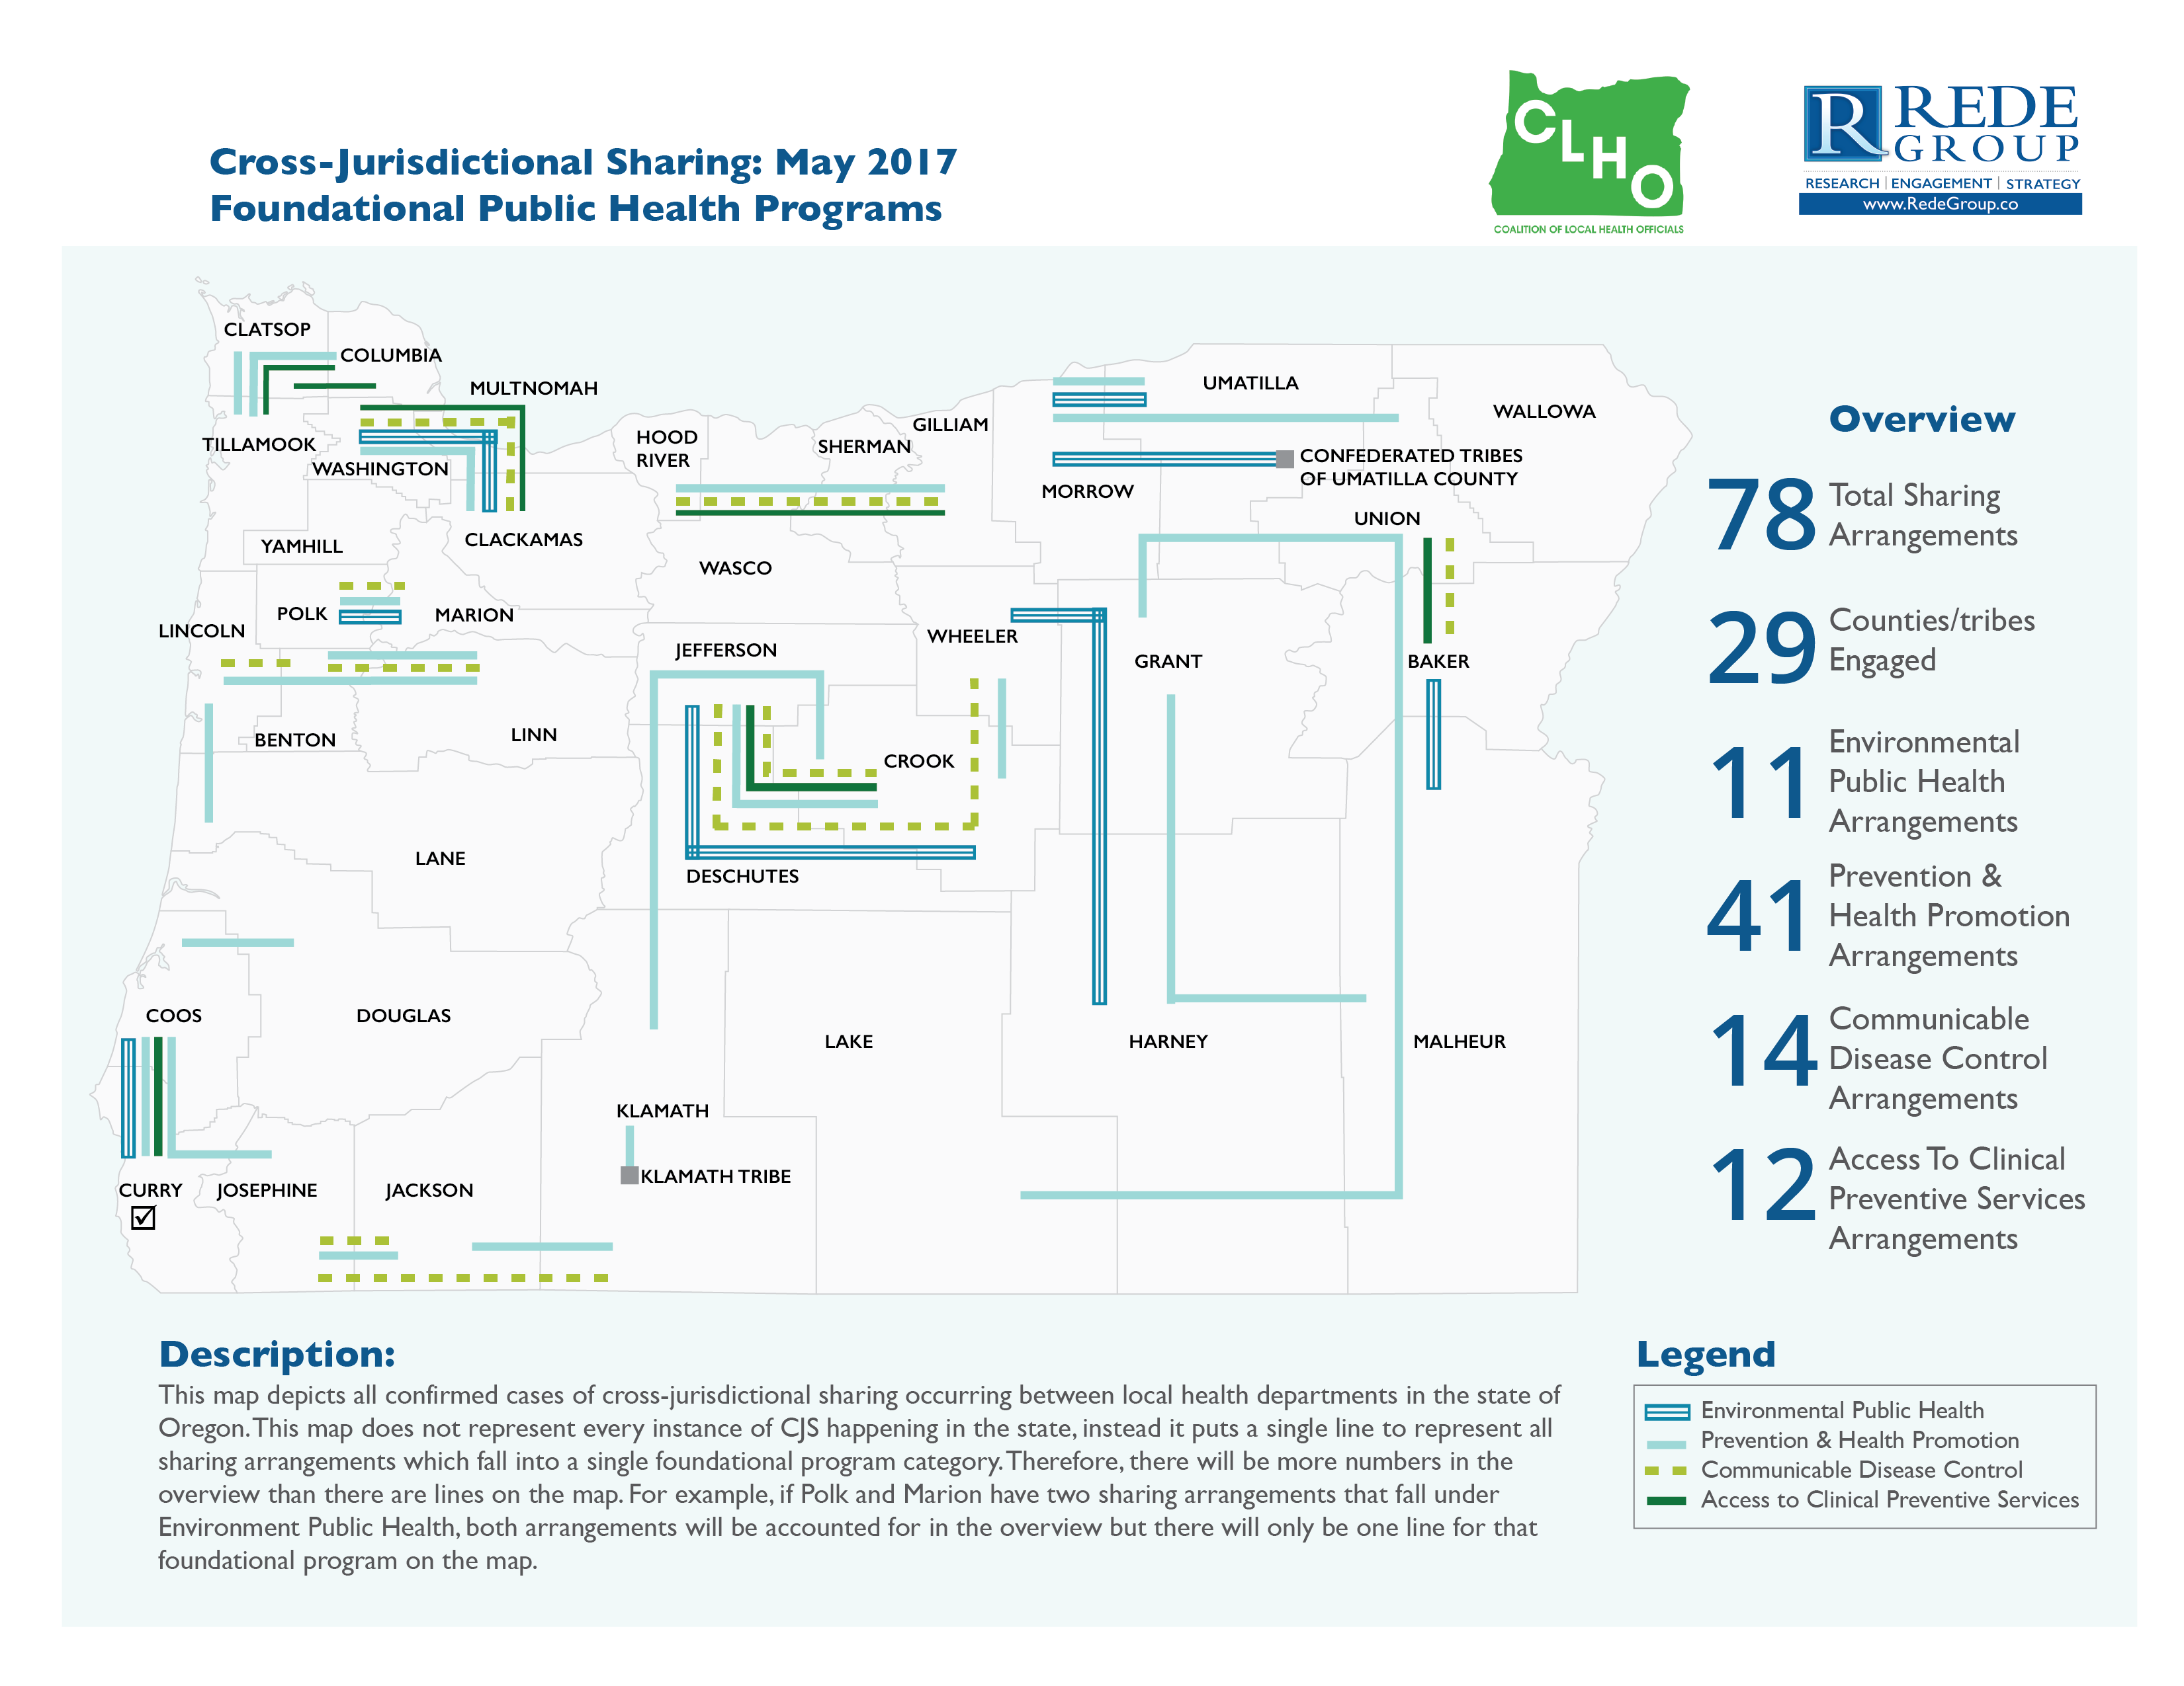
Notes:
One example of public health modernization currently occurring in Oregon is cross-jurisdictional sharing. For instance, an analysis was conducted by CHLO and the Rede Group demonstrating a variety of cross-jurisdictional sharing across Foundational Public Health Programs . The analysis revealed that many local health departments have innovated to partner with neighboring jurisdictions to increase efficiency and provide greater value to their communities through cross-jurisdictional sharing. For instance, three counties have established an arrangement to share an environmental health specialist to meet their shared need of only requiring an employee in this role on a part-time basis.

Slide 30
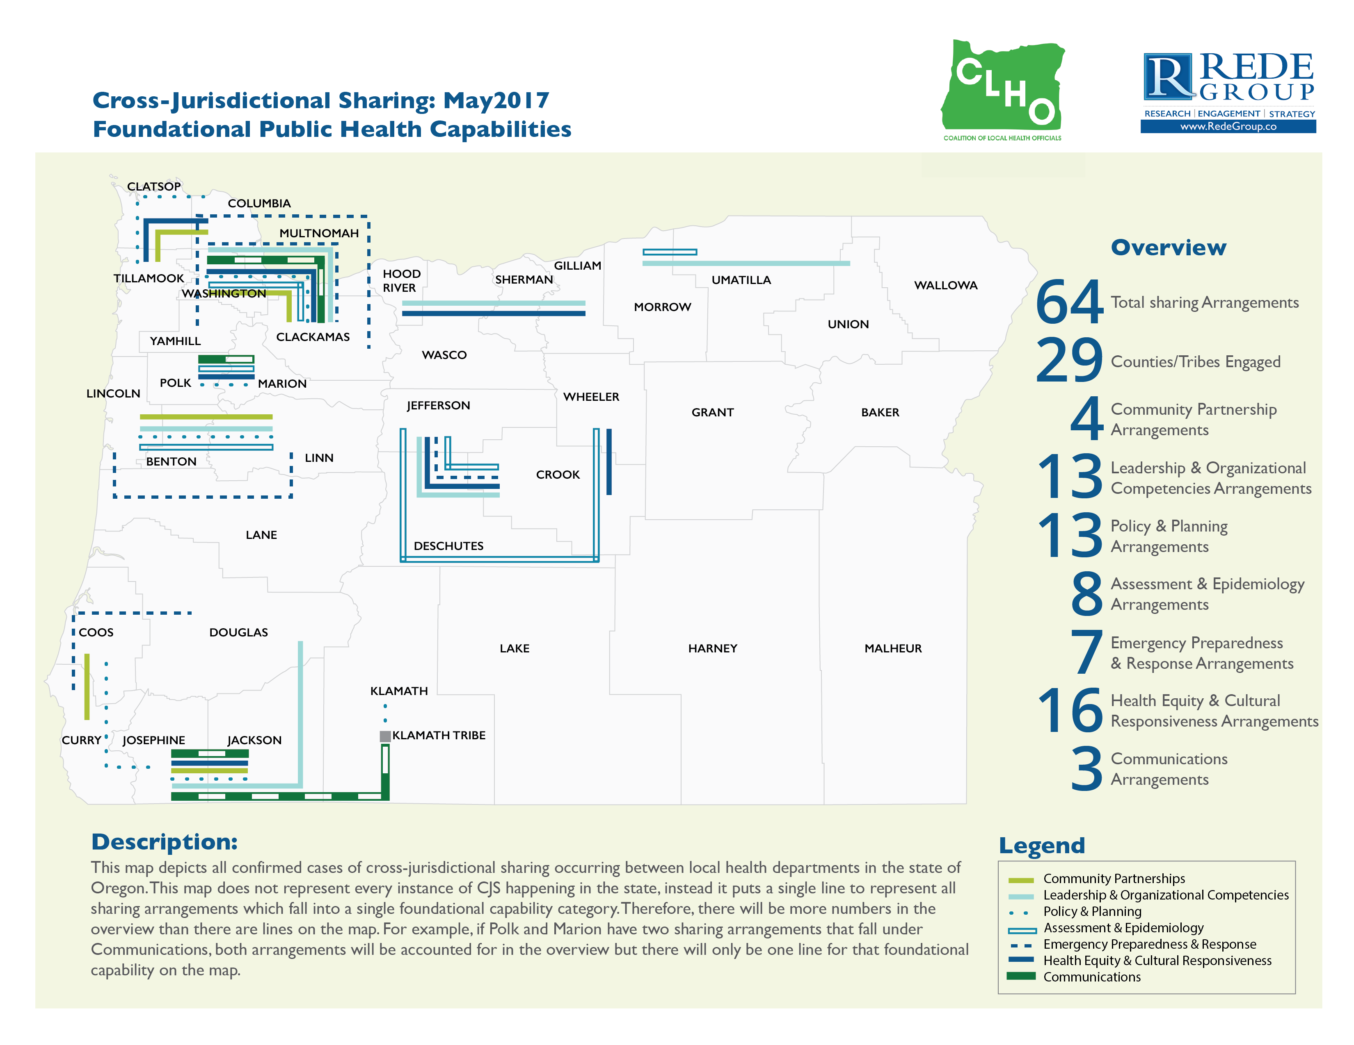
Notes:
The analysis also demonstrated cross-jurisdictional sharing across Foundational Public Health Capabilities. For example, a few counties have described sharing communications across jurisdictions on the topic of health promotion and prevention to identify shared priorities and to plan for emerging issues.

Slide 31
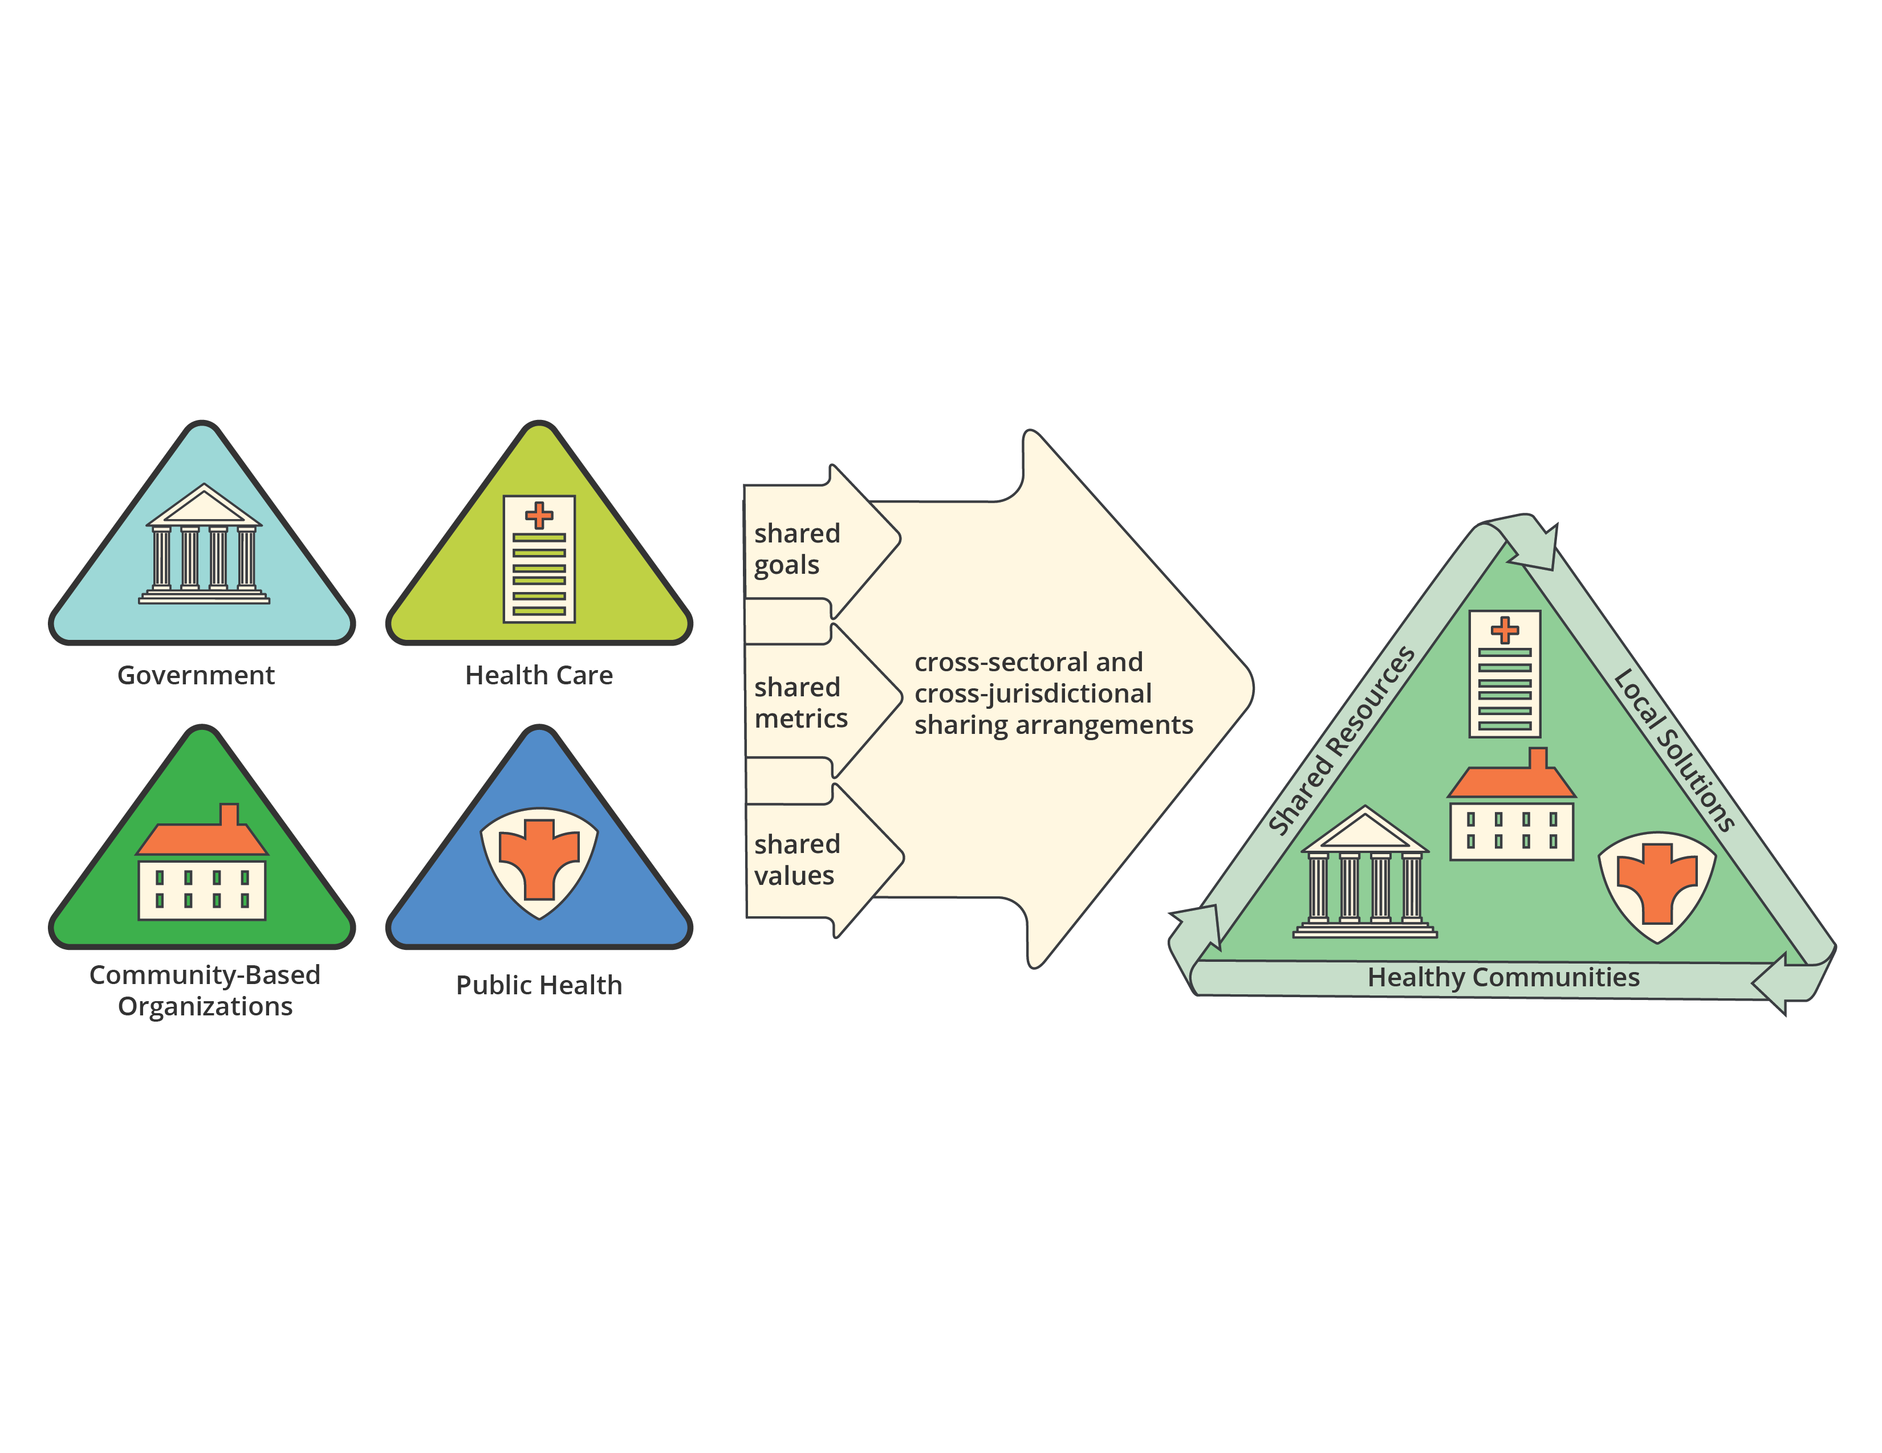
Cross-Sector Partnerships
Notes:
In addition to cross-jurisdictional sharing across health departments, cross-sector partnerships to improve community health are another avenue occurring to modernize the public health system. Recently, the Oregon Health Authority and Rede Group collected case-studies on five examples of cross-sector partnerships in public health addressing childhood obesity, food security, access to healthy eating and physical activity, support for preconception health, the health of mothers and babies.
These partnerships often involved public health along with health care, community-based organizations and government who demonstrated shared goals, shared metrics and shared values as a way to achieve shared resources, local solutions and healthy communities.

Slide 32
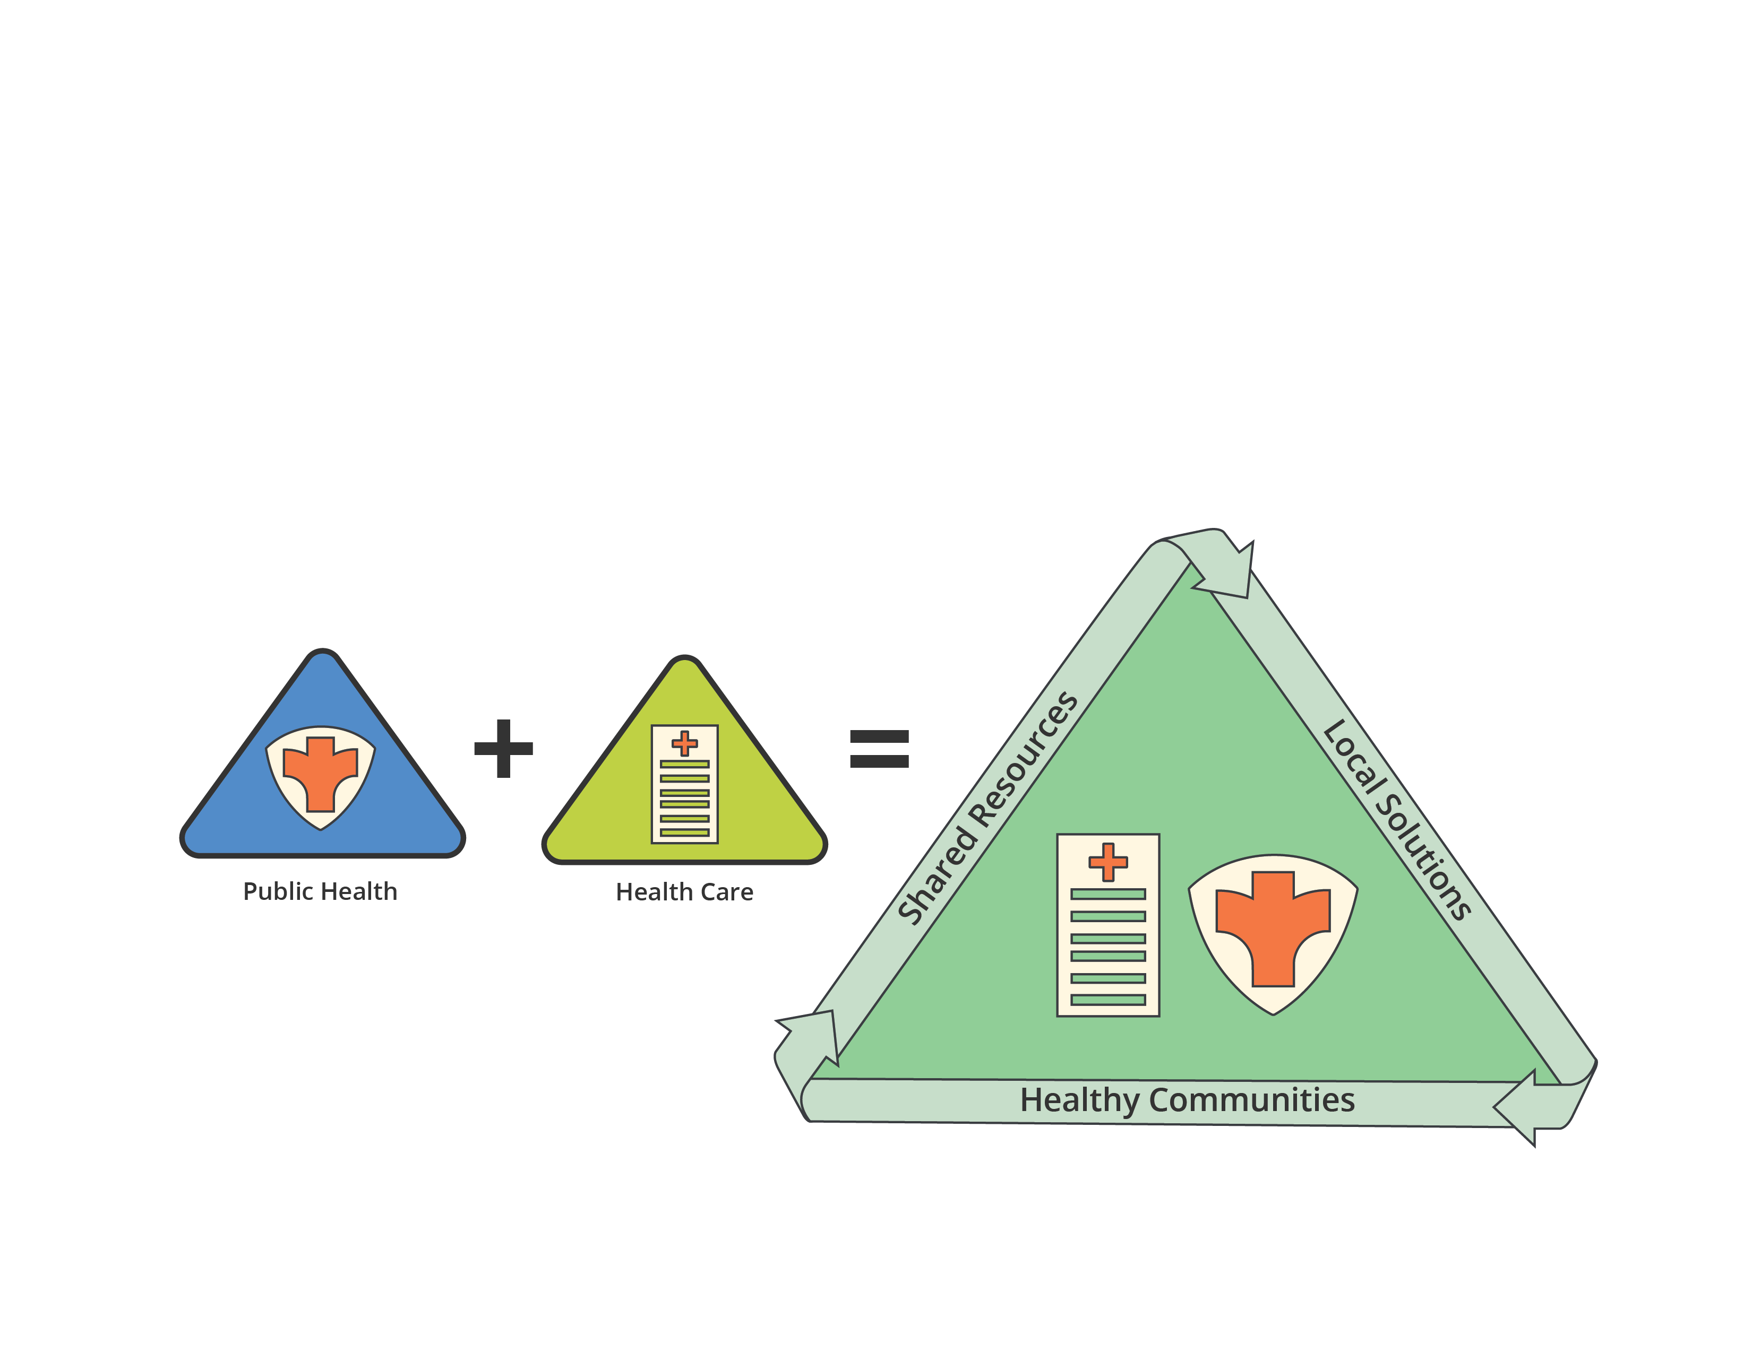
Cross-Sector Partnerships:
Improving the Health of Mothers & Babies
Notes:
As one example, one region sought to improve health for mothers and babies by creating a systematized approach for referring women to prenatal health care and creating a regional tracking and coordination system.

Slide 33
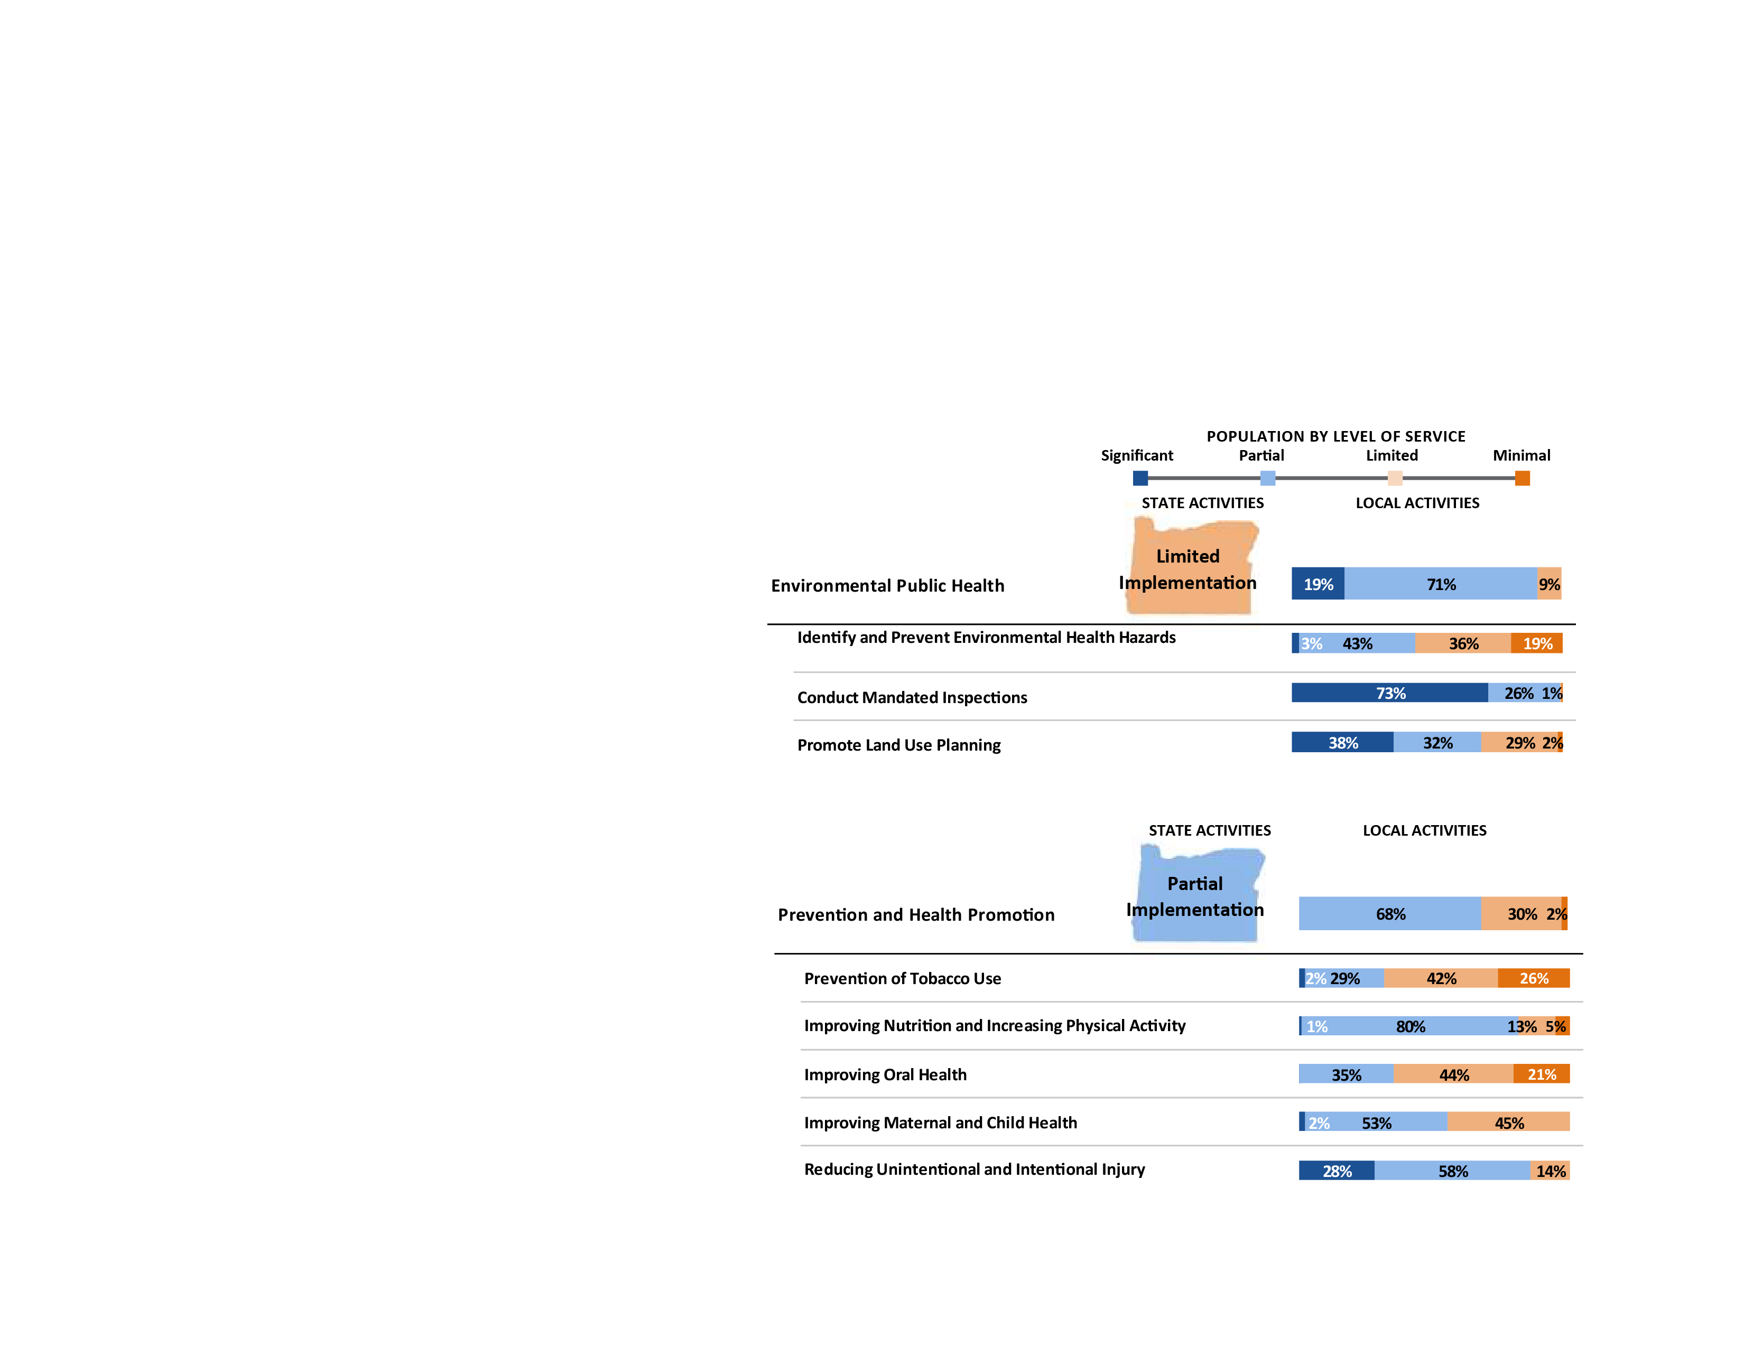
Building on Current Efforts
Notes:
However, while we have promising examples of public health modernization in Oregon. There is huge opportunity to scale up efforts and build on our current activities.
Earlier we mentioned the 2016 Oregon State Public Health Modernization Assessment Report prepared by Berk where Oregon’s governmental public health authorities were asked to assess their current implementation of the public health modernization framework. As a key finding, this assessment revealed that there are no foundational capabilities and programs that are substantially universally implemented across all public health.
In many ways the gaps are not uniform, nor do they appear in the same places in every organization. As such, the Berk report states that current implementation of public health modernization can be described as a “patchwork quilt”. Here we can see that Environmental Public Health is being implemented in a limited manner, whereas Prevention and Health Promotion are partially being implemented.

Slide 34
Health and Economic Benefit of Public Health
Annual medical care expenditures in Oregon related to physical inactivity is an estimated $1.3 billion.
Reducing physical inactivity health care costs by less than 1% (.12%) would offset the recommended additional spending of $1.6 million, annually.
Notes:
To identify what is needed to build on current efforts, the 2017 Health and Economic Benefits of Public Health Modernization report, prepared for the Oregon Health Authority estimated the recommended additional spending needed to close the gap between what it will cost to fully implement the foundational programs and capabilities of public health modernization, as identified in the Berk report, and current (2016) annual spending on foundational programs and capabilities. For example, the report estimate that by increasing Oregon public health departments’ per capita spending by 10%, there would be 202 fewer diabetes deaths per year.
It is important to keep in mind that Oregon does not stand alone in its level of investment in public health. The United states lags considerably behind many nations in overall life expectancy and the incidence of preventable diseases and injuries. Experts have made a strong case that the country’s lagging population health status is a result of inadequate investment in public health strategies that promote health and prevent disease and disability. Oregon can provide leadership to other states on the public health modernization front.

Slide 35
Regional Partnerships for Communicable Disease Control
In 2017, the Oregon State Legislature allocated $5 Million to modernization.
In November 2017, Oregon Health Authority will be distributing $3.9 million in funds to local public health departments to develop regional approaches for:
  -- identifying,
  -- responding to; and
  -- preventing the transmission of communicable disease…
  … with an emphasis on reducing communicable disease-related health disparities.
Notes:
Indeed, the Oregon State Legislature is taking leadership to provide investment in public health modernization. In 2017, the Oregon State Legislature dedicated some funds to be distributed by the Oregon Health Authority to modernize communicable disease control. Full implementation will take time, so current implementation funds will support local public health departments to focus on communicable diseases and cross-jurisdictional sharing approaches. Though funds may not always be readily available, there are steps that local health departments and the state can take to begin implementing modernization.

Slide 36
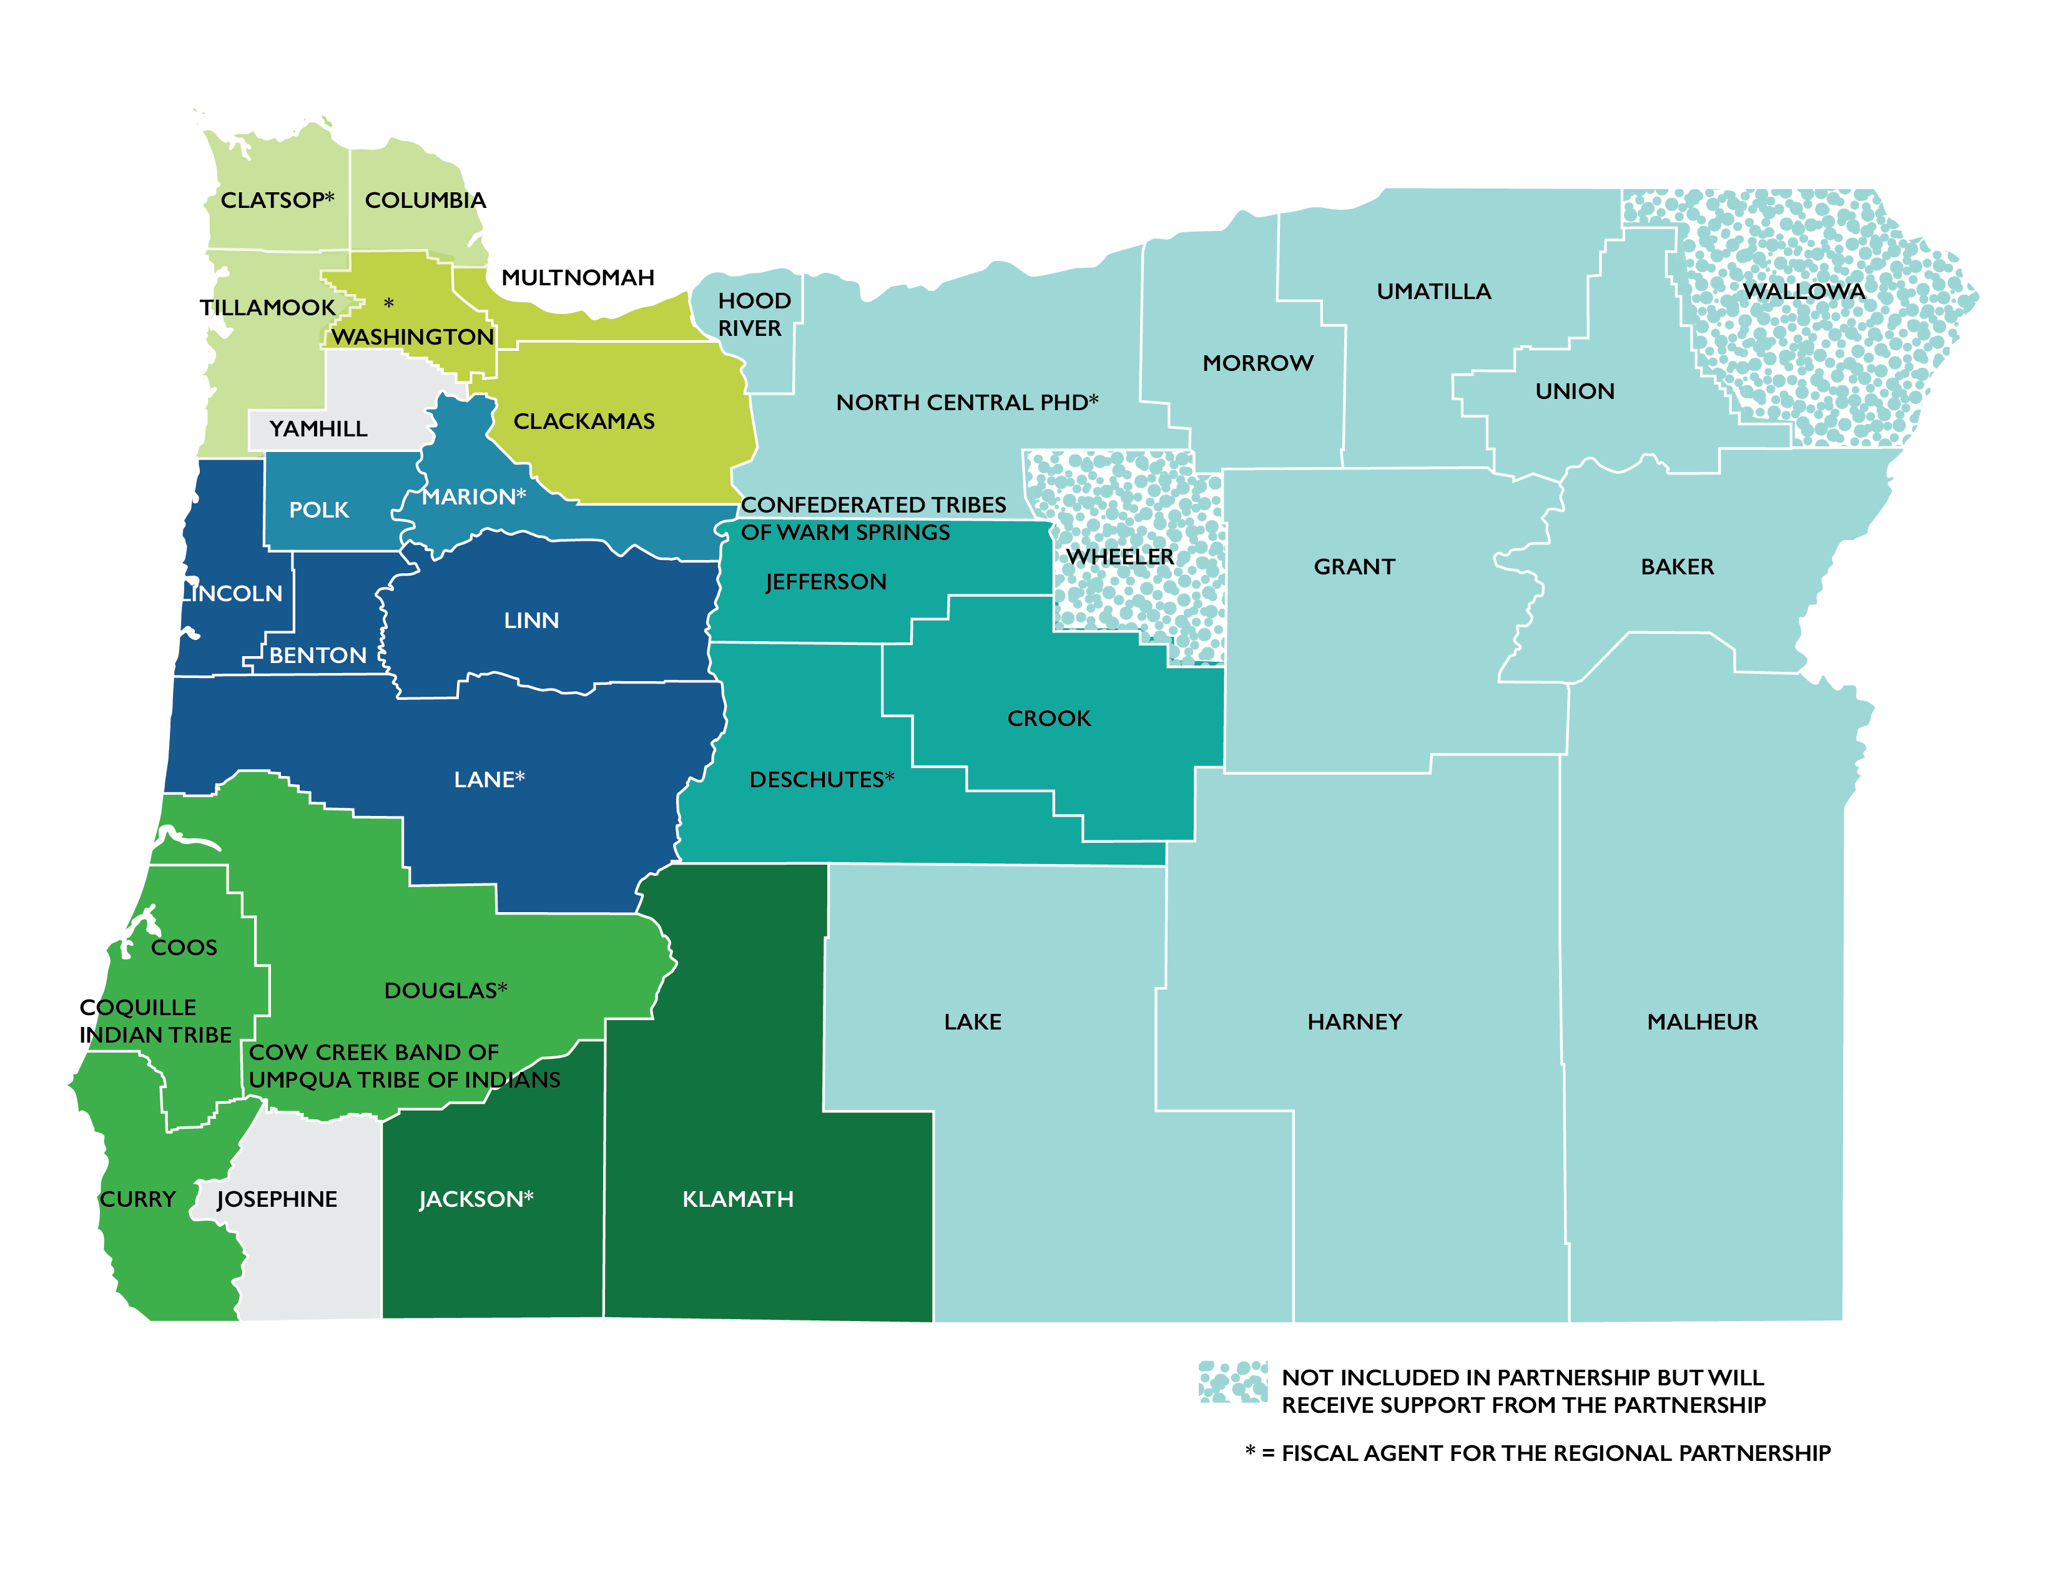
Local Public Health Modernization Grantees
Notes:
This map shows regional partnerships that have formed to begin modernizing the communicable disease prevention in Oregon

Slide 37
What’s Next
Review the Public Health Modernization Manual
Review Oregon Public Health State Health Improvement Plan
Review the newly launched CLHO AIMHI Roadmap Toolkit
Notes:
As some examples of next steps, health departments can begin by:
Reviewing the Public Health Modernization Manual;
Reviewing the Oregon Public Health State Health Improvement Plan;
And by reviewing the newly launched CLHO AIMHI Roadmap Toolkit.

Slide 38
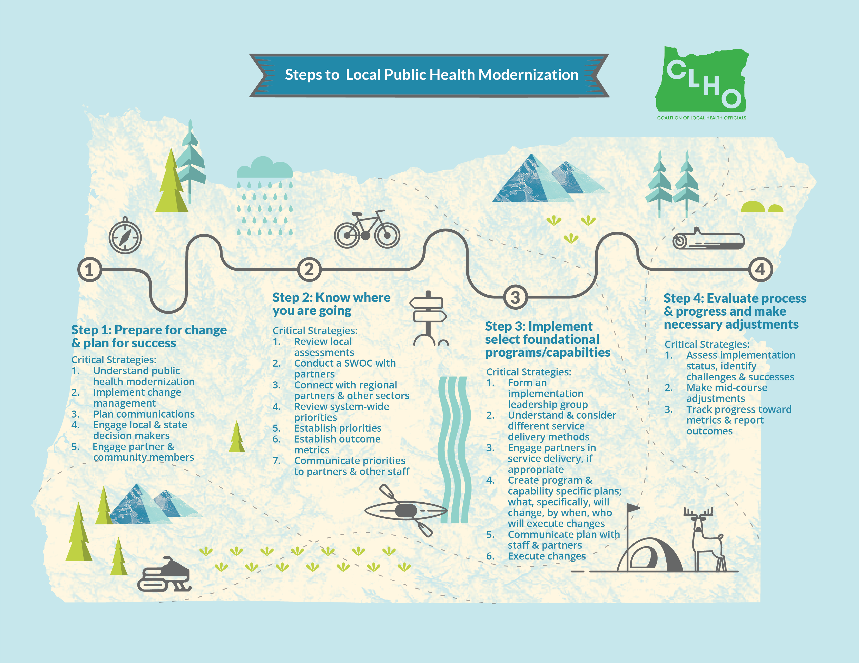
Notes:
CHLO’s AIMHI Roadmap Toolkit includes a set of tools developed to help local health departments implement public health modernization. This roadmap offers a step by step process, resources, and practical suggestions for advancing to a modernized public health system where everyone in Oregon lives in a community with access to foundational public health programs and capabilities.

Slide 39

Technical Assistance
Technical assistance provided by the Rede Group
For questions regarding the AIMHI Roadmap contact:
Jill Hutson jill.hutson@redegroup.co 503-764-9696
Notes:
Thank you for taking the time to learn about public health modernization and the implementation strategy and modernization roadmap! If you have any questions about what you heard in this module today, or if you run across any questions as you begin using the roadmap and tools please call or e-mail Jill Hutson at the Rede Group: #, email.
The Rede Group is here to provide technical assistance for any and all aspects of the AIMHI Roadmap.

