Slide 1
Modernizing
Our Public
Health System
LHD LOGO
PRESENTER NAME
DATE
LOCATION
Notes:
[This presentation TEMPLATE can be used to provide an overview of public health modernization. It is intended for use with local public health leaders/elected officials.]

Slide 2
Public Health Modernization
Public Health Modernization means everyone in Oregon can expect public protections critical to their health and the health of future generations— these include:
clean air
safe food & water
health promotion & prevention of diseases
response to new health threats

Slide 3

What does our public health system currently do?
Notes:
Public Health achievements over the past century have included vaccination campaigns, improvements in motor-vehicle safety, safer workplaces, the control of infectious diseases (like tuberculosis, measles, and HIV/AIDS), a reduction in deaths from heart disease and stroke, more nutritious and safe food, a decline in infant and maternal mortality, an increase in accessibility to family planning services, and the identification of tobacco as a health hazard and the decrease in use over time.
Public health works tirelessly to keep people healthy and safe, and it is only when something has gone wrong do we usually realize how many aspects of our lives depend on the work of public health.
As a public health workforce we continue to tackle issues such as:
Healthcare accessibility
Disease outbreak control, like Zika, bacterial meningitis, and Ebola
Child mortality
Food and water safety
Tobacco use
Preparing for and responding to natural disasters
Include one or two BRIEF examples of work done by your LHD.

Slide 4
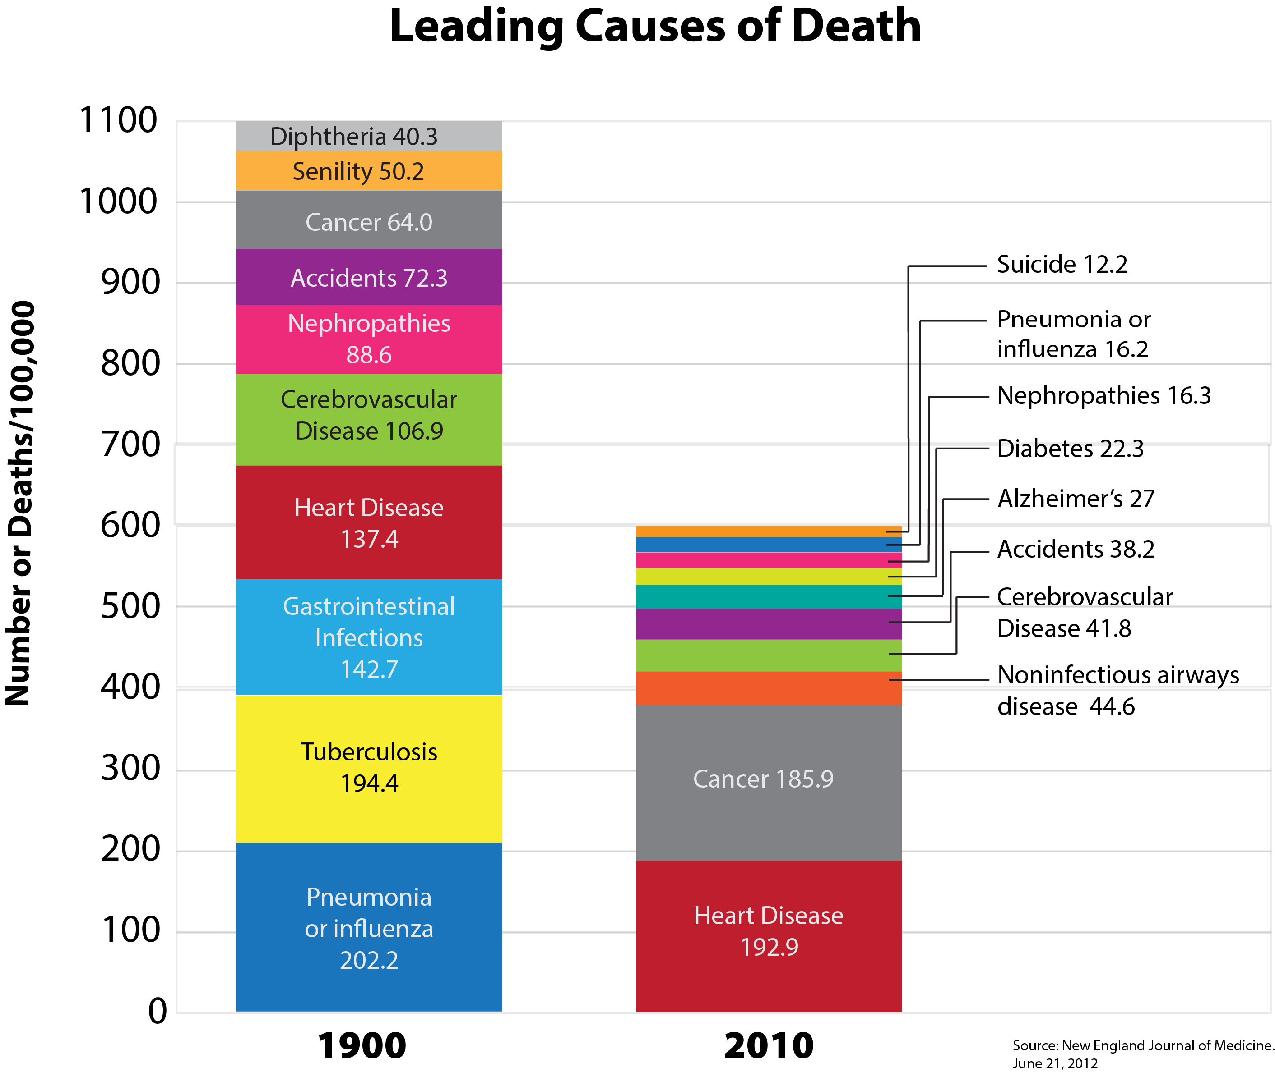
Notes:
The leading causes of death globally have changed significantly from 1900 to 2010. We can see that we have made tremendous progress in reducing premature death.

Slide 5
Notes:
While our public health system is essential for community health, we can’t ignore the fact that our system was designed for a previous age, which makes it difficult for us to address new and emerging public health challenges. Some of our current challenges are increases in chronic conditions such as diabetes and heart disease, an increase in cancers, and emerging new infectious diseases as well as outbreaks of older diseases. The most current leading causes of death (e.g. cancer, heart disease, diabetes) are diseases that are driven by tobacco use, physical inactivity, and poor nutrition.

Slide 6
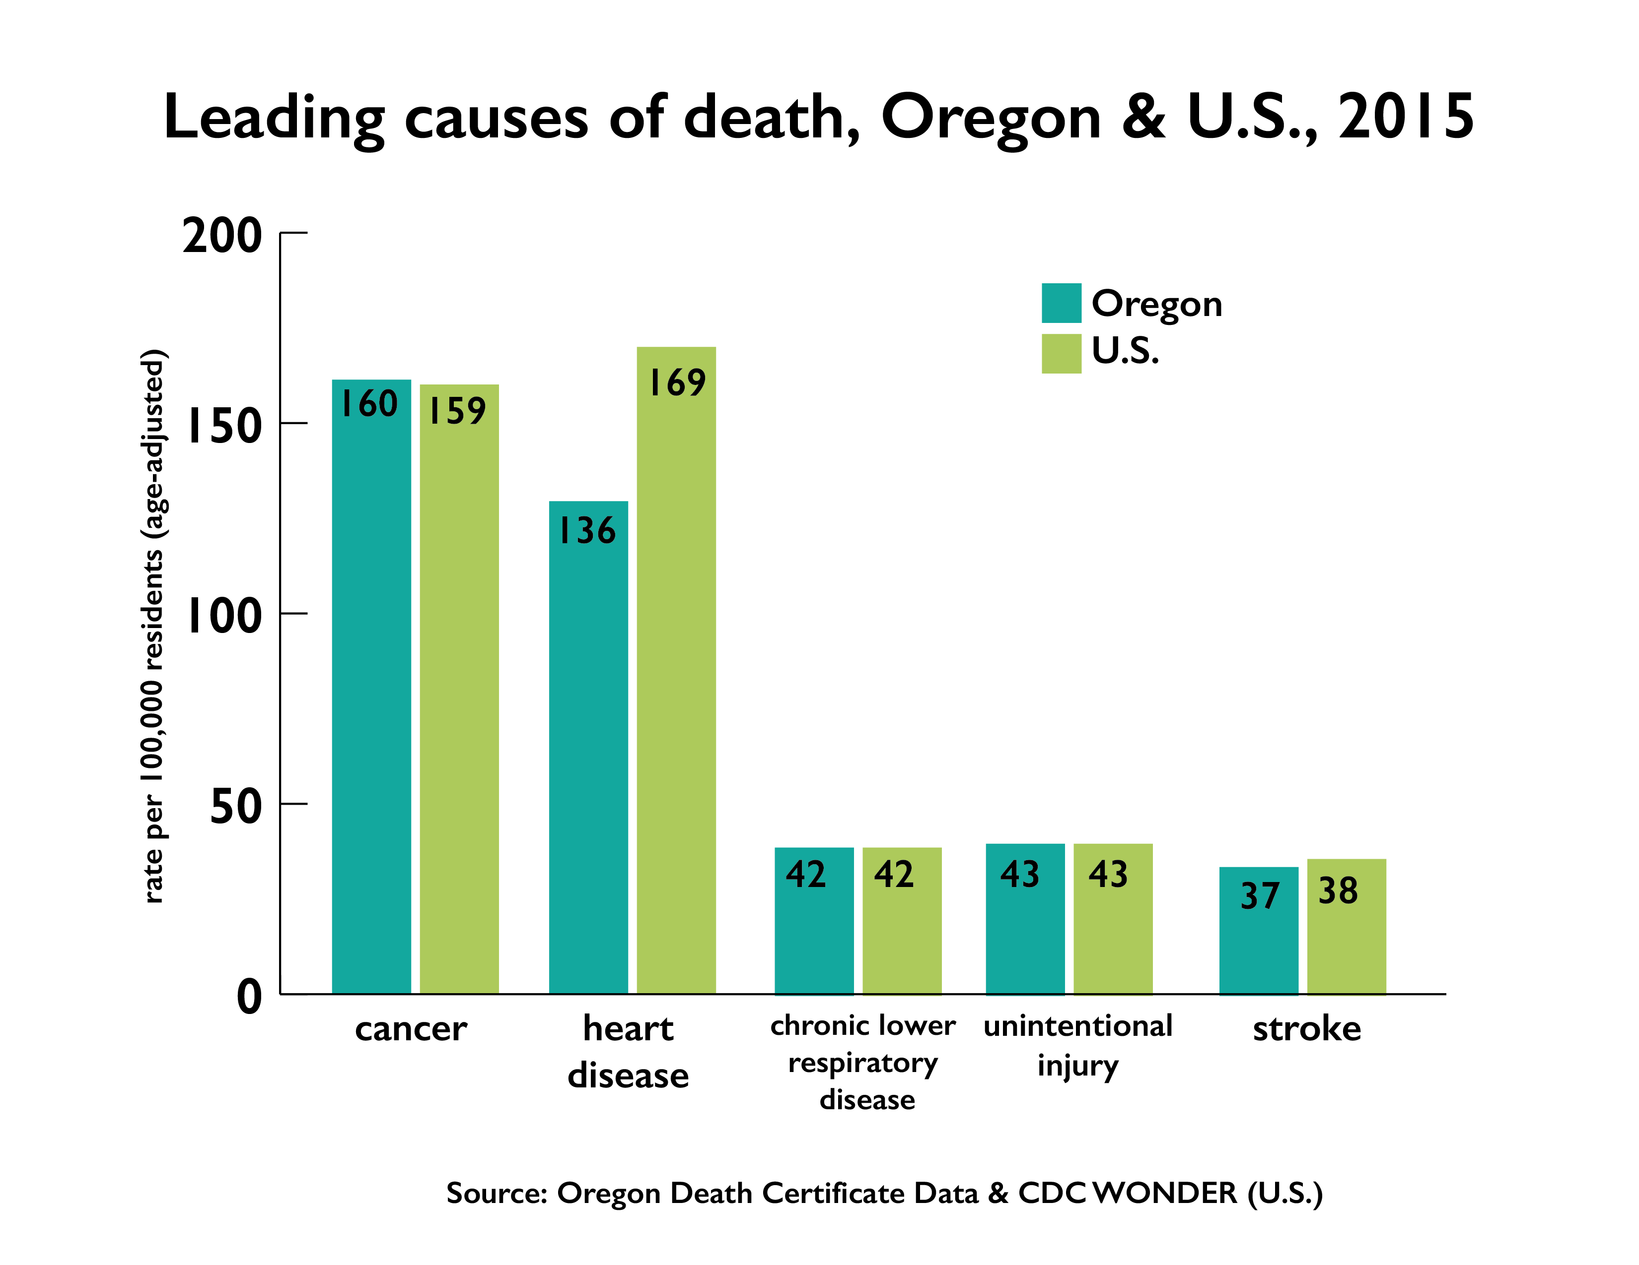
The Challenges We Face
Notes:
Many people in Oregon suffer from preventable illnesses and premature death that public health can help prevent .
In Oregon our leading causes of death include Cancer, Heart Disease, chronic respiratory disease, and stroke– all preventable diseases
However, the public health system is often challenged to proactively address preventable diseases and instead, focuses on present and emerging threats like tuberculosis, whooping cough and other communicable diseases. Include an example here of an outbreak/or mobilizing in prep for potential outbreak and the work that required.
Our public health system should be able to engage in work helping to prevent preventable diseases and death AND respond to emerging threats and outbreaks at the same time.
Oregon’s challenges in maximizing the conditions in which people can be healthy continues to take a growing toll on our economy and on society. As the backbone of the health system, public health possesses the skills and expertise that support communities and other partners to improve the conditions in which we live and work, leading to better health outcomes for all in Oregon.
This requires new strategies that preserve and expand the public health protections and prevention currently enjoyed by everyone in Oregon.

Slide 7

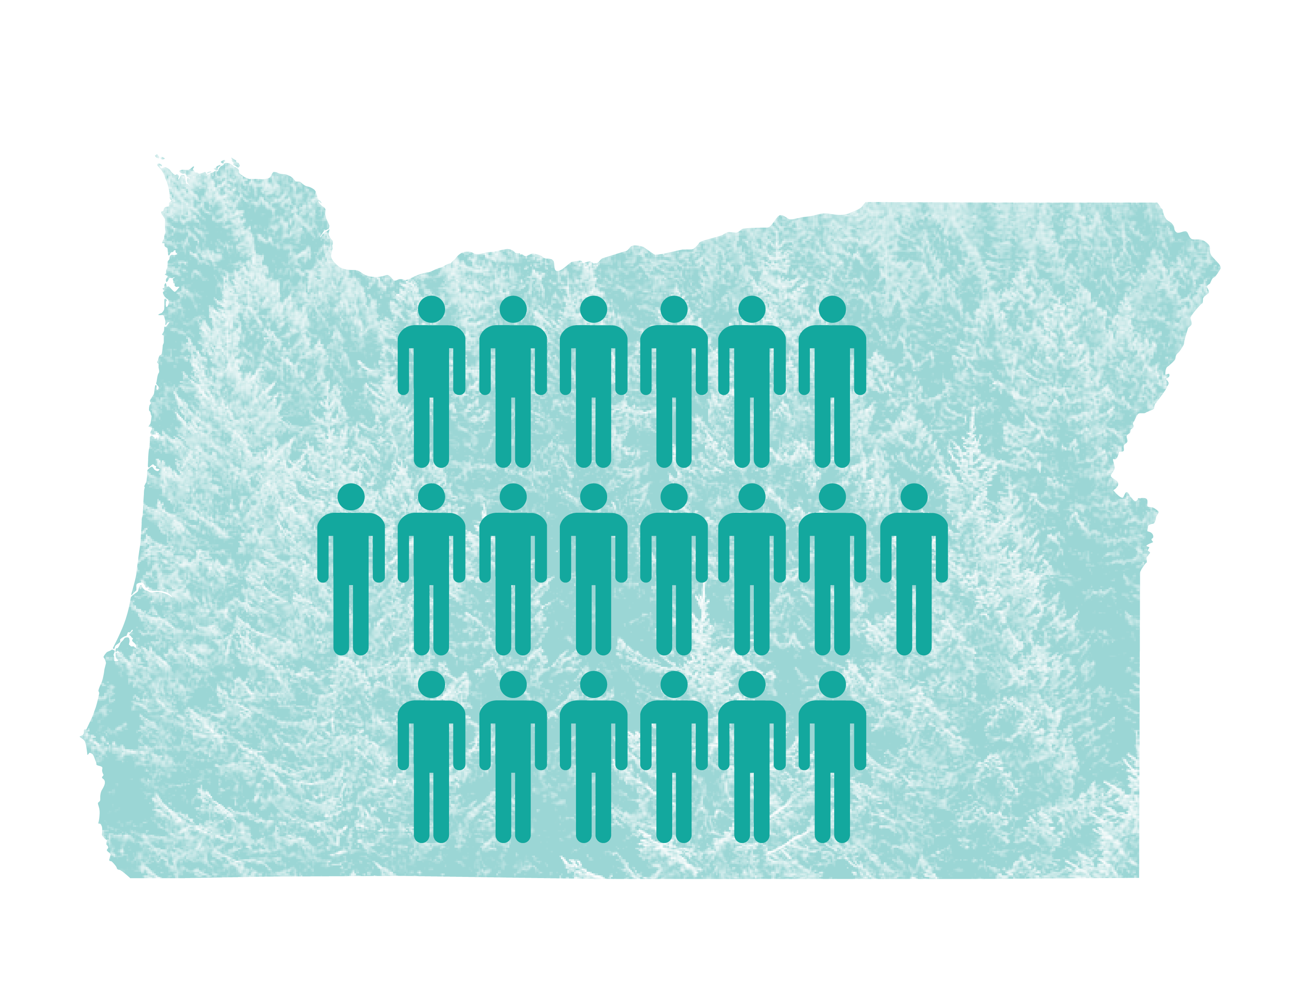
Finishing the Work We Started
To improve the health of everyone in Oregon and reduce deaths from preventable disease while maintaining our health protections, we must:
Notes:
ANIMATED SLIDE- CLICK THROUGH IMAGES
Shift our perspective to the population from the individual (Image 1)
Prioritize public health funding (image 2)
Chronic diseases that drive the bulk our health spending and loss of workforce productivity are conditions that could be decreased or prevented through the initiatives, services and expertise that public health departments provide. Provide an example of some of the innovative work your health department may be engaging in to address community health (with or without partners).

Slide 8
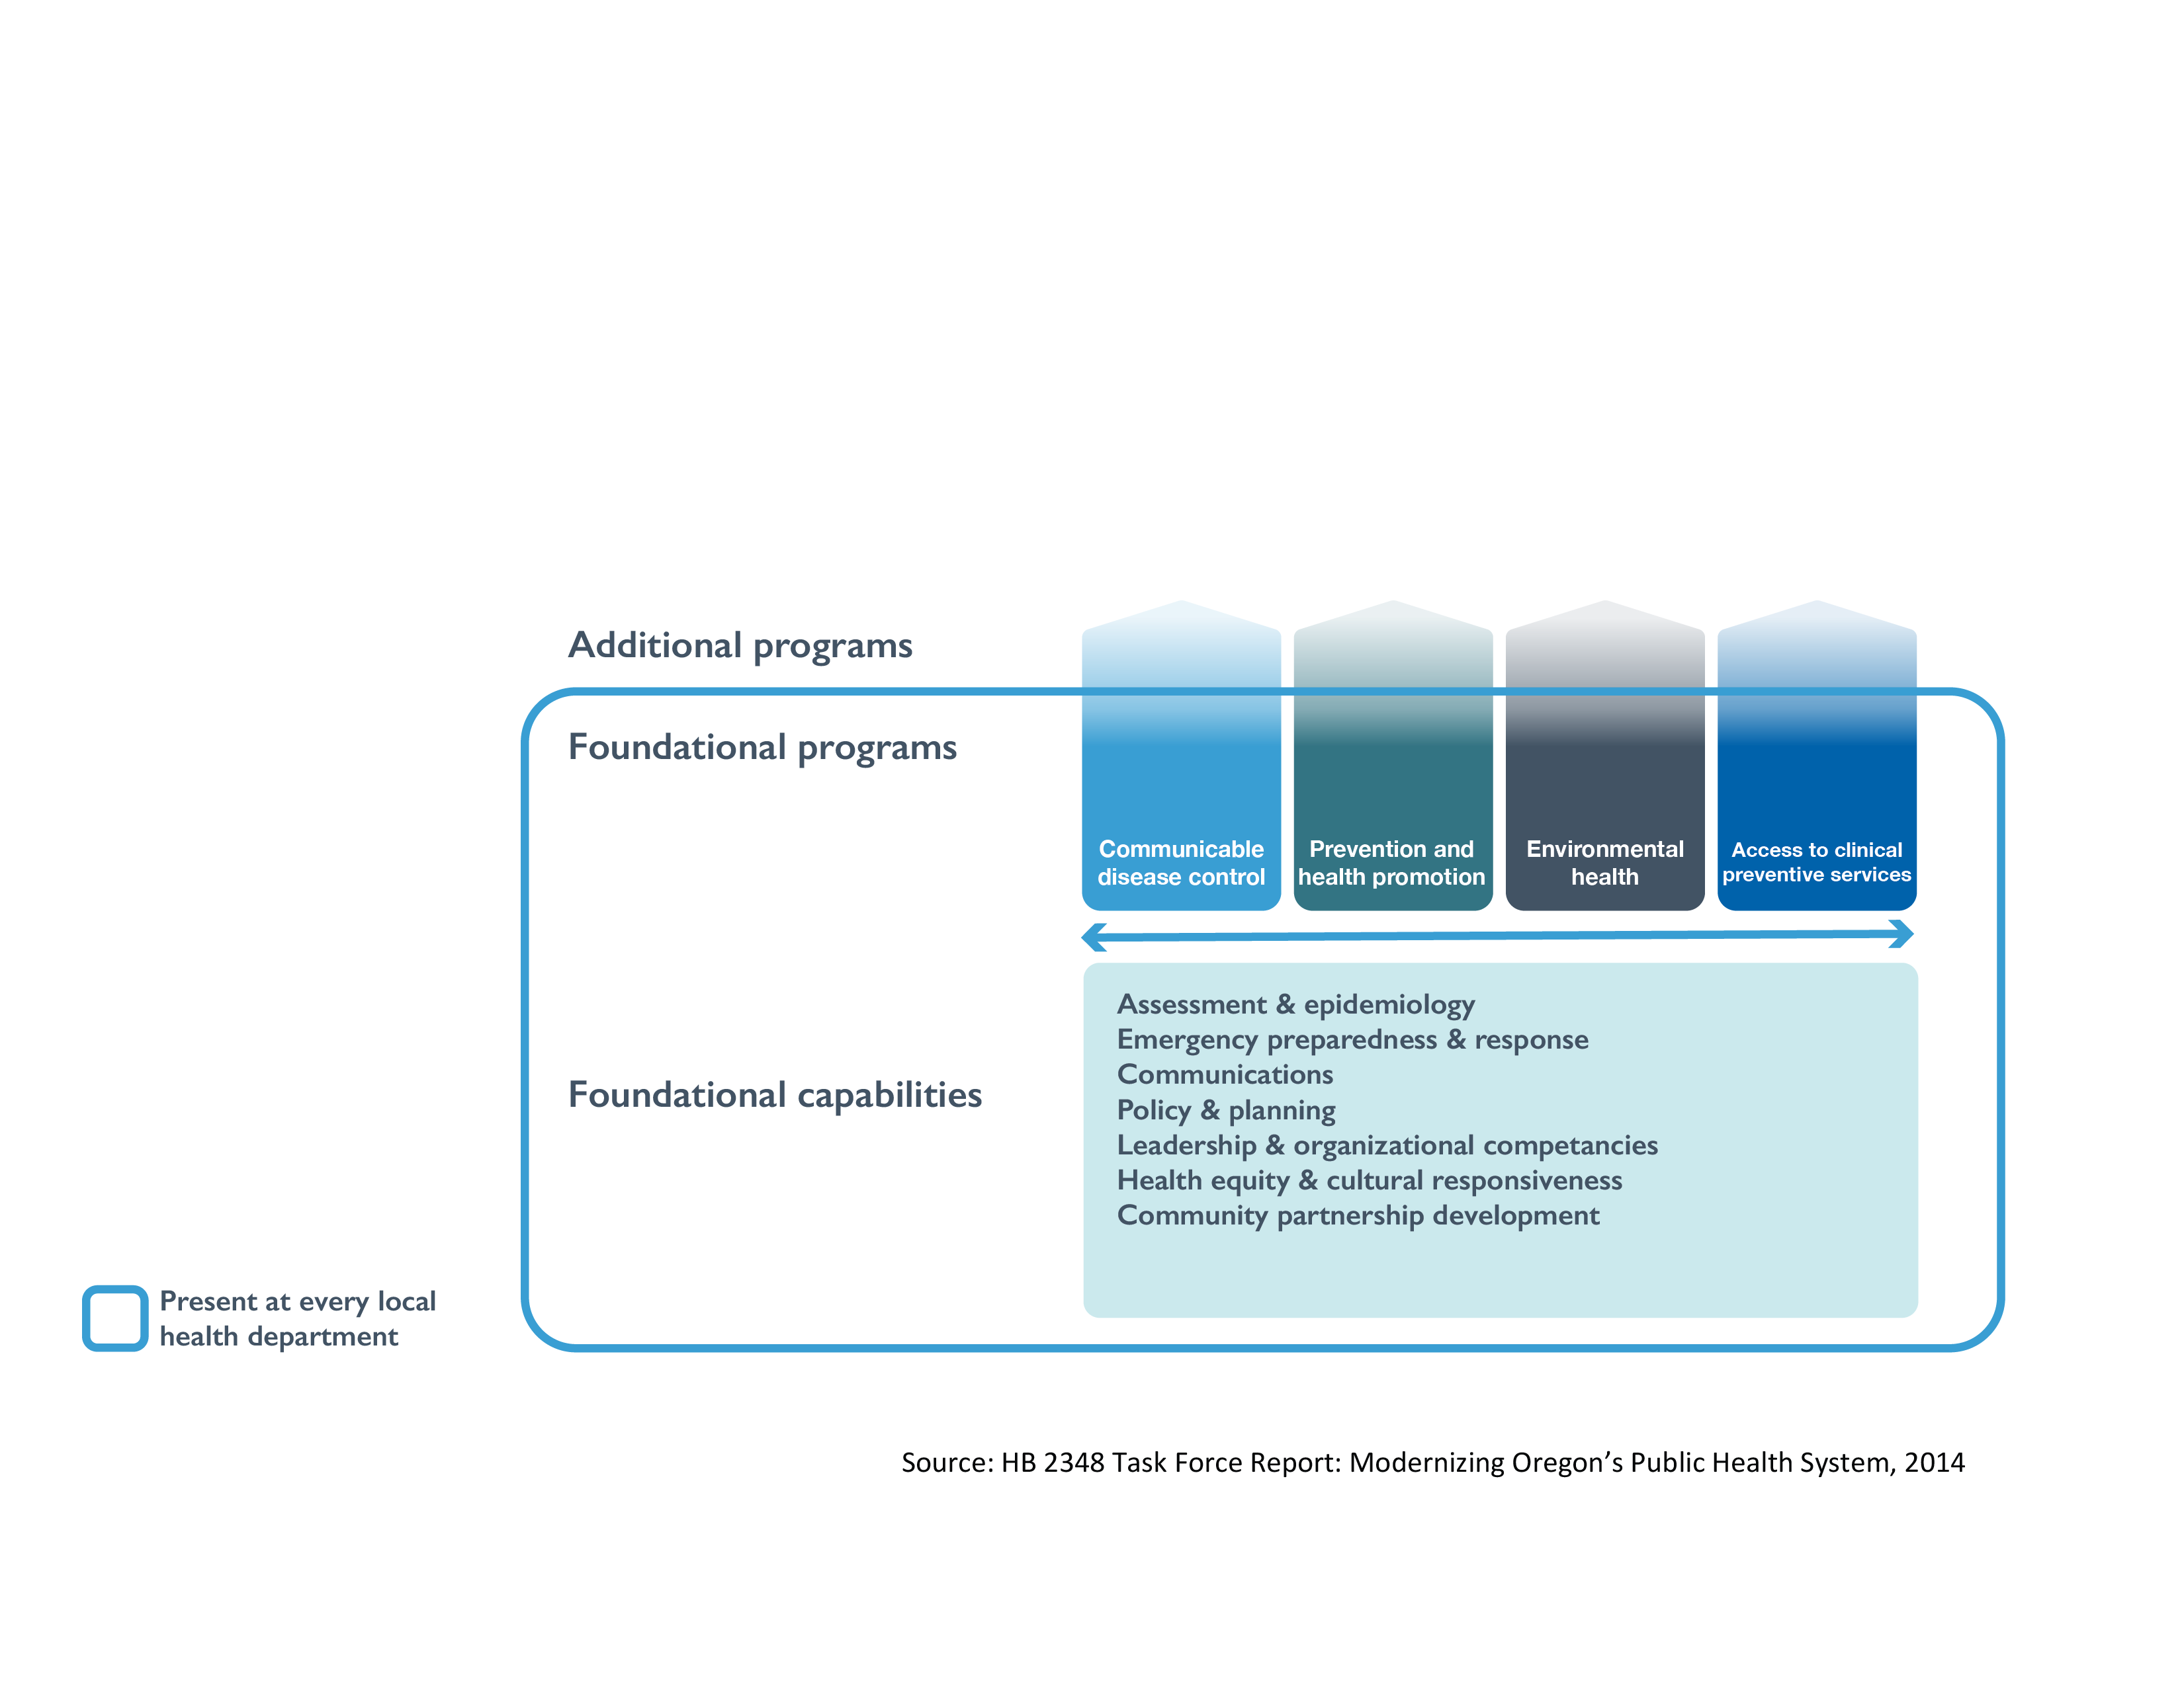
A New Model For Public Health
Notes:
Public Health Modernization is a “minimum, or basic, package of services;” in other words, the suite of skills, programs, and activities that must be available in state and local health departments everywhere for the health system to work anywhere.
A modernized public health system:
protects and promote the health of populations, and
is available and visible in all communities across Oregon
A system-wide assessment conducted in the Spring of 2016 determined that the following public health programs are limited or minimal in over a third of Oregon communities:
• Capacity to investigate and respond to disease outbreaks.
• Ability to identify and prevent environmental health hazards, including air toxics and lead.
• Promote health equity through partnerships and engagement with communities that experience an excess burden of disease and death.
• Access to local, timely and accurate population health data that helps drive community-based decision-making and resource allocation.
The Public Health Advisory Board is recommending investment in these areas as a first step in implementing the Public Health Modernization model.

Slide 9
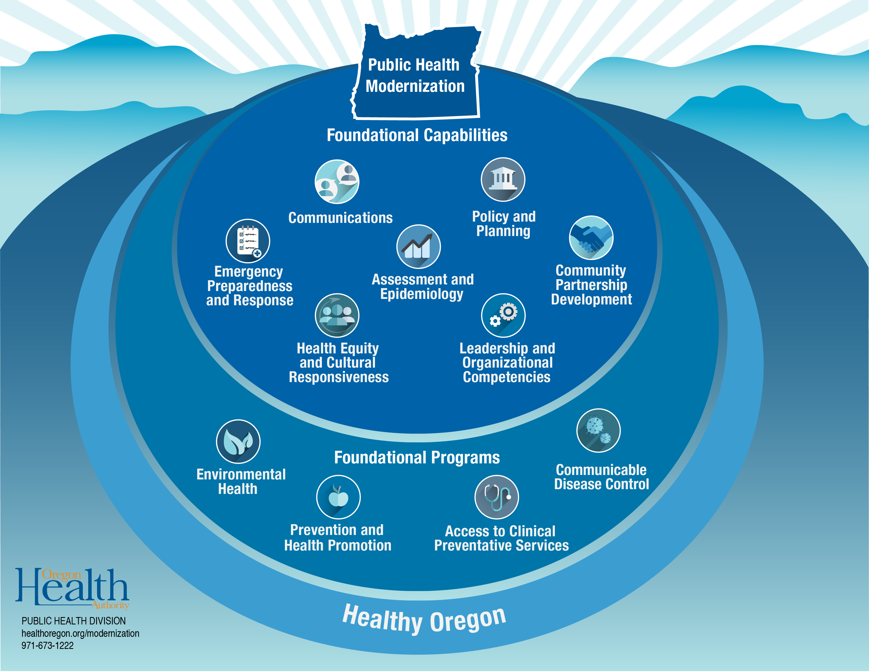
Notes:
In public health modernization, there are 7 foundational capabilities and 4 foundational programs:
Foundational capabilities are the knowledge, skills, and abilities needed to successfully implement foundational programs. The 7 foundational capabilities are: leadership and organizational competencies, health equity and responsiveness, community partnership development, assessment and epidemiology, policy and planning, communications, and emergency preparedness and response.
Foundational programs include topic- and disease-specific work to achieve improved health outcomes, such as a decrease in the prevalence of a particular disease or health risk behavior. The 4 foundational programs are: communicable disease control, prevention and health promotion, environmental health, and access to clinical preventative services.

Slide 10
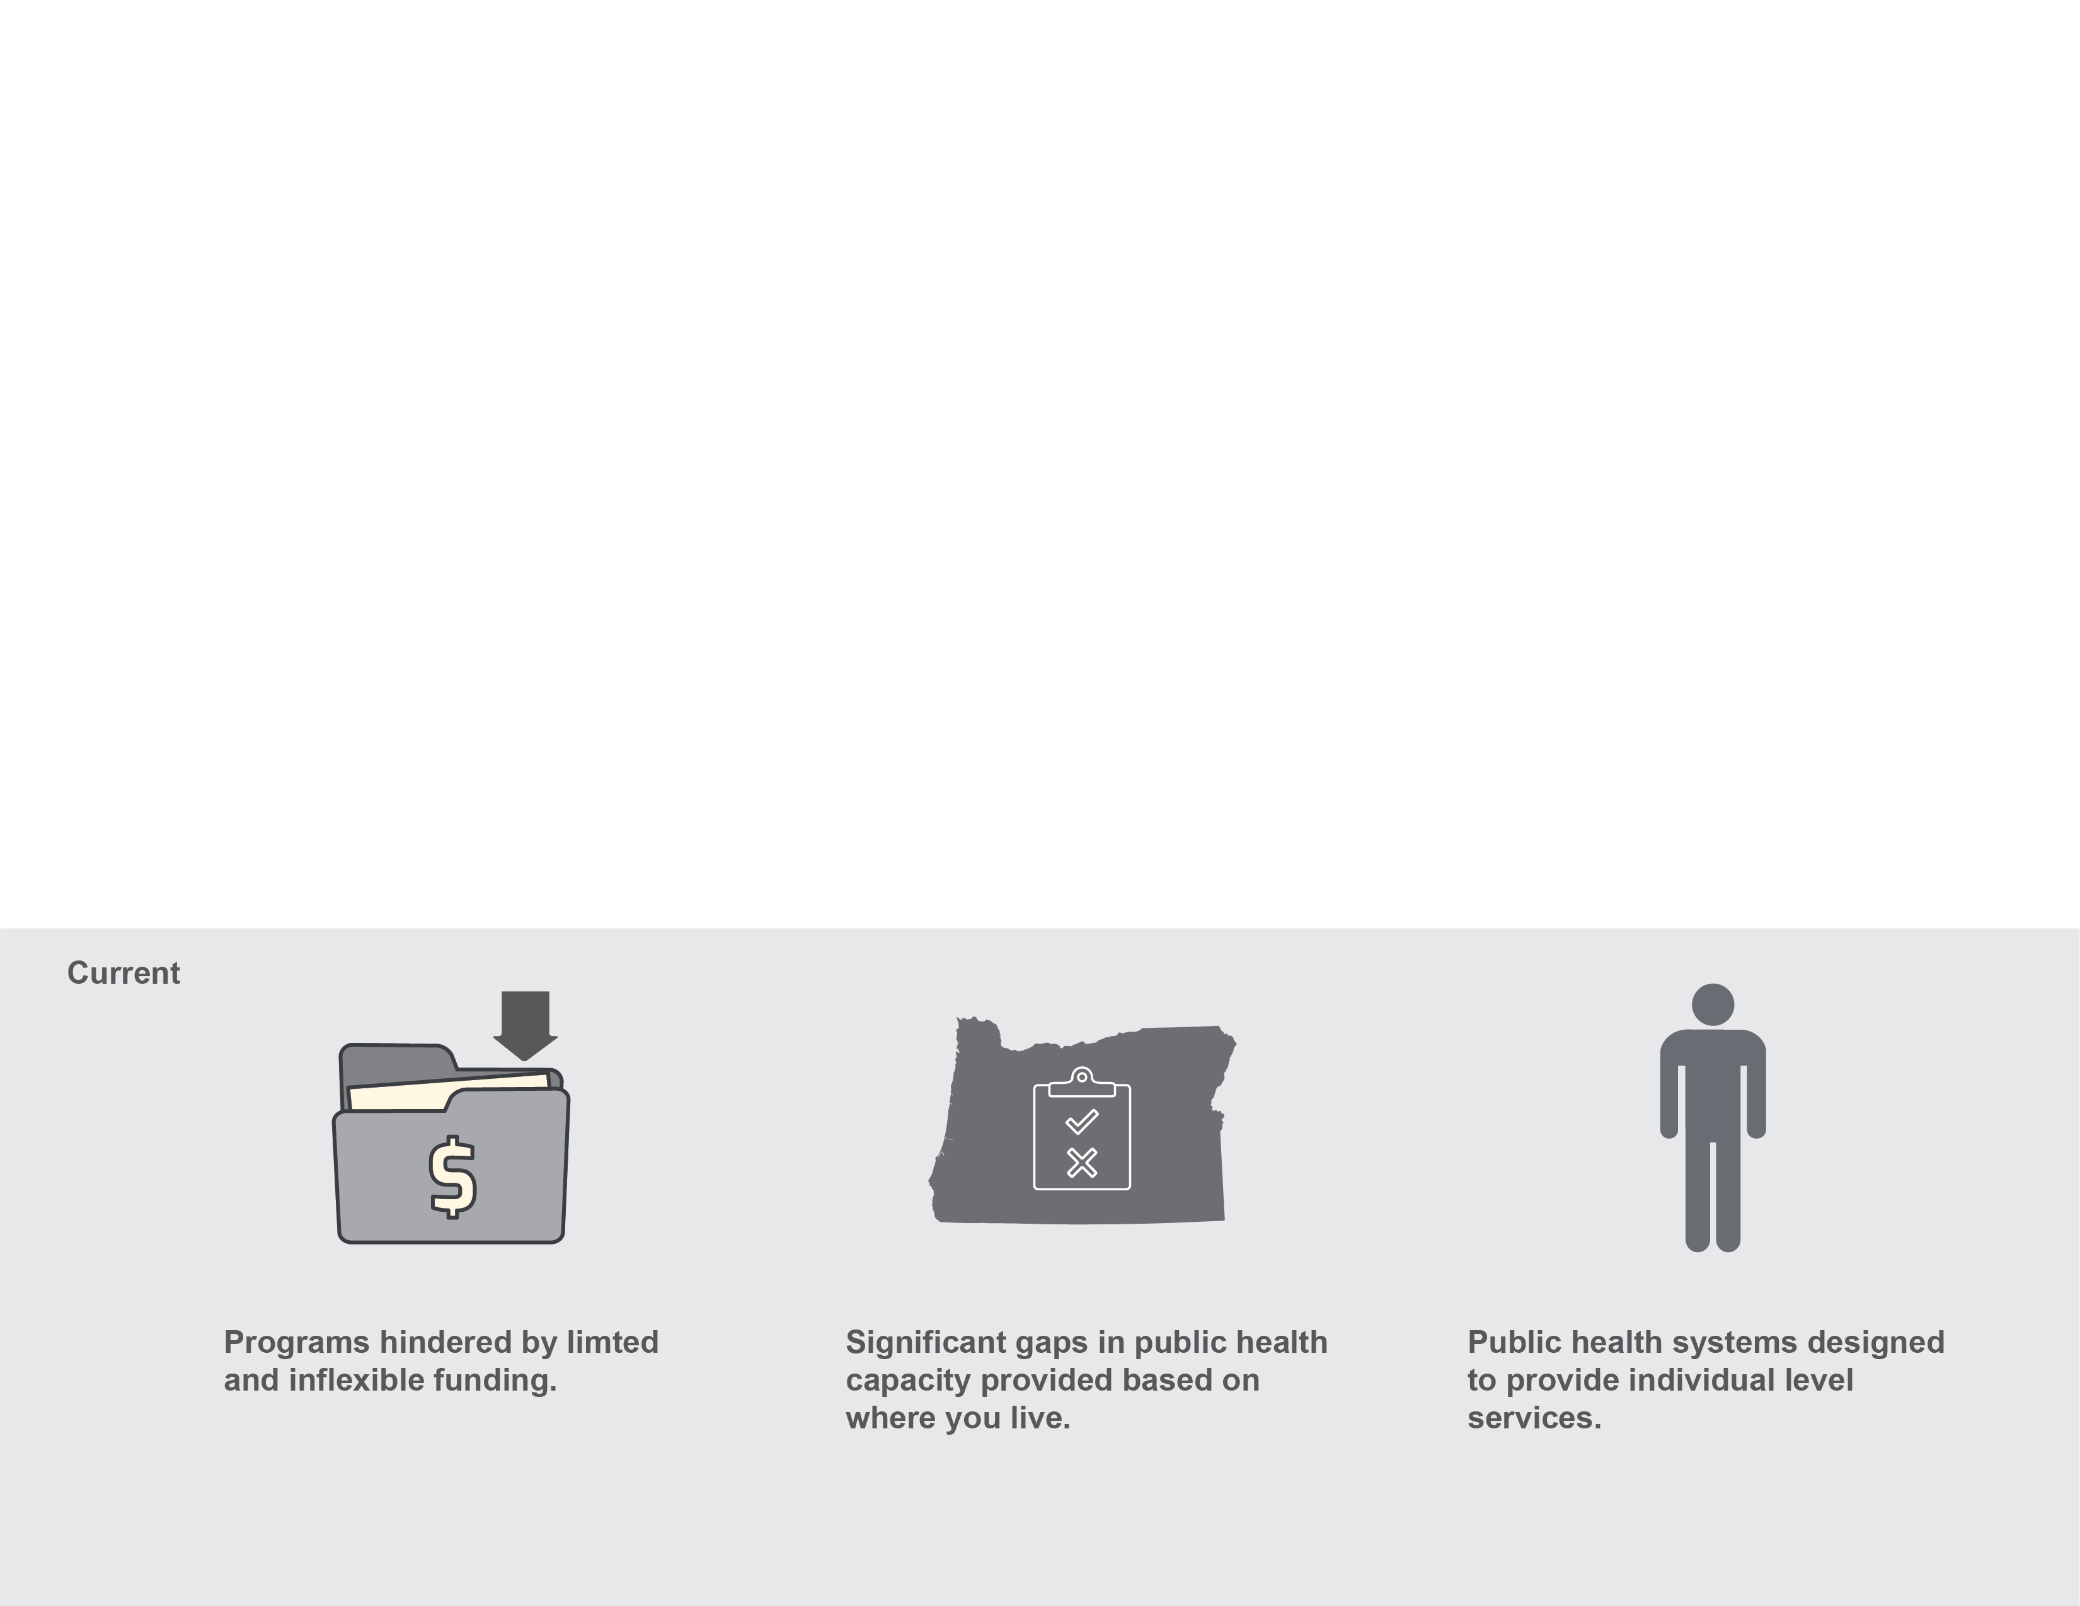
Why We Need a New Model
Notes:
Currently, Oregon’s public health system suffers from a lack of funding to support skills and systems that support effective programs. Specific programs are supported by inflexible and categorical grants
There are significant gaps in public health capacity and coverage based on where you live
the system is designed to provide individual level services.

Slide 11
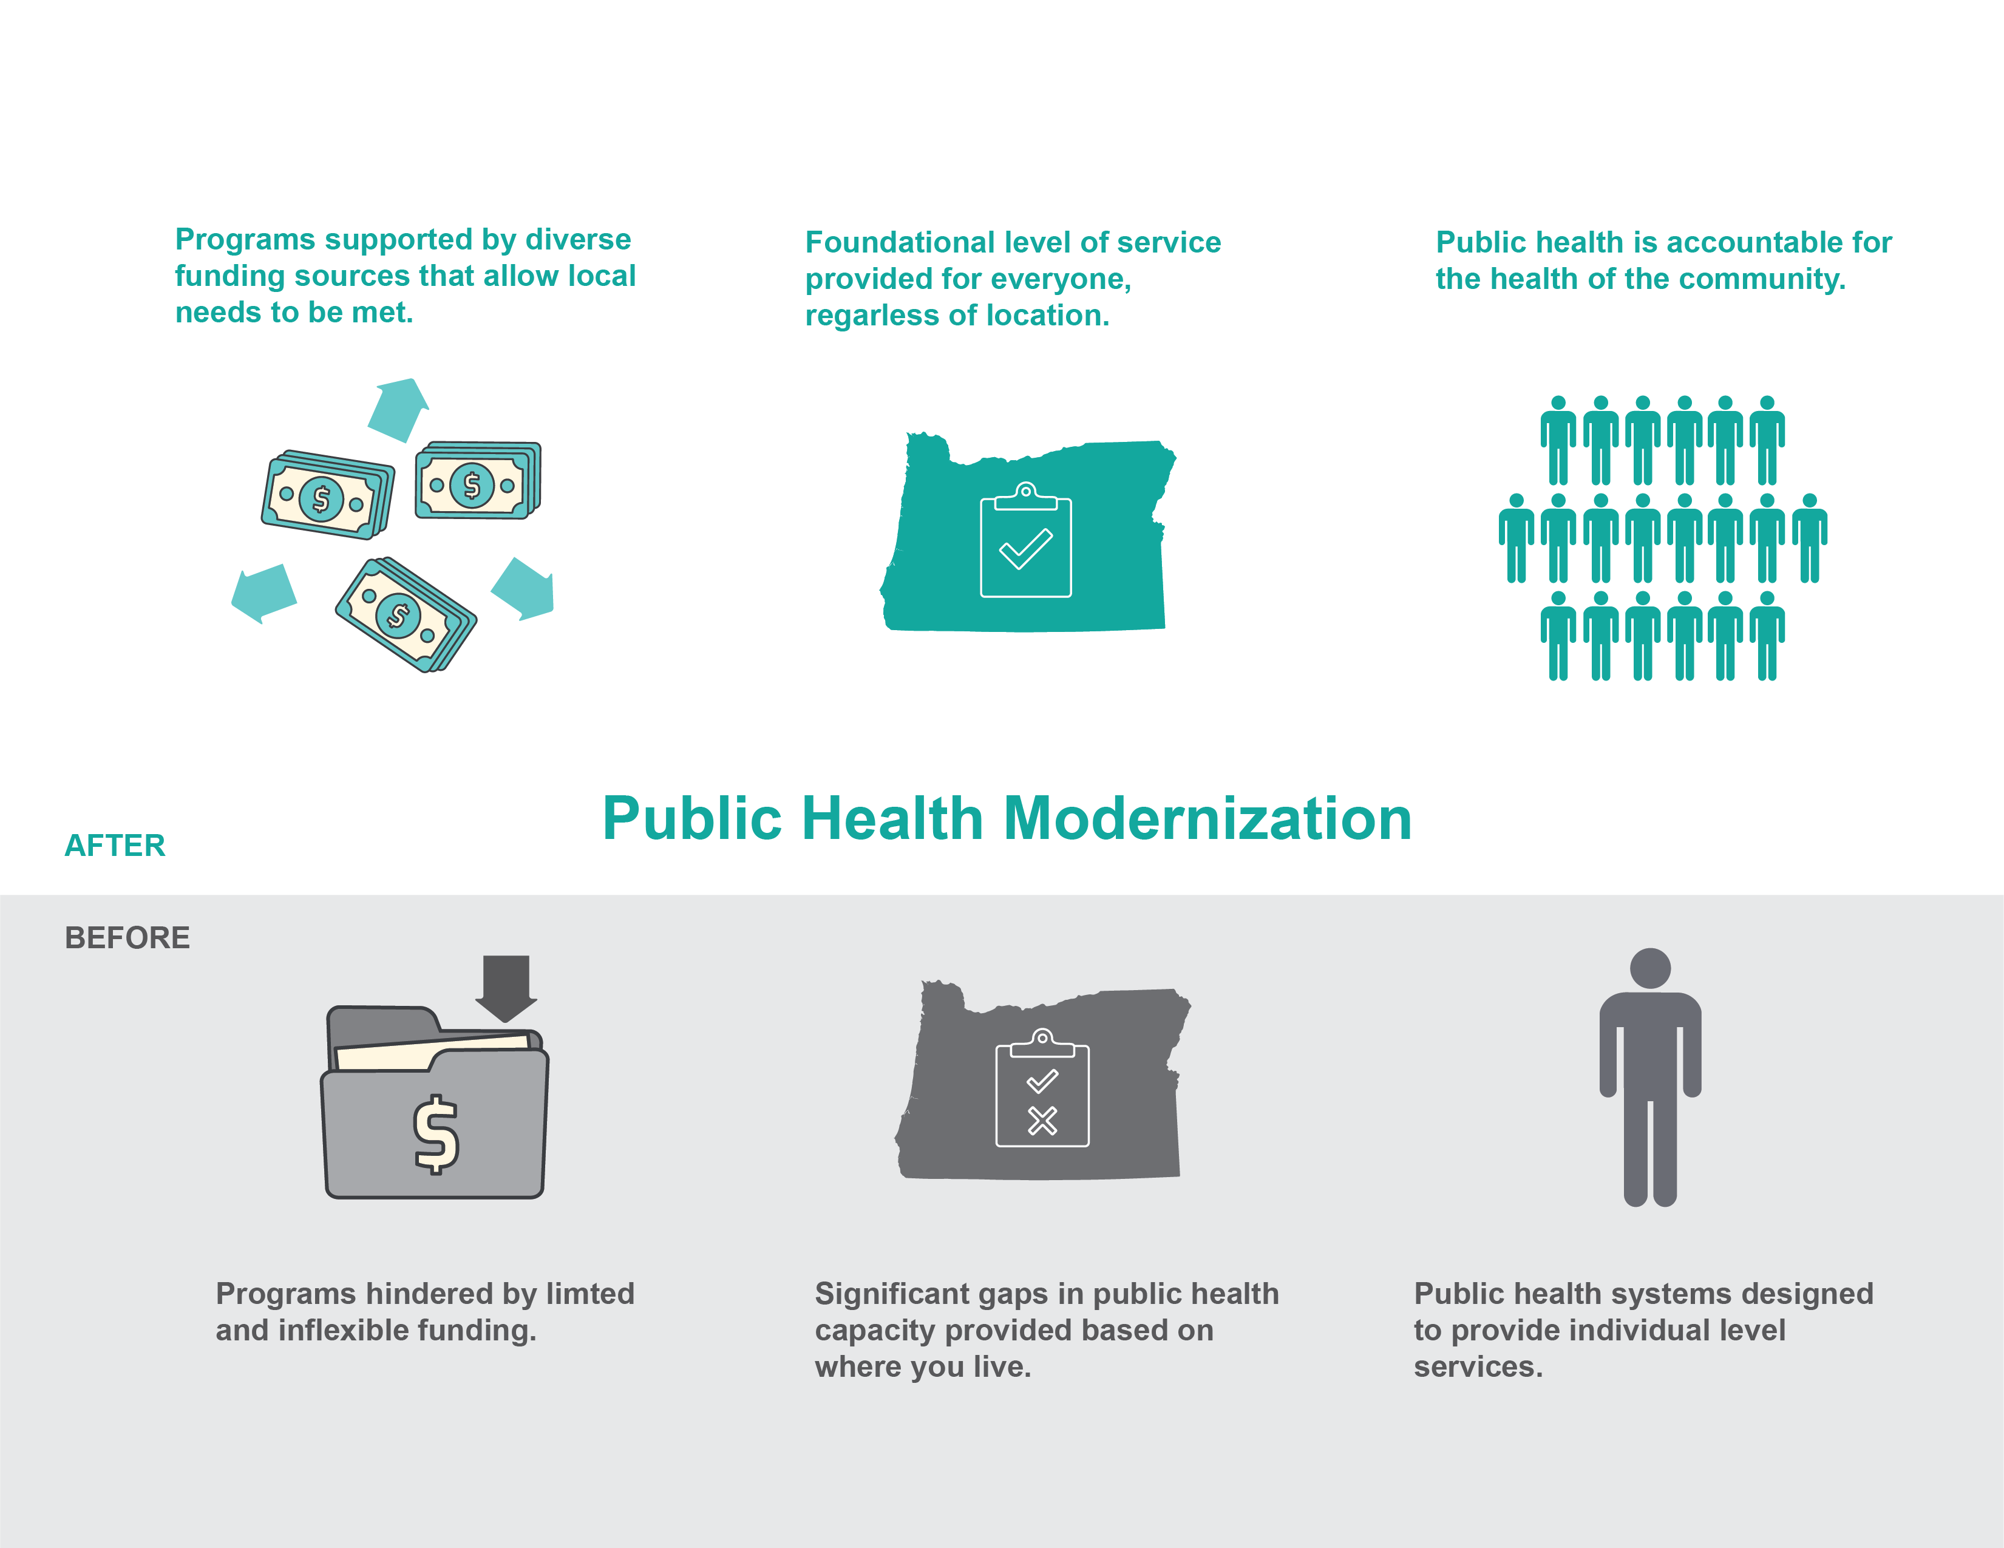
Why We Need a New Model
Notes:
Public health modernization will provide the structure and funding to support the skills, resources, and programs to help fully address health needs of every community in Oregon.
basic comprehensive programs are delivered to all in Oregon.
Public health is accountable to the health of the community.

Slide 12
Where Do We Go From Here?
In 2017, the legislature allocated $5 million to implement public health modernization
$3.9 million was allocated to Local Health Departments
Dissemination of this money to Local Health Departments was done through a competitive grant process, for projects focused on communicable disease
Notes:
We need to focus our resources on targeted programs and skills that build upon existing capacity and fill identified gaps. The Public Health Advisory Board is recommending that Oregon’s public health system first focus on:
Capacity to investigate and respond to disease outbreaks.
Ability to identify and prevent environmental health hazards, including air toxics and lead.
Promote health equity through partnerships and engagement with communities that experience an excess burden of disease and death.
Access to local, timely and accurate population health data that helps drive community-based decision-making and resource allocation.

Slide 13
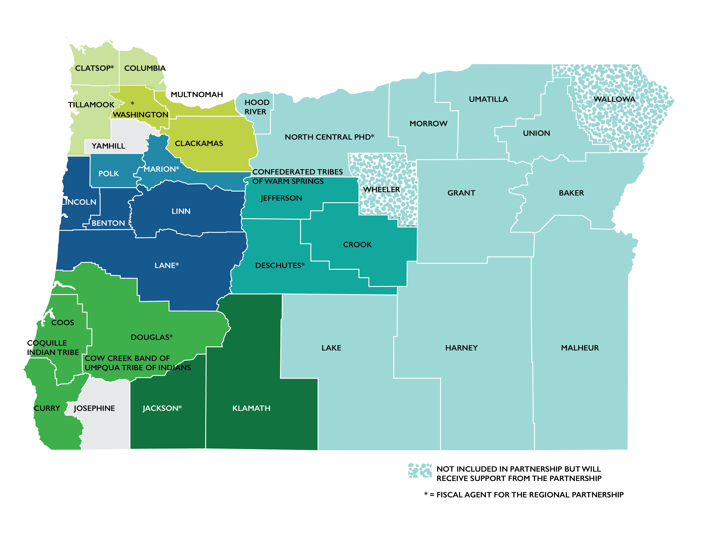
Local Public Health Modernization Grantees
Notes:
This map shows regional partnerships that have formed to begin modernizing the communicable disease prevention in Oregon

Slide 14
Add Contact Information

