Slide 1


Aligning National Public Health Accreditation & Modernization
Caitlin Hill, CLHO
Jill Hutson, Rede Group
Notes:
CAITLIN

Slide 2
Learning Objectives
By the end of the webinar participants will be able to:
Gain insight into ways that the deliverables of public health modernization can crosscut with the domains of public health accreditation;
Make use of a template that can help local health departments in aligning the priorities of their Community Health Improvement Plan, Agency Strategic Plan, and key operations with the goals of public health modernization and accreditation;
Identify 1 – 2 public health modernization priorities that align with current public health initiatives at their local health department.
Notes:
CAITLIN

Slide 3
Zoom Webinar Technology Test
Raise your hand if you had breakfast this morning
In the chat box type what you had for breakfast
Poll:
  Describe your experience with accreditation
Notes:
ALEX
The chat, Q&A, and raise hand features can be accessed by clicking the icons found in the black rectangle at the top or bottom of your screen.
Chat
The chat feature allows you to send a message to the host, panelists, and attendees. If you have a comment you would like to make to the host, panelists, or the entire group you can type the comment in here and the host and participants will be notified to look at the chat box.
Q & A
The Q&A feature can be used to type in questions to the host or panelists throughout the webinar. The host and panelist can then choose to answer your question by typing into the Q&A window or by answering verbally.
Raise Hand
You can raise your hand by selecting this icon during the webinar to indicate that you need something from the host. For our purposes we will use this feature to indicate that you would like to speak out loud to either ask a question or make a comment. The host can then enable the participant to speak through the webinar.
Polling
If the host has decided to incorporate polling into the webinar the host will begin the polling and the polling question will appear on your screen. You will then have the opportunity to select your answer. After the host has closed the polling the results will be displayed on the screen.

Slide 4
Why Look for Alignment in Modernization and Accreditation?
Use resources efficiently
Avoid duplication
Identify starting points for modernization work
Natural fit
Notes:
Although many components of modernization call for innovation in public health practice, several of the core deliverables of modernization align well with existing public health goals. In particular, the aims of Oregon’s public health modernization overlap with the national Public Health Accountability Board’s (PHAB) Standards and Measures for Accreditation. Thinking about the alignment of the modernization and accreditation goals may help local health departments plan for both sets of deliverables in a manner that uses resources efficiently and avoids duplication. As modernization is a relatively newer process for public health in Oregon, finding alignment with accreditation processes may indicate starting points for modernization work. Also, when you look closely at the deliverables relating to modernization and accreditation as we will today you can see areas of natural overlap such as goals around cross sector and community collaboration or ongoing quality improvement.
To support public health in this work, the AIMHI Public Health Modernization Roadmap includes two tools (“crosswalks”) that demonstrate specific areas of alignment between modernization and accreditation.

Slide 5
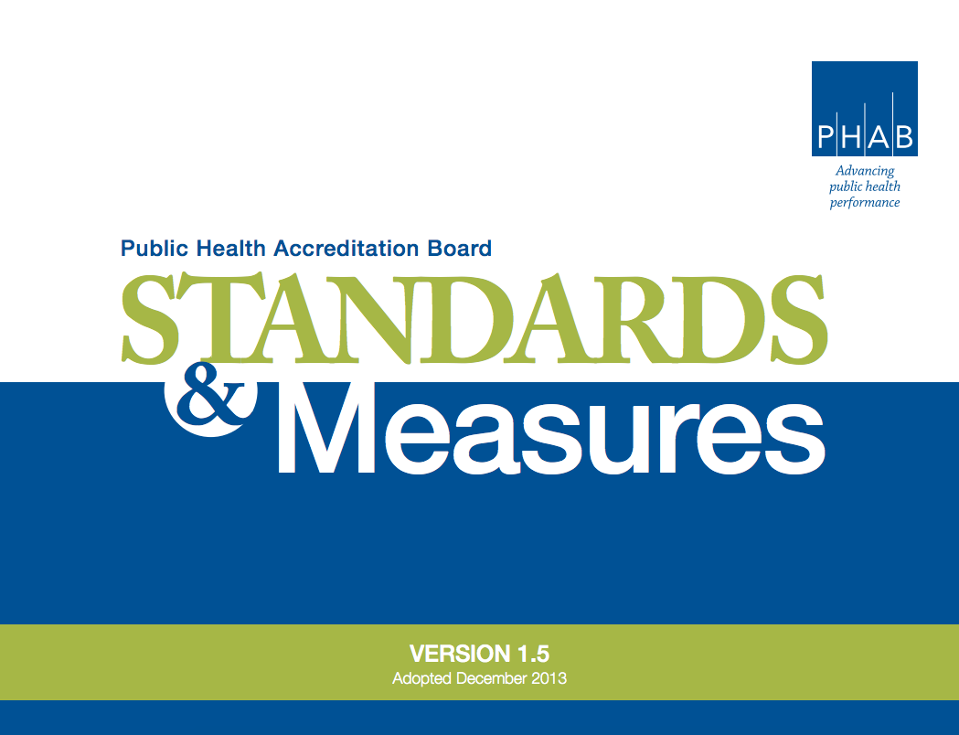
Public Health Accreditation
Notes:
Improves and protects the health of every community by advancing the quality and performance of public health departments.
The national Public Health Accreditation Board provides guidance with accreditation. It’s Standards and Measures are found in the manual here which we draw from in the tools we will be showing you today.

Slide 6
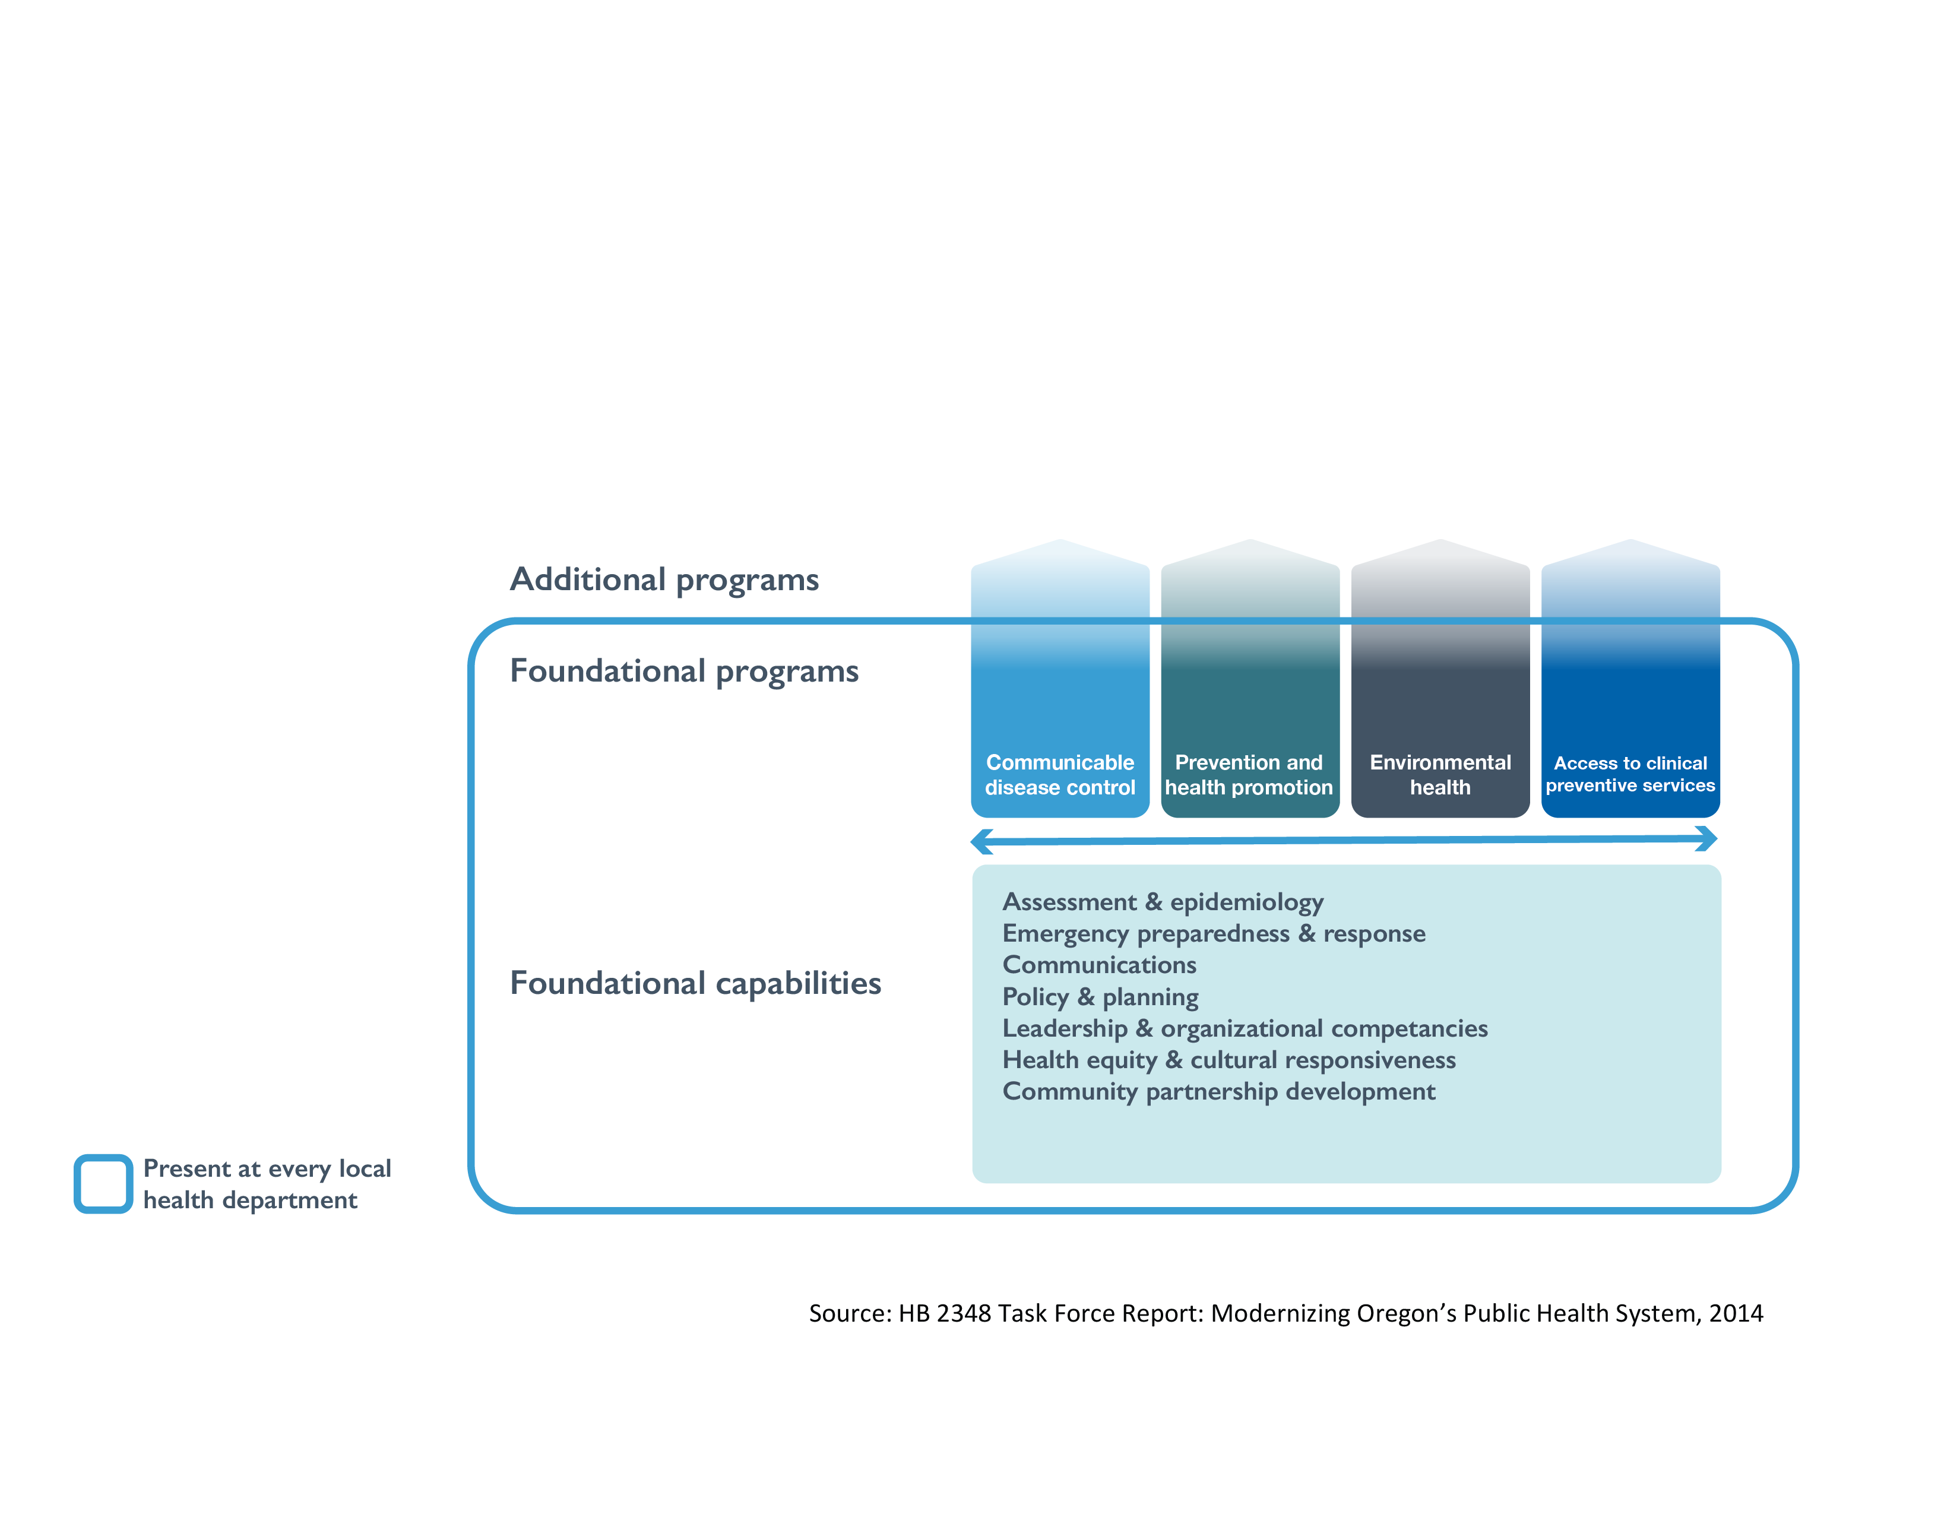
Public Health Modernization
Notes:
Public Health Modernization creates a public health system for the future through: adoption of the foundational capabilities and programs in all public health jurisdictions, sustained state funding, for the public health system, and adoption of population health metrics.

Slide 7
Oregon Public Health Modernization Roadmap Tools

Slide 8
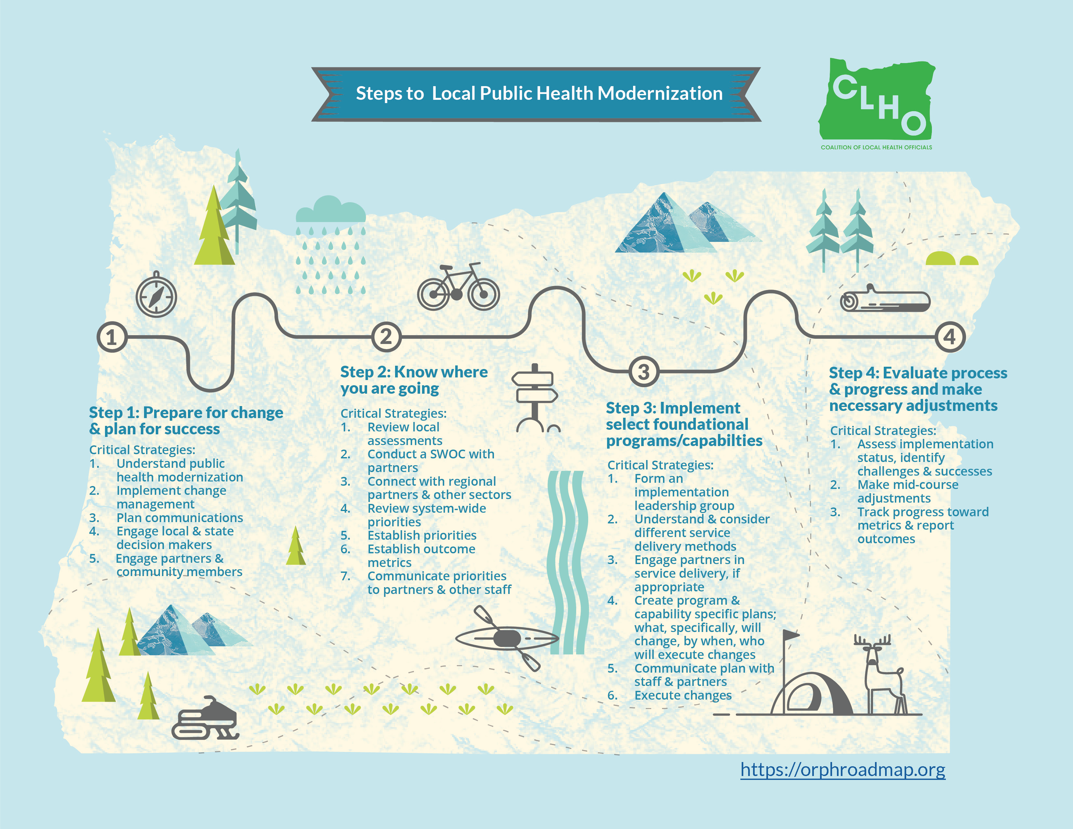
Notes:
You can access the tools we will discuss today on [website page] of the AIMHI Public Health Modernization Roadmap Website

Slide 9
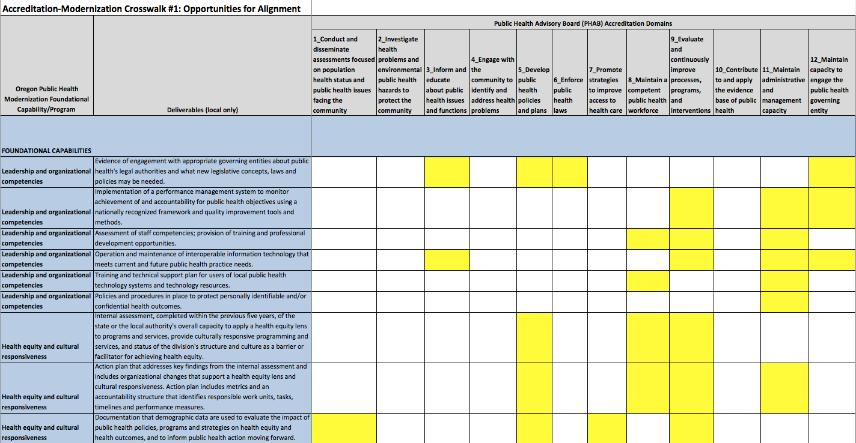
Notes:
Accreditation-Modernization Crosswalk #1: Opportunities for Alignment
Crosswalk #1 is intended for health department administrators and public health staff working in the area of accreditation. Crosswalk #1 suggests areas of alignment between local deliverables set out in Oregon’s public health modernization foundational capabilities and programs (see Public Health Modernization Manual (2017)) and the 12 domains of the national Public Health Accreditation Board’s Standards and Measures (2015). This crosswalk is meant to provide public health practitioners with an example of how to envision, organize and operationalize the ways that modernization work is achievable and in tandem with other public health goals.
Using this tool:
Review the Oregon Public Health Modernization Foundational Capabilities and Programs along with their local deliverables on the first two left columns of the table (shaded in blue).
Review the PHAB Accreditation Domains on the top row of the table (shaded in grey).
Familiarize self with the description of the PHAB Accreditation Domains by reviewing PHAB Standards and Measures (2015) manual.
Identify the areas where the modernization capabilities/programs and deliverables match up with the PHAB domains (shaded in yellow). Use these matching points as a starting point for reflection and discussion at your health department. Your health department may be able to find additional ways that the goals of accreditation and modernization can be met in tandem.
Begin modernization projects that can also meet the goals of accreditation.

Slide 10
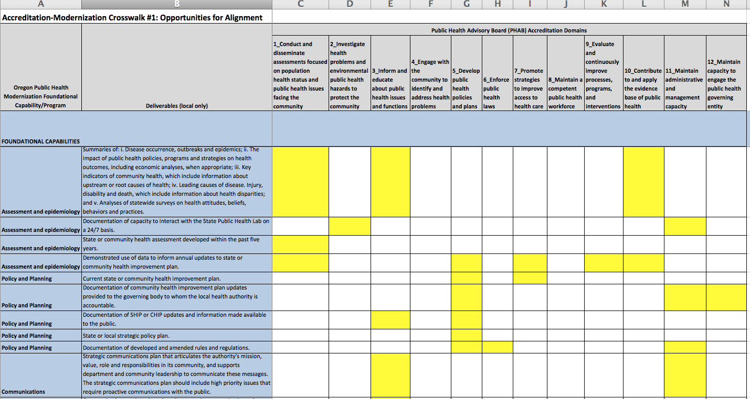
Notes:
Here we can look specifically at one point of alignment where accreditation Domain 1 (Conduct and disseminate assessments focused on population health status and public health issues facing the community) aligns with a modernization capability and its deliverable (Assessment and Epidemiology: State or community health assessment developed within the past five years)

Slide 11
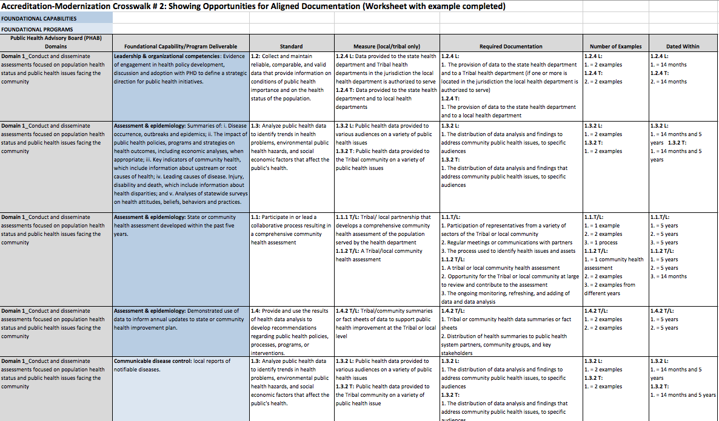
Notes:
Accreditation-Modernization Crosswalk # 2: Opportunities for Aligned Documentation (Worksheet Example - excel document - Sheet 2):
Crosswalk #2 is also intended for health department administrators and public health staff working in the area of accreditation. This document is a worksheet where public health staff, using information from Crosswalk #1, can identify required documentation for specific accreditation domains that align with modernization capabilities and programs. Completing this worksheet will allow public health staff to track how progress towards accreditation can also meets the goals of modernization.
Using this tool:
Write down the PHAB domains that matched with the modernization capabilities and programs in Crosswalk #1 in the first column of the table (those shaded in yellow). (Some examples have been provided using PHAB Domain 1: Conduct and disseminate assessments focused on population health status and public health issues facing the community.)
Fill in the modernization capabilities and programs that align with the PHAB domains as identified in Crosswalk #1 in the second column of the table (those shaded in yellow).
For the remaining columns use the PHAB Standards and Measures (2015) manual to complete the appropriate columns for the PHAB Standards and Measures (local/tribal only) as well as identify any Required Documentation (including examples).

Slide 12
Notes:
Let’s look back at Crosswalk #1 to find the information we want to plug into Crosswalk #2. We could use the circled example of alignment where we marked off Domain 1 as aligning with the Assessment and Epidemiology deliverable of State or community health assessment developed within the past five years.

Slide 13
Notes:
On our worksheet for Crosswalk #2 we’d type in the modernization deliverable that matches with the domain (blue column).

Slide 14
Notes:
Next, we’d look to the PHAB manual to find the Standard and Measure that best fits with that deliverable

Slide 15
Notes:
From there we would use the information in the PHAB manual to identify the necessary documentation, examples and timeframe required for accreditation.

Slide 16
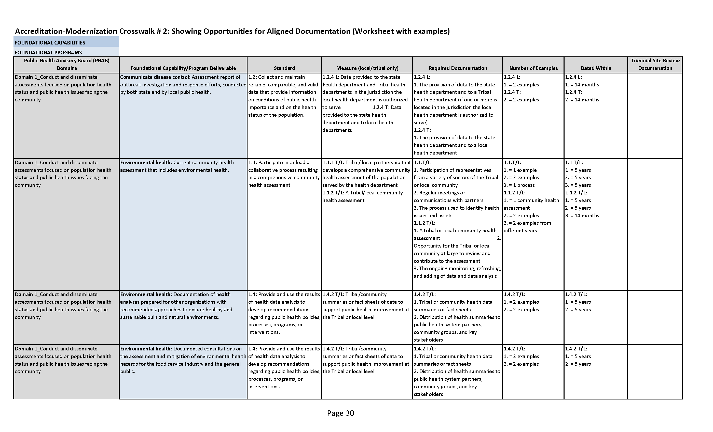
Triennial Site Review Documentation
For a more comprehensive table:
Add Triennial Site Review Documentation

Slide 17
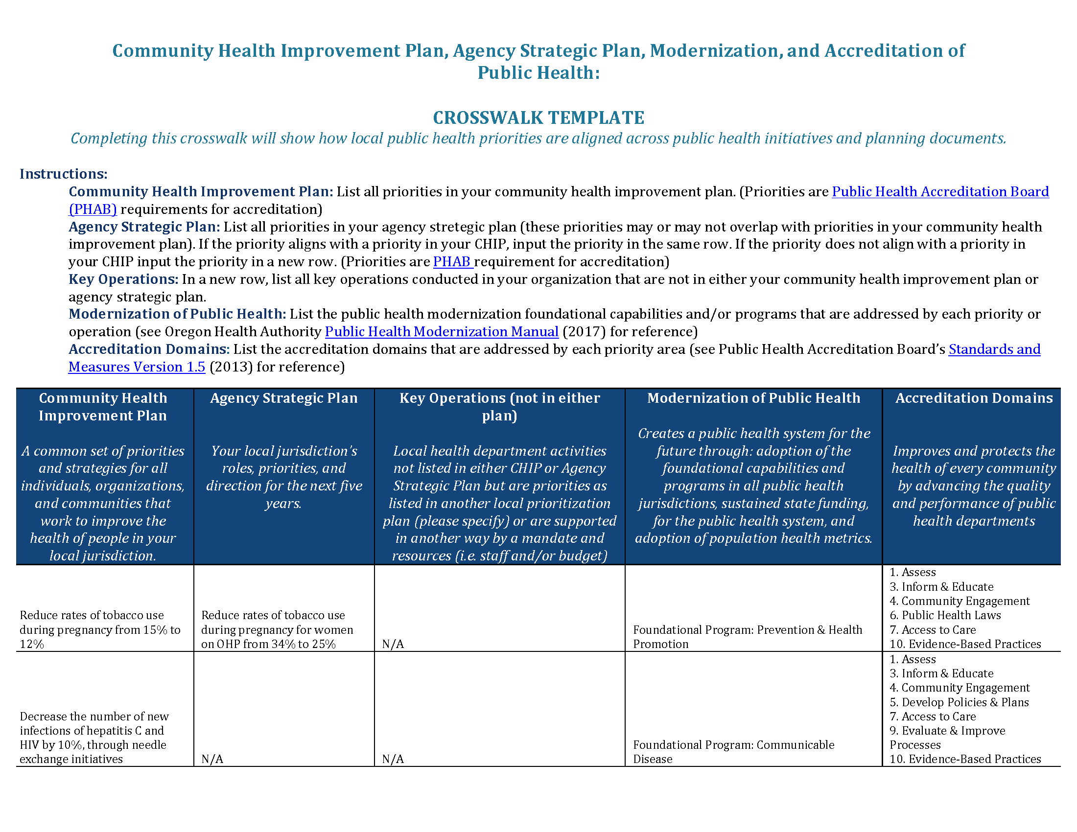
Notes:
This document is also intended for health department administrators and public health staff working in the area of accreditation. The document is an applied worksheet that asks public health practitioners to list their priorities associated with their CHIP, Agency Strategic Plan and other key operations and then to align these with priorities in the Public Health Modernization Manual (2017) and with PHAB’s accreditation domains. Completing this crosswalk will show how local public health health priorities are aligned across public health initiatives and planning documents.
Using this Tool:
Community Health Improvement Plan: List all priorities in your community health improvement plan. (Priorities are Public Health Accreditation Board (PHAB) requirement for accreditation)
Agency Strategic Plan: List all priorities in your community health improvement plan (these priorities may or may not overlap with priorities in your community health improvement plan). If the priority aligns with a priority in your CHIP input the priority in the same row, if the priority does not align with a priority in your CHIP input the priority in a new row. (Priorities are PHAB requirement for accreditation)
Key Operations: In a new row, list all key operations conducted in your organization that are not in either your community health improvement plan or agency strategic plan.
Modernization of Public Health: List the public health modernization foundational capabilities and/or programs that are addressed by each priority or operation (see Oregon Health Authority Public Health Modernization Manual (2017) for reference)
Accreditation Domains: List the accreditation domains that are addressed by each priority area (see Public Health Accreditation Board’s Standards and Measures Version 1.5 (2013) for reference)

Slide 18
Questions or comments?

Slide 19
Future Questions
For questions regarding the AIMHI Roadmap contact:
Caitlin Hill caitlin@oregonclho.org
Notes:
CAITLIN

