Slide 1

Communication Planning for Public Health Modernization
Caitlin Hill, CLHO
Jennifer Chu, McCabe Message Partners
Robb Hutson, The Rede Group
Notes:
Caitlin:

Slide 2
Learning Objectives
By the end of the webinar participants will be able to:
Understand the "movable center" and how to tailor messages to them.
Locate communications planning and preparation tools on the CLHO Modernization Roadmap Website.
Identify ways that communications tools can be used from the CLHO Modernization Roadmap website and make use of these tools to improve communications outputs.
Notes:
Robb:

Slide 3
Zoom Webinar Technology Test
Raise your hand if you went out of town over the holidays
In the chat box type where you went during the holidays or if you stayed home type that in
Notes:
Robb:
The chat, Q&A, and raise hand features can be accessed by clicking the icons found in the black rectangle at the top or bottom of your screen.
Chat
The chat feature allows you to send a message to the host, panelists, and attendees. If you have a comment you would like to make to the host, panelists, or the entire group you can type the comment in here and the host and participants will be notified to look at the chat box.
Q & A
The Q&A feature can be used to type in questions to the host or panelists throughout the webinar. The host and panelist can then choose to answer your question by typing into the Q&A window or by answering verbally.
Raise Hand
You can raise your hand by selecting this icon during the webinar to indicate that you need something from the host. For our purposes we will use this feature to indicate that you would like to speak out loud to either ask a question or make a comment. The host can then enable the participant to speak through the webinar.
Polling (if applicable)
If the host has decided to incorporate polling into the webinar the host will begin the polling and the polling question will appear on your screen. You will then have the opportunity to select your answer. After the host has closed the polling the results will be displayed on the screen.

Slide 4
Using Public Polling
Public polling to inform communication approaches
Notes:
Jennifer:

Slide 5
Background – Methodology and Demographics
Public Opinion Strategies conducted a representative, statewide telephone survey in Oregon among N=500 registered voters from May 1-4, 2017.
Margin of error: +4.4%.
 | Registered Voter/Census Population Statistics | Survey*
Male | 49% | 48%
Female | 51% | 52%
Ages 18-44 | 44% | 41%
Ages 45+ | 56% | 59%
White | 88% | 87%
Total Non-White | 12% | 11%

Slide 6
Public health departments ranked in the second tier of organizations that were tested.
Various Organizations Importance In Creating A Healthy Community Ranked by % 10
Mean
Schools
Fire Departments
Hospitals
Police Departments
Libraries
Public Health Departments
Parks
9.1
9.2
9.0
8.7
7.9
7.8
7.9

Slide 7
CORE SUPPORTERS
Those sub-groups rating public health departments’ role as “very important” tend to be women (younger, moms, voters with lower levels of education and income, those working in health care, seniors, and those living in rural communities).

Slide 8
For these voters, these public health services resonated most/least
Public Health Department Services Personal Importance Ranked by % 10 | % 10 | % 8-10
Support women's and children's health, such as pre-natal care and appropriate nutritional assistance. | 50% | 75%
Help stop the spread of communicable diseases, such as meningitis, Salmonella, and the flu. | 47% | 78%
Bring others in government, like police and fire departments and state authorities, together to respond to public health emergencies, such as those resulting from natural and human caused disasters, and rebuild afterward. | 47% | 74%
Work with partners to help create strong local policies that support health, such as smoke-free workplace laws. | 26% | 50%

Slide 9
THE MOVABLE CENTER
Those sub-groups rating public health departments’ role as “somewhat important” tend to be men (independent, w/ college degrees, middle and upper class, aged 45-64, dads, and Republicans)

Slide 10
Zeroing in on the distinction between core supporters and the movable center, we see a difference in priorities, intensity, and uncover a divisive third rail in explaining public health to this group
 | % 10 | % 8-10
Help stop the spread of communicable diseases, such as meningitis, Salmonella, and the flu. | 22% | 63%
Bring others in government, like police and fire departments and state authorities, together to respond to public health emergencies, such as those resulting from natural and human caused disasters, and rebuild afterward. | 26% | 54%
Reach out to people that are at greatest risk of having poor health outcomes, such as the elderly, disabled, or low-income families. | 22% | 53%
Work with partners to help create strong local policies that support health, such as smoke-free workplace laws. | 9% | 24%

Slide 11
The Bottom Line
There is a “moveable center” that you need to reach in order to significantly increase support for public health.
The “moveable center” is more responsive to public health services around acute events. In terms of importance, ranked highest were:
  Helping to stop the spread of communicable diseases
  Coalescing other government agencies to respond to public health emergencies and rebuild
They feel public health should prioritize delivering population health services over direct health services.
So-called nanny state issues proved divisive with them

Slide 12
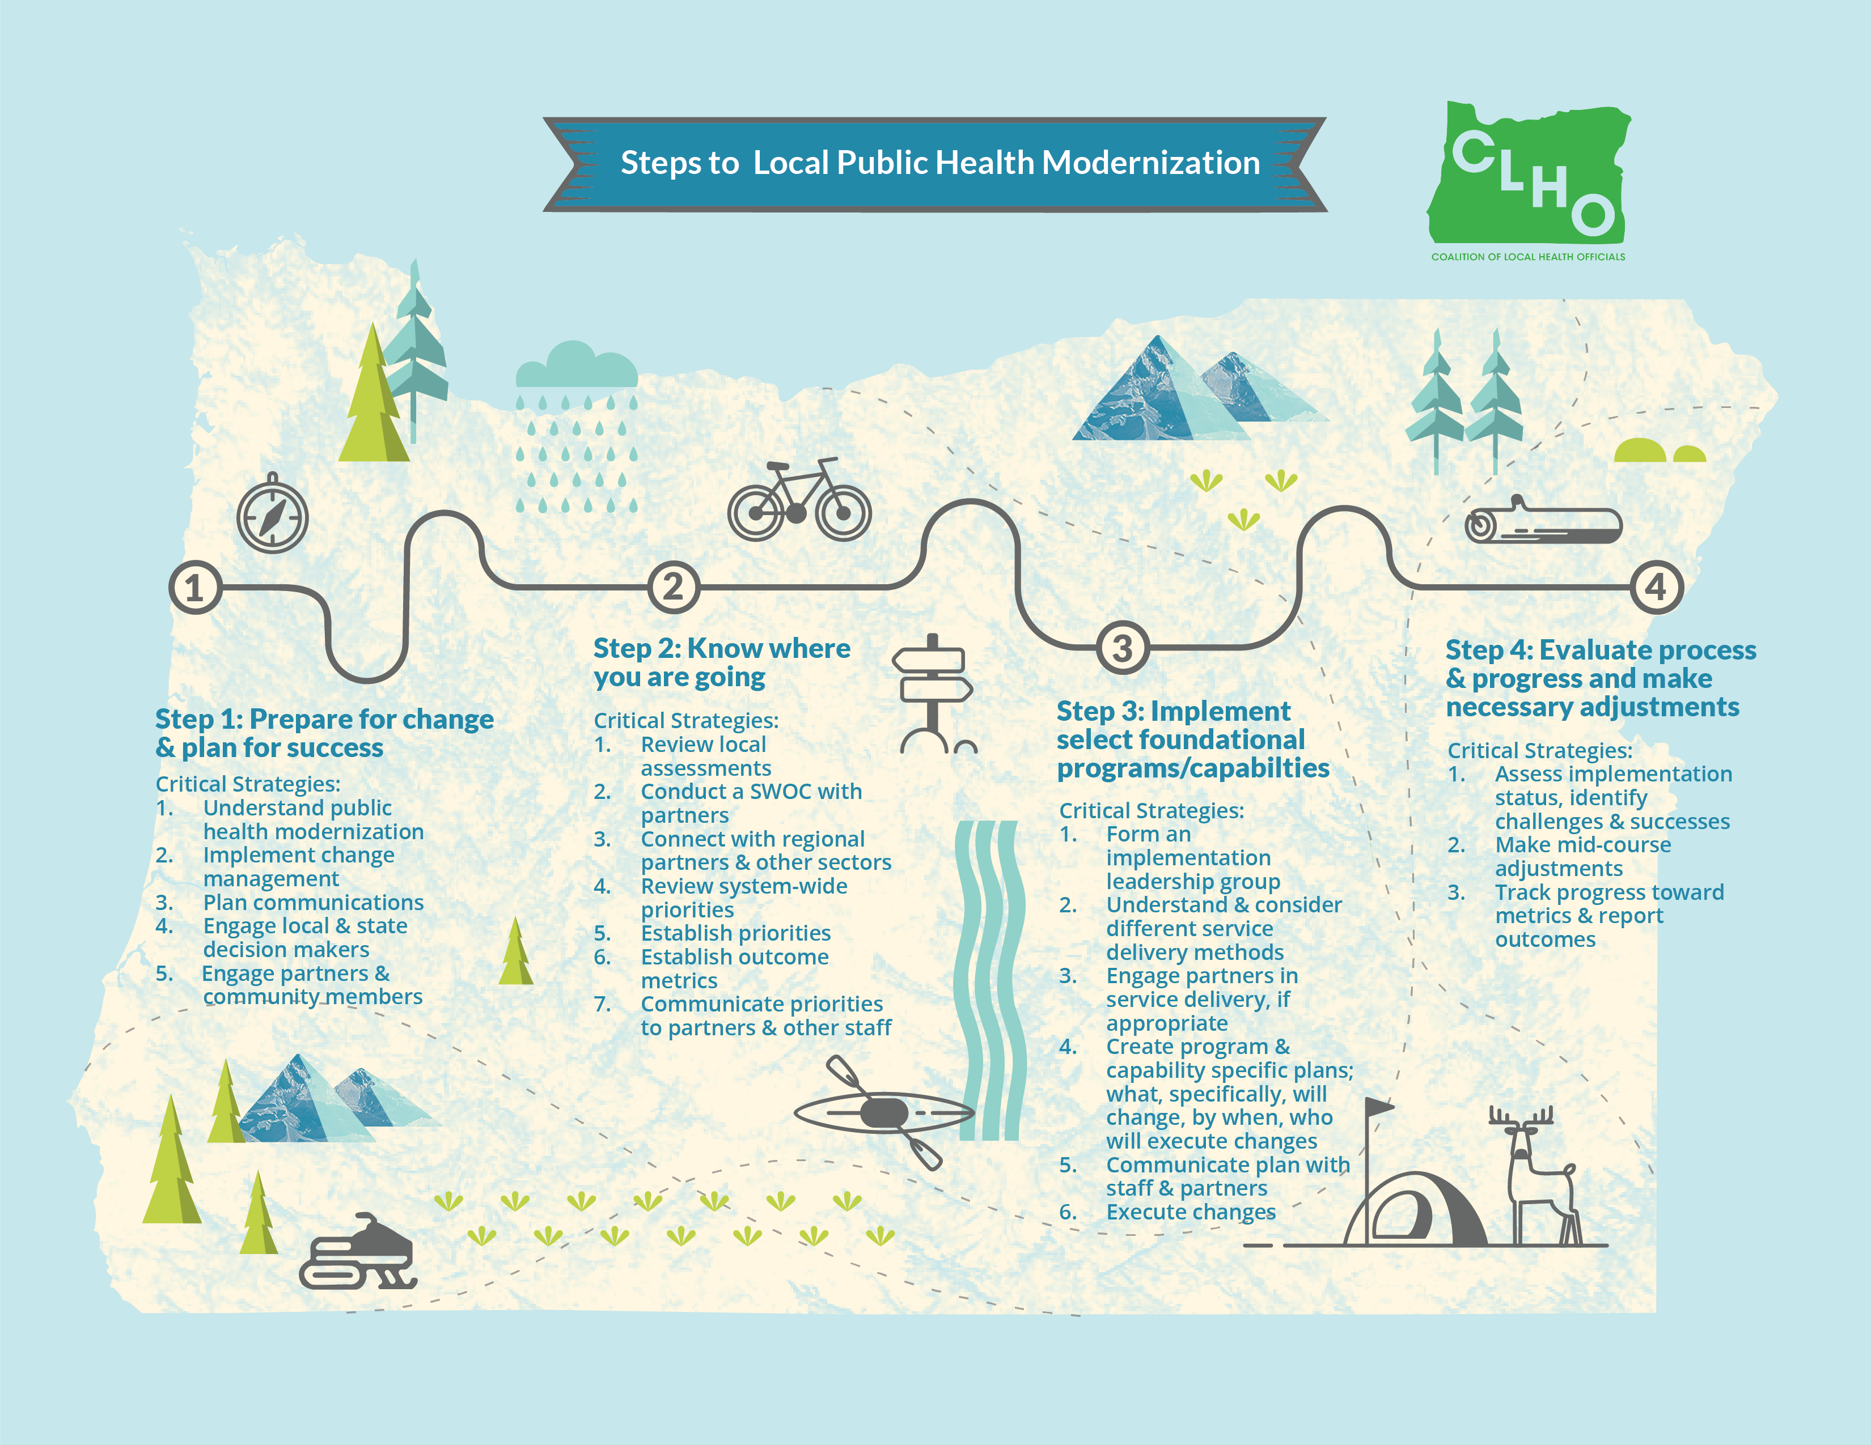
Notes:
Robb

Slide 13
Finding the communications tools on the
Oregon Public Health Roadmap website.
http://orphroadmap.org

Slide 14
Let’s take a quick poll!

Slide 15
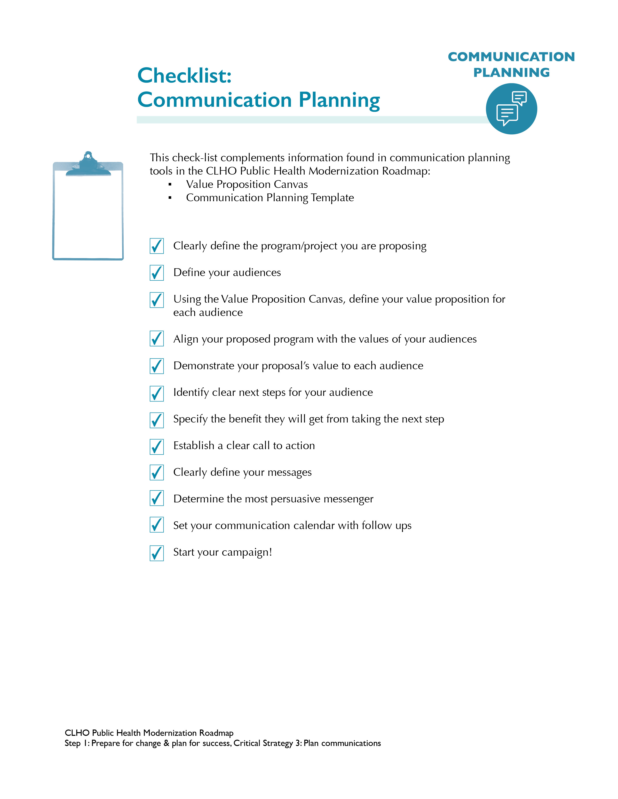
Notes:
Robb: I will go through each step on this checklist and how it pertains to communication for our audience

Slide 16
Checklist:
Communication Planning
Clearly define the program/project you are proposing
Define your audiences
Using the Value proposition Canvas, define your value proposition for each audience

Slide 17
Checklist:
Communication Planning
Align your proposed program with the values of your audiences
Demonstrate your proposal’s value to each audience
Identify clear next steps for your audience

Slide 18
Checklist:
Communication Planning
Specify the benefit they will get from taking the next step
Establish a clear call to action
Clearly define your message

Slide 19
Checklist:
Communication Planning
Determine the most persuasive messenger
Set your communication calendar and follow ups
Start your campaign

Slide 20
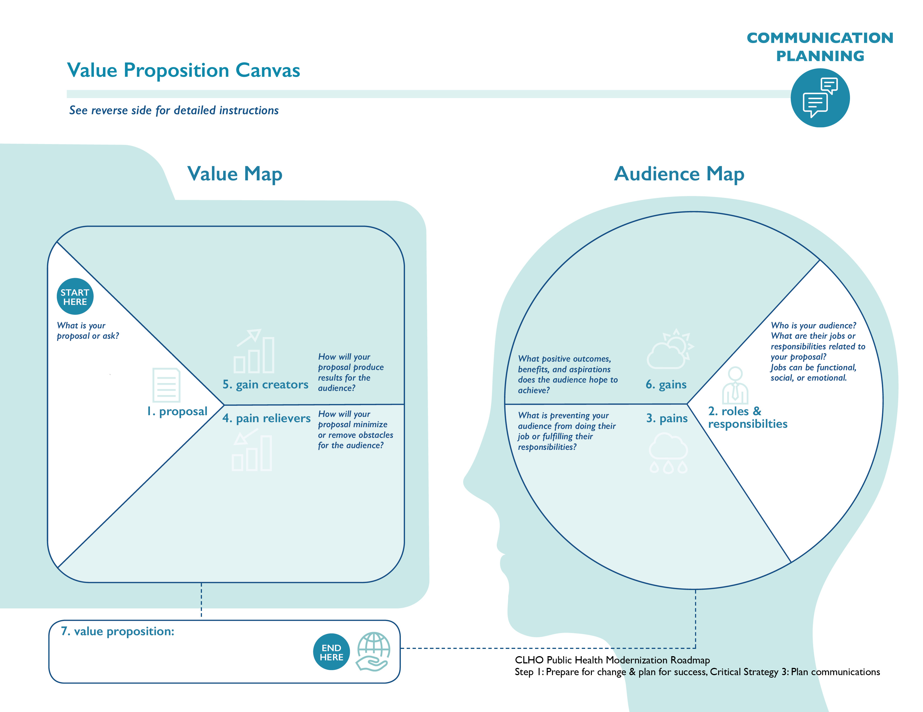
Notes:
Robb: Although the title of this canvas is demonstrating the value of public health to community partners, it has multiple applications. The value proposition canvas can be used for internal communication as well as communication with other counties, cities and partners who you want to work with. I may adjust this graphic to more county to county communication prior to the webinar

Slide 21
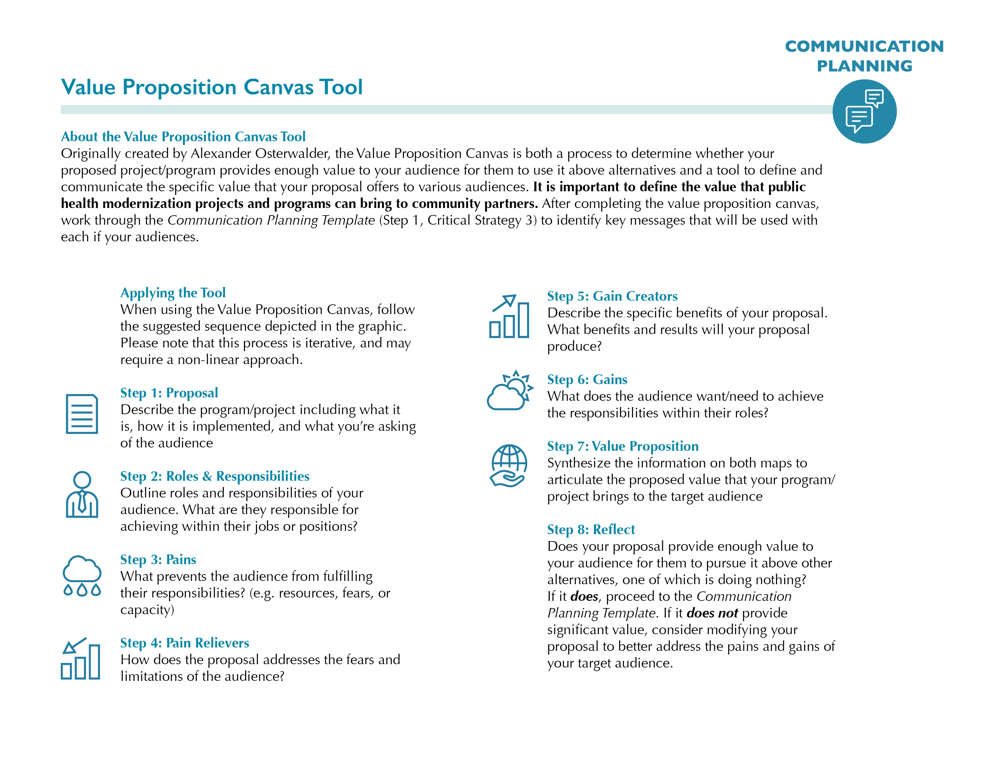
Notes:
Robb:

Slide 22
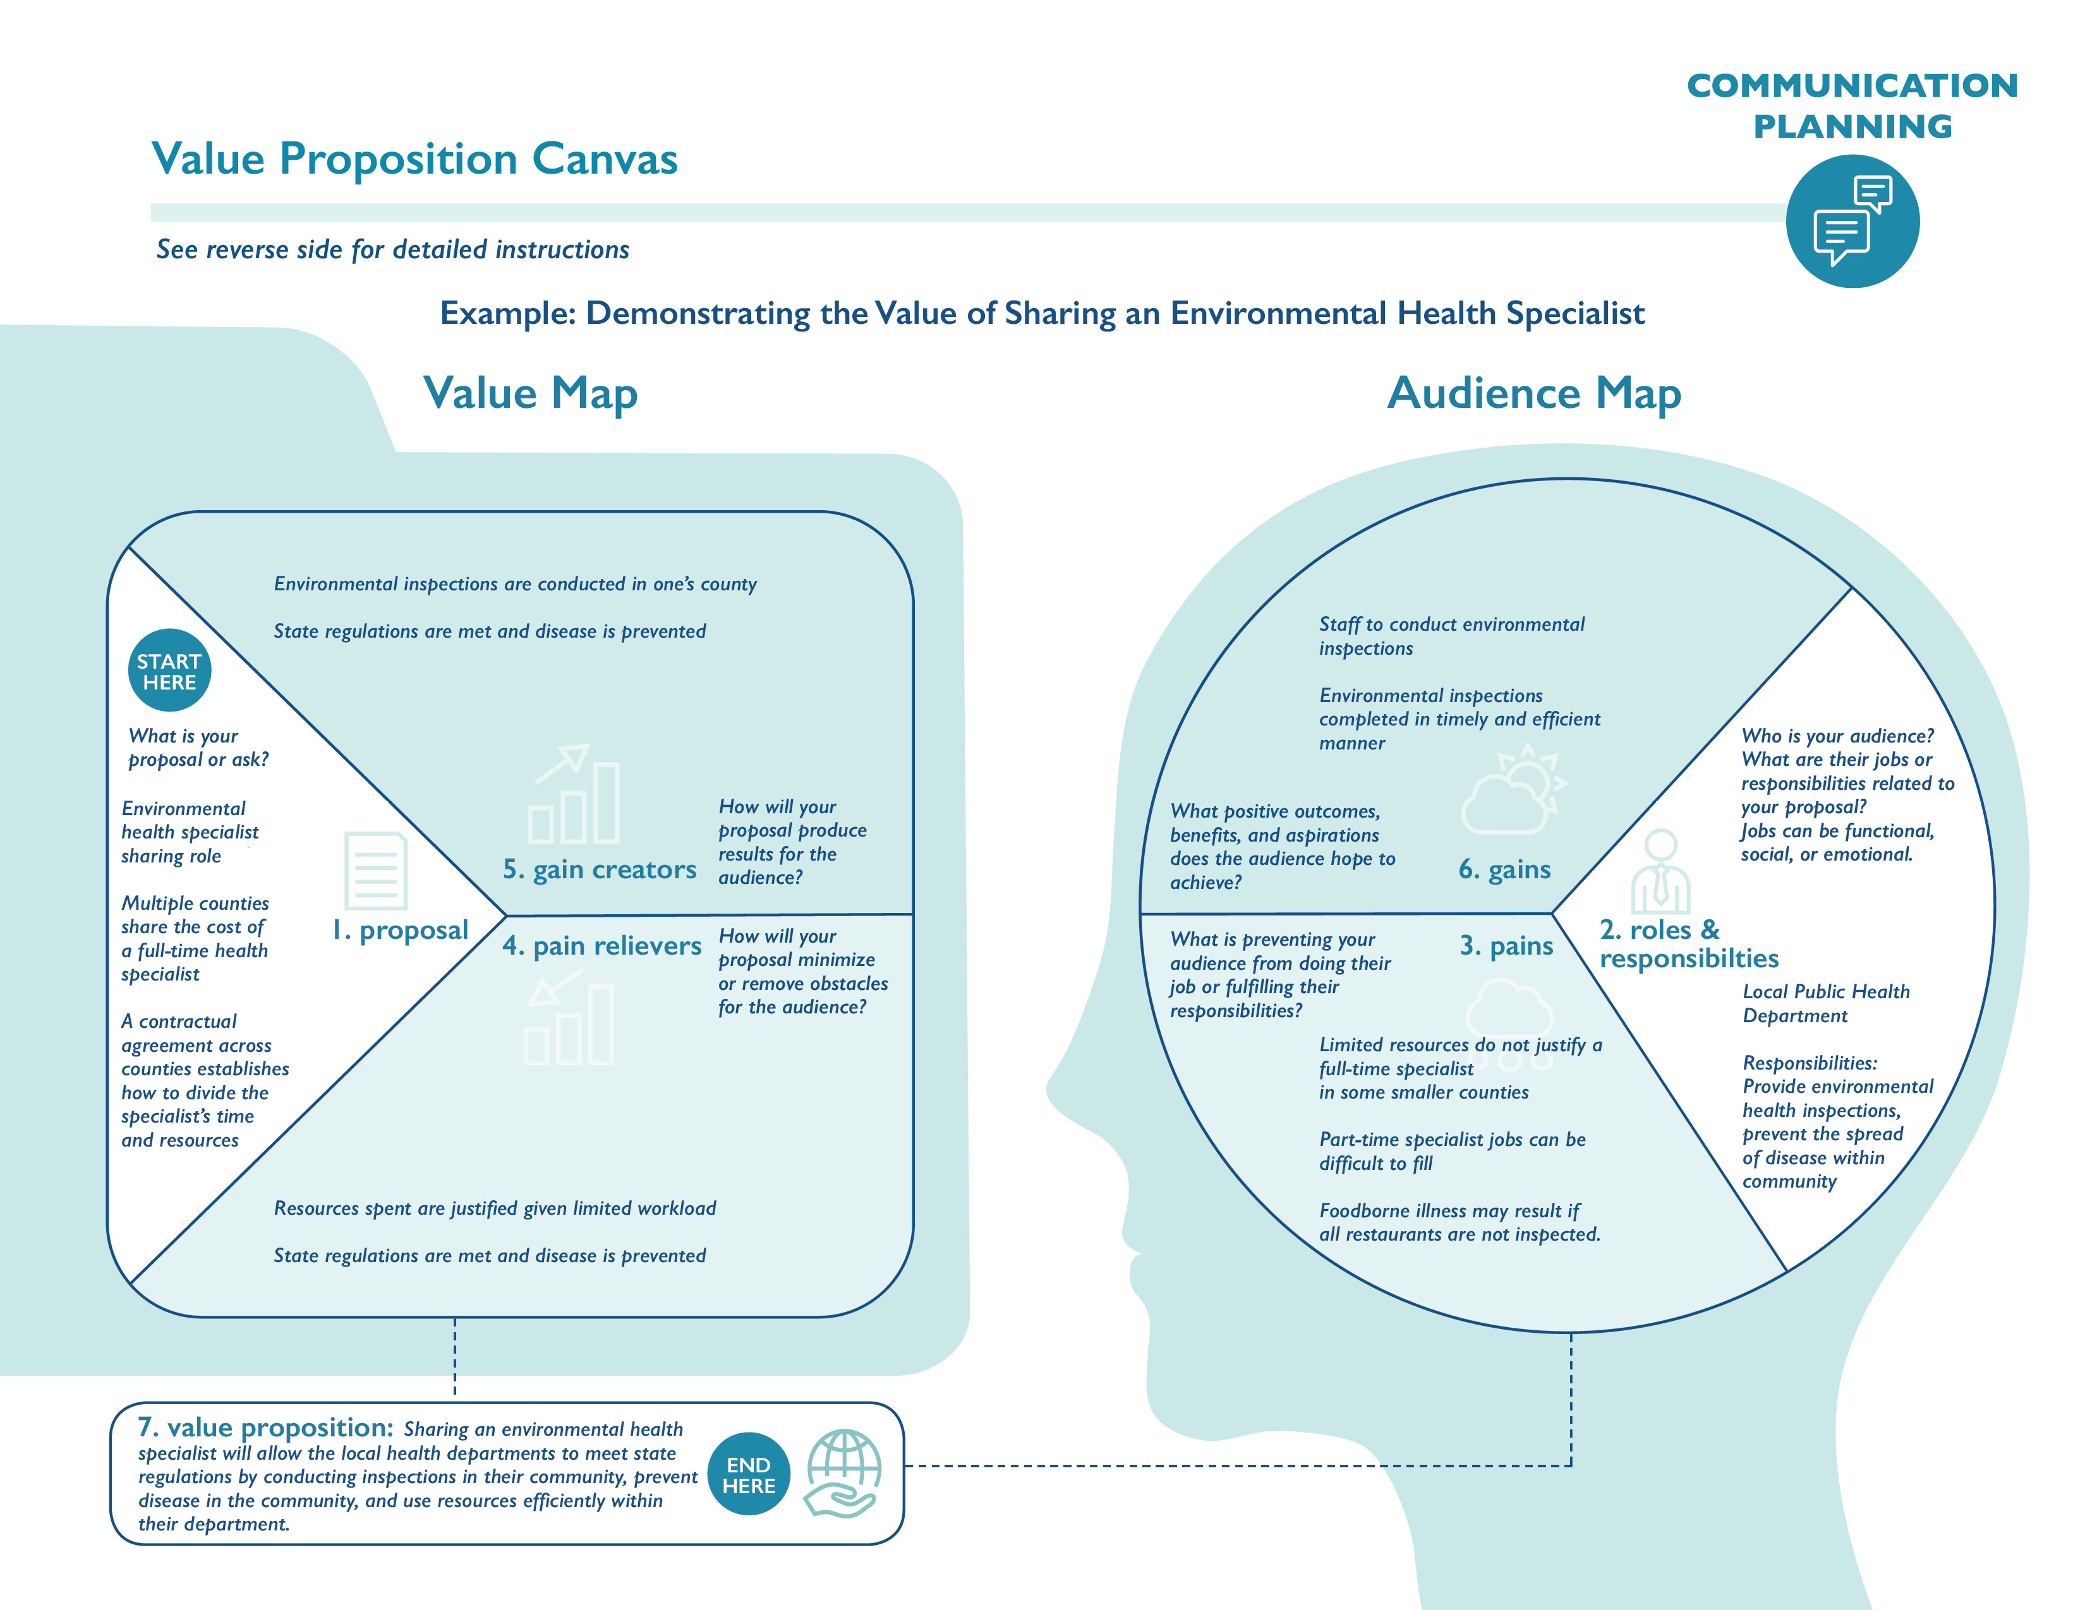
Notes:
Robb:

Slide 23
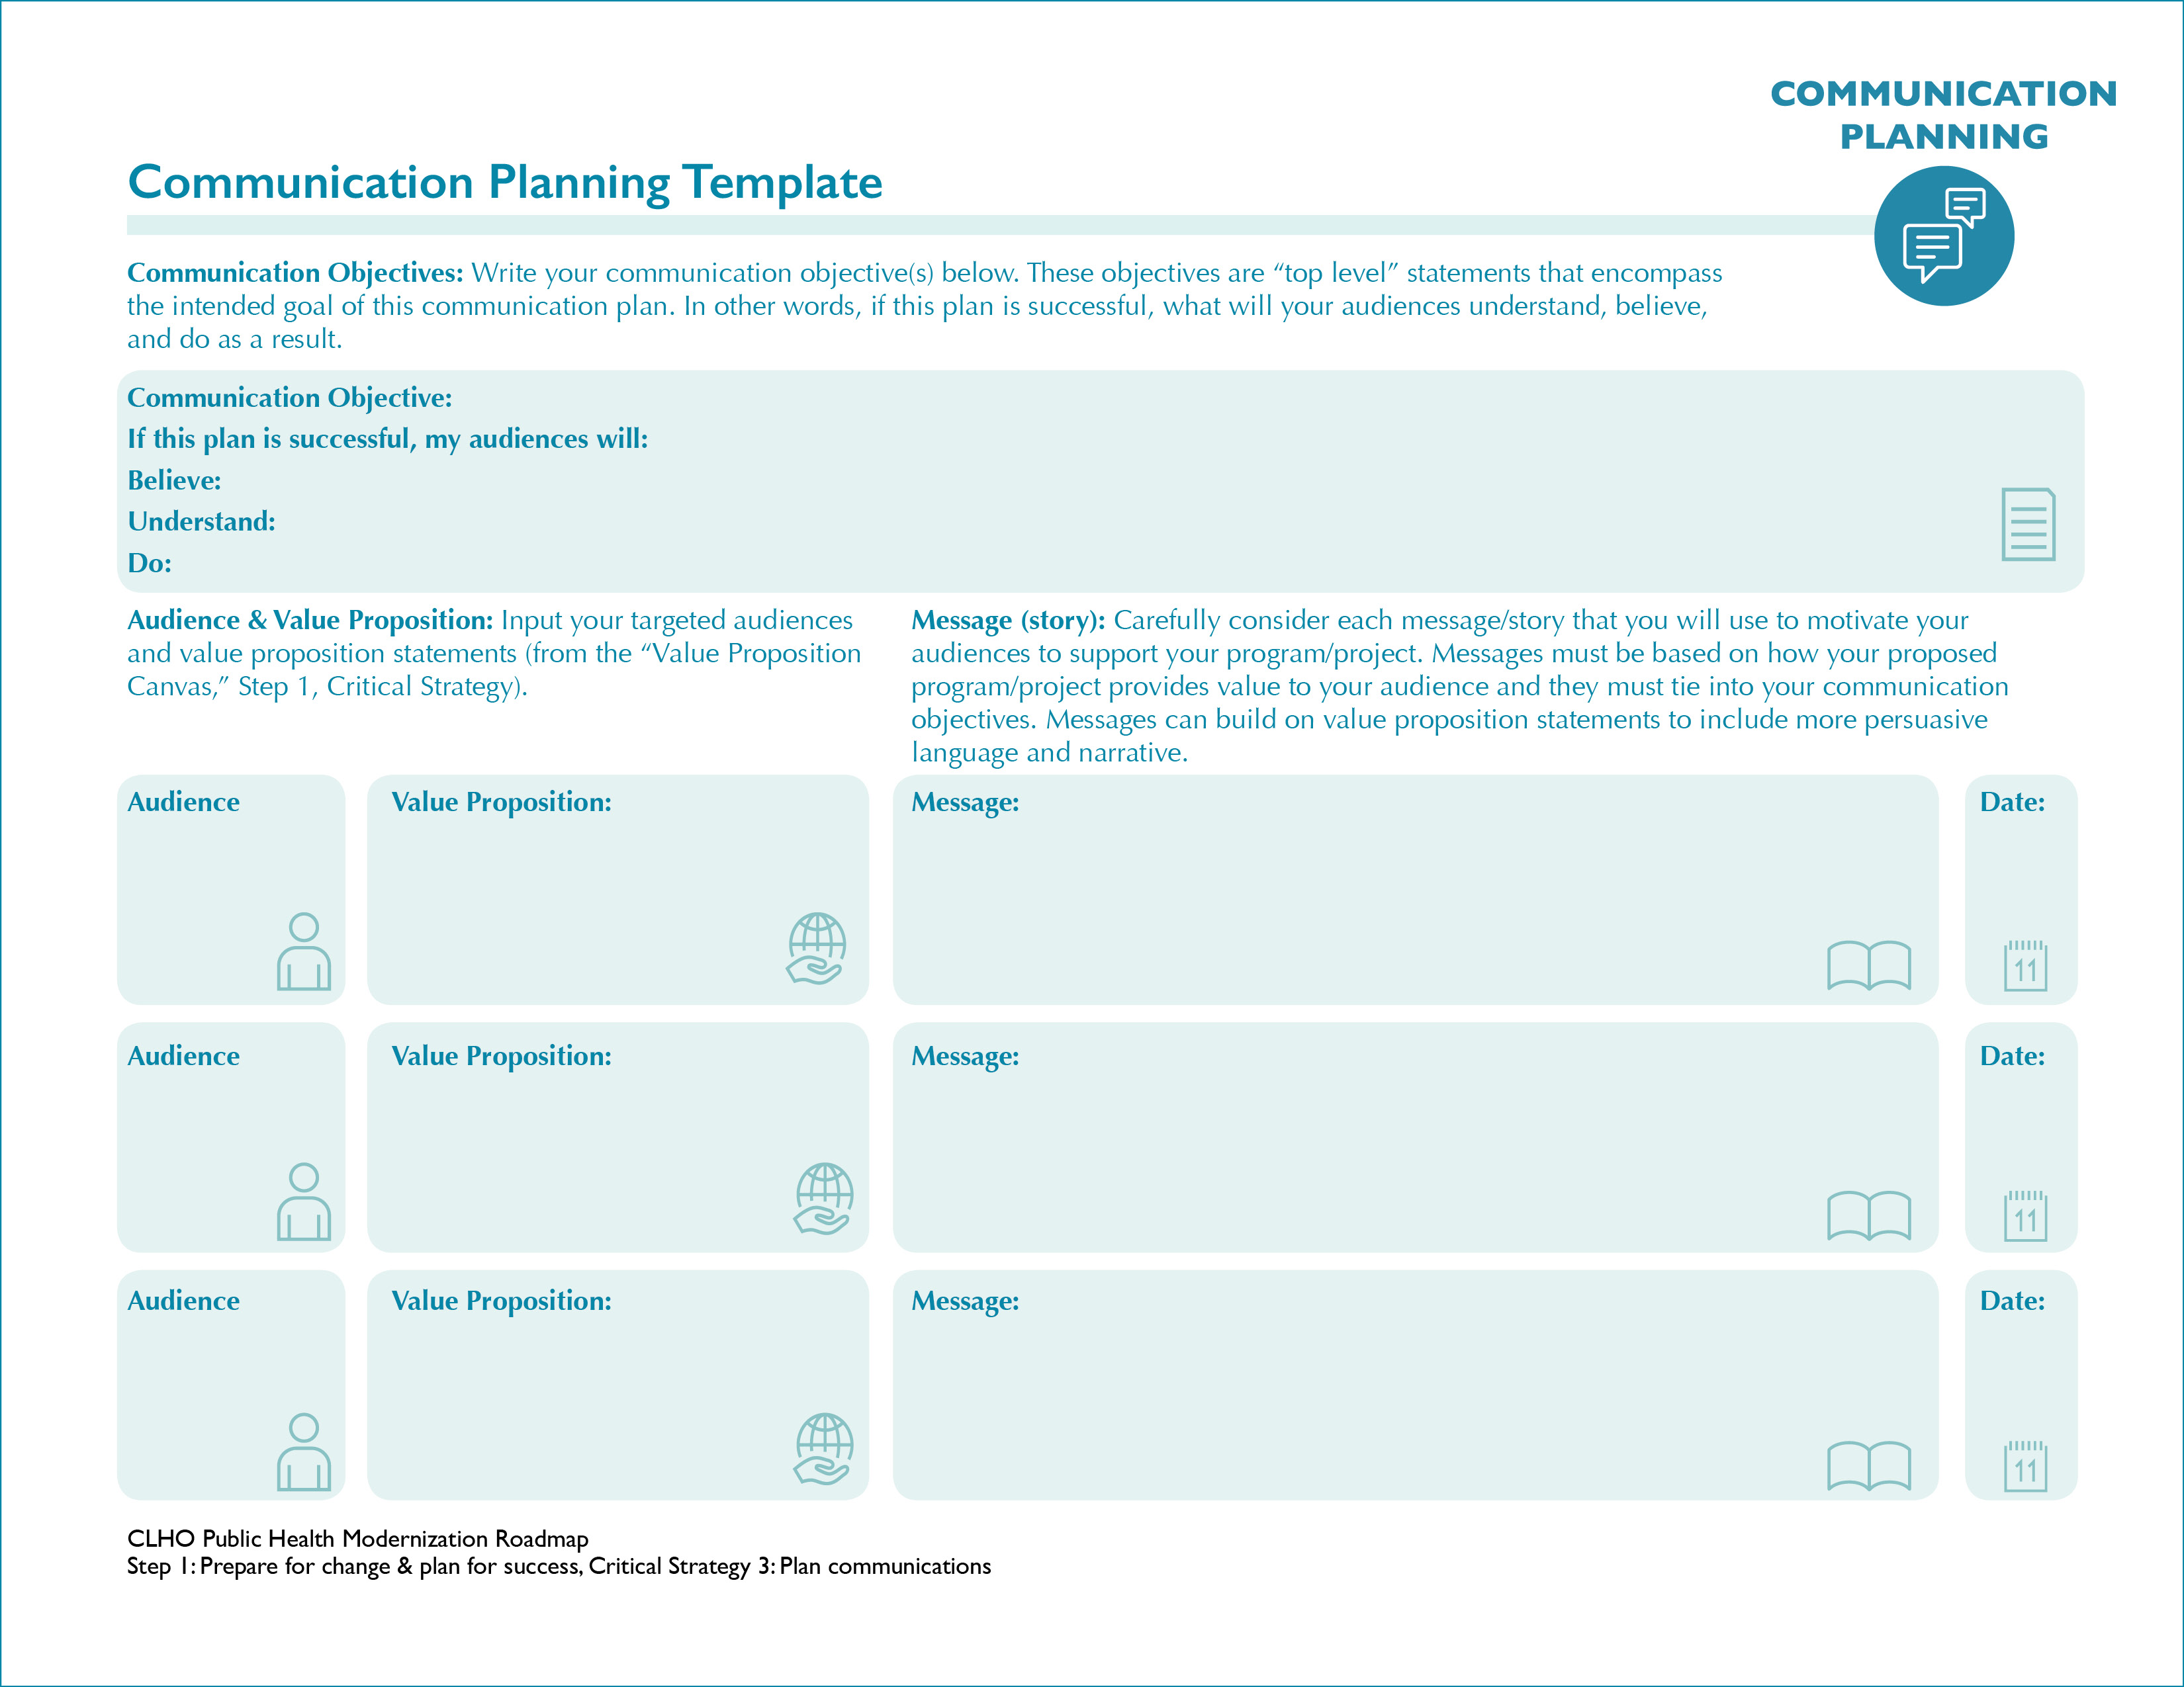
Notes:
Robb:

Slide 24
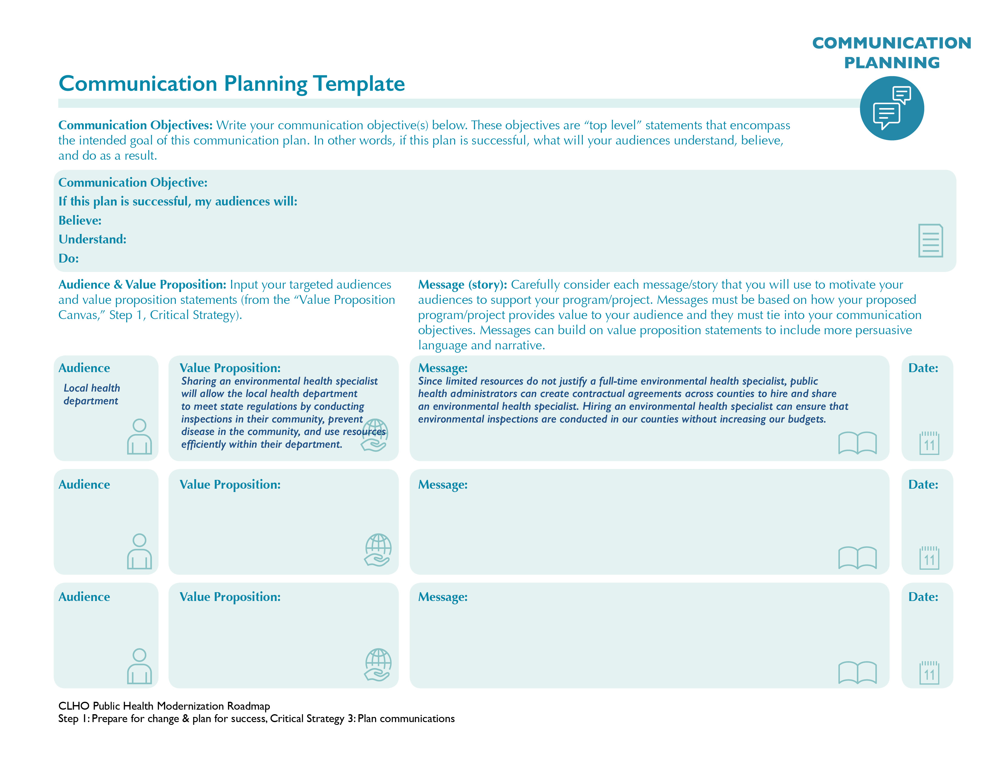
Notes:
Robb:

Slide 25
Questions or comments?

Slide 26
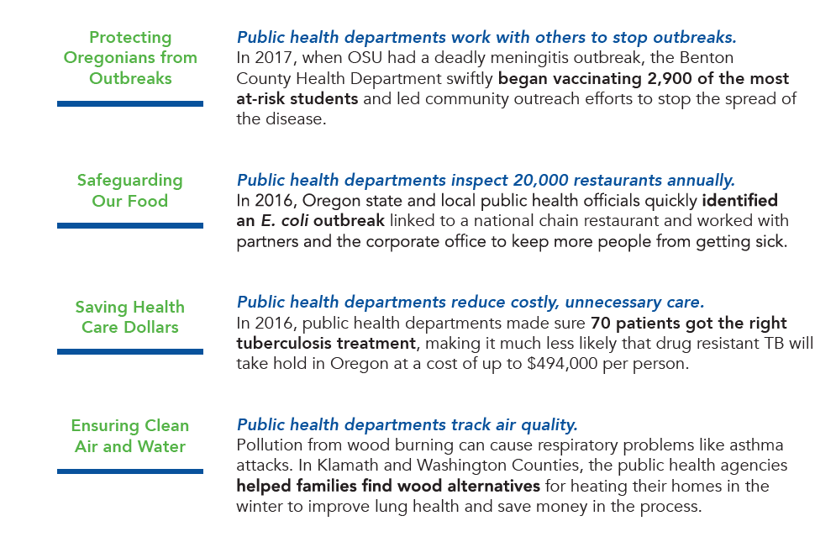
Public Health Protecting Oregon:
Public Health Successes in Action
Every day and during times of emergencies public health makes Oregon a healthier and safer place to live and work.
Notes:
Caitlin:

Slide 27
Closing
Technical assistance Available from Rede Group:
  Change Management
  Communication planning and design
  Cross jurisdictional sharing arrangements
  Cross-sector sharing arrangements
  Local Modernization Plans
Next Webinar
  Topic: Public Health Modernization & Accreditation Crosswalk
  Date/Time: February 27, 9-10 AM
Notes:
Caitlin:

Slide 28

Technical Assistance
Technical assistance provided by the Rede Group
For questions regarding the AIMHI Roadmap contact:
Jill Hutson jill.hutson@redegroup.co 503-764-9696
Notes:
Caitlin:
Thank you for taking the time to learn about the communication tools available on the CLHO AIMHI roadmap! If you have any questions about what you heard in the webinar today, or if you run across any questions as you begin using the roadmap and tools please call or e-mail Jill Hutson at the Rede Group: #, email.
The Rede Group is here to provide technical assistance for any and all aspects of the AIMHI Roadmap.

